Slide 1
Fuzzy Inference in Sparse Rule Bases and Related Model Identification Techniques
Zsolt Csaba Johanyák
Kecskemét College,
Department of Information Technologies
johanyak.csaba@gamf.kefo.hu
Notes:
Dear Ladies and Gentlemen! First of all I would like to thank Dr. Mark-Tell Schneider and the organizers for the invitation. As you probably know Dr. Schneider spent a few years in Kecskemét as a director of the IT Infrastructure & Operations Department of Daimler AG. Besides, he also carried out teaching activities at our university. As a recognition of the high quality of his work and his commitment he received in 2013 the title of honorary professor of Kecskemét College. I hope todays event will give a good opportunity to exchange ideas and experiences as well as to establish new connections and strengthen those we already have.

Slide 2
Contents
IT Education in Hungary
Kecskemét – College – Department
Fuzzy Rule Interpolation – Rule Base Identification
Notes:
My presentation will consist of three main parts. First, I would like to give a short overview of the IT education in Hungary, followed by some slides about my home town, university and department. The third and biggest part of my presentation is related to my research area, namely fuzzy rule interpolation and rule base identification.

Slide 3
IT Education in Hungary
Notes:
I have been asked by the organizers to talk shortly about the IT education in Hungary. I am going to start it from the very beginning.

Slide 4

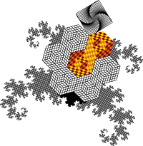
The First Touch
Kindergarten
  Bee Bot
  Turtle Bot
Elementary school
  3rd or 4th grade
    Algorithmic skills
    Basic computer management skills,
    office knowledge, Logo
http://www.tts-group.co.uk/_rmvirtual/media/tts/images/legacy/ITSBOT.jpg
http://libreoffice.hu/files/2012/11/turtle2.png
Notes:
In Hungary in some cities a child can get IT related knowledge already in kindergarten. Bee bots or other simple robots are used in several institutions to teach basic control skills. They can be controlled/programmed using a few buttons. However, usually pupils meet computer science for the first time in the elementary school in their 3rd or 4rd grade. For example my son started it in his 3rd grade. The main purpose is to develop the algorithmic skills, as well as basic computer management skills and to acquire some office knowledge. The pupils at this age also learn basics of the Logo language.

Slide 5

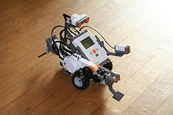
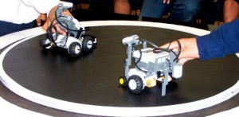
Elementary/Secondary school
5th-8th grade
Interactive white boards
Lego Robots
http://sg.hu/kep/2007_11/1128tabla2.jpg
http://en.wikipedia.org/wiki/Lego_Mindstorms_NXT
Notes:
Most of the schools use interactive white boards. The pupils not only passively use the boards by looking at the explanations, but they also prepare their own presentations often as a project work in small groups. The use of the programmable Lego Robots is also wide spread. There are several competions which are very popular among the pupils.

Slide 6
Secondary/Grammar School
Compulsory IT education until the 10th grade
Hardware knowledge
MS Office/Libre Office
Programming Pascal, Visual Basic.Net, C#, C/C++
Standard/advanced level secondary school final exam
Notes:
There is a compulsory IT education until the 10th grade, wich comprises hardware knowledge, MS Office/Libre Office knowledge and programming knowledge in one of the following languages: Pascal, Visual Basic.Net, C#, C/C++. Pupils can choose IT as one of the elective standard/advanced level secondary school final exams. There are also grammar schools with a specialization in IT where pupils can gain deeper programming, network administration, etc. Knowledge.

Slide 7
Higher Education
Assistant (4 semesters)
  Computer Economist (15 U)
  Computer Engineer (5 U)
  Computer Program Designer (6 U)
BSc (7 semesters)
  Computer Economist (15 U)
  Computer Engineer (Engineering Information Technology) (12 U)
  Computer Program Designer (8 U)
MSc (4 semesters after BSc)
  Master in Business Information Systems (6 U)
  Master in Computer Science and Engineering (8 U)
  Master in Computer Science and Information Technology (3 U)
  Master in Info-Bionics (2 U)
PhD (6 semesters after MSc)
  PhD course in Computer Science (8 U)
Notes:
Computer Economist=Gazdasági informatikus BSc
Master in Business Information Systems=Gazdasági informatikus MSc
Computer Engineer=Mérnökinformatikus BSc
Master in Computer Science and Engineering=Mérnökinformatikus MSc
Computer Program Designer=programtervező informatikus BSc
Master in Computer Science and Information Technology=programtervező informatikus MSc
The next stage is the higher education. One can distinguish here four levels. The first one is relatively new. It is a two-year course in one of the three main IT related areas, i.e. business/economy, engineering (including network administration as well), and software development. Each of the here existing coourses has its counterpart in the BSc course list, which gives similar but deeper knowledge. After the secondary school final exam one can continue their studies either as an Assistant or as an BSc student. The next level following the BSc is the master course. While in most of the cases the BSc is strongly practical oriented the master courses set the focus more on theoretical knowledge. As a sequel to the master course one can continue their studies as a PhD student. The numbers in the parantheses in the list indicate how many universities offer the given type of course. As you can see there are several institutions that offer IT related courses. Most student wannabes choose a university based on their geographical location, the number of points they need to get in, and the size of the hosting city, which is related to the expected „pleasures of student life”.

Slide 8
Kecskemét - College -Department
Notes:
Next, I will speak about Kecskemét and my workplace.

Slide 9
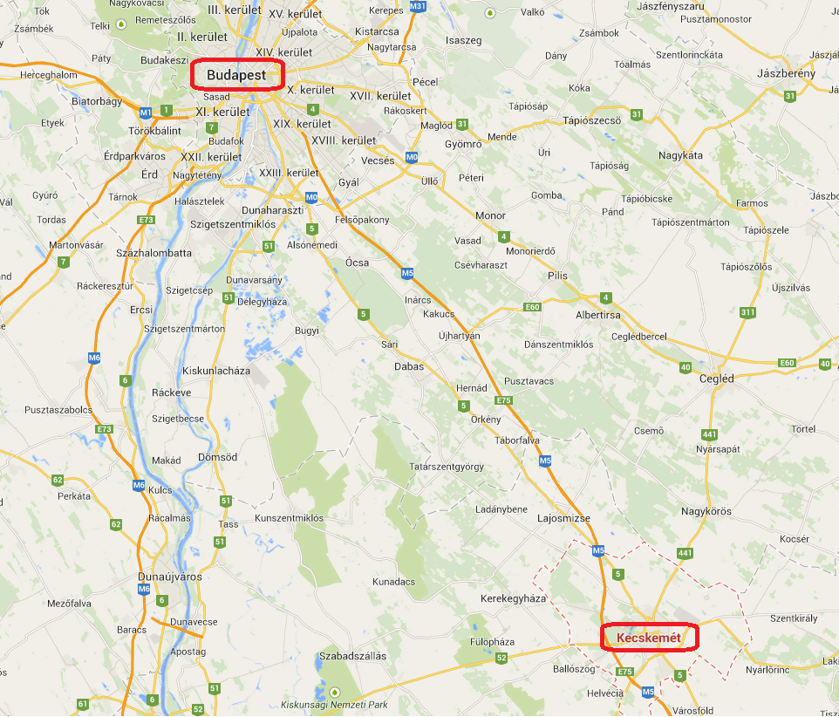
Where is Kecskemét?
Notes:
Kecskemét is a small town about 1000 km far from Stuttgart in SE direction and about 80 km far from Budapest in SE direction. The number of inhabitants is about 110 000

Slide 10



Historic places
Notes:
Kecskemét was mentioned as a market-town for the first time in King Louis I of Hungary’s charter from 1368. The Main Square is known as one of the most beautiful city centres of Hungary. In this slide you can see three of its finest/emblematic buildings, i.e. the city hall, the ornamental palace, and the main theater.

Slide 11


Wellness Tourism
Notes:
Being situated in the sunniest part of Hungary and having thermal springs Kecskemét is also one of the favourite places of the visitors looking for recovery, and recreation.

Slide 12


Kecskemét College
Faculty of Mechanical Engineering and Automation
Faculty of Horticulture
Teacher Training Faculty
Department of Information Technologies
Notes:
And Kecskemét is also a city of higher education. Kecskemét College has three faculties, from which the biggest one is the Faculty of Mechanical Engineering and Automation. The Department of Information Technologies, where I work, is part of this faculty. In the following slides I am going to give some details on our faculty.

Slide 13
Facts and Details - Faculty
Founded: 1964
Number of teaching staff: 90
Total number of students: 2400
Full-time students: 1400
Part-time students: 1000

Slide 14
BSc Courses
Information Technology
Materials Engineering
Mechanical Engineering
Technological Manager
Vehicle Engineering
Dual System – Vehicle Engineering, Mechanical Engineering , Technological Manager

Slide 15
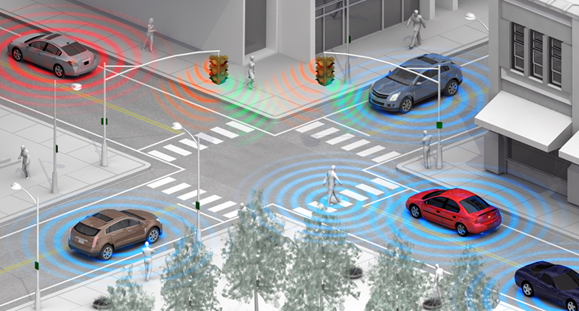
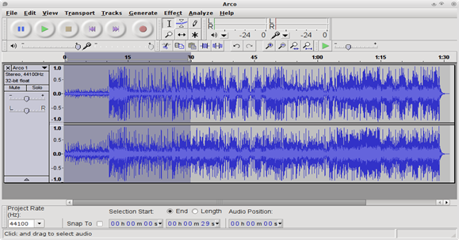

Information Technology
Specializations
Network and WEB Technologies
Industrial Informatics and Microcontrollers
Mobile Application Development
Media Informatics
Vehicle Informatics
Notes:
At the end of their 4th semester the IT students can choose a specialization. Most of the subjects (8 in total) they study in their next three semesters is related to the chosen specialization.

Slide 16
Research at our Department
Notes:
Next, I will give you a short overview of some recent research projects related to our department.

Slide 17
Effects of innovative teaching methods in IT education
Experiments to apply innovative methods into our courses
Possibilities and effectiveness of cooperative learning in IT education
Project method and model robots in teaching of programming
Robert Pap-Szigeti
pap-szigeti.robert@gamf.kefo.hu
Notes:
Although most of the open IT positions are programming related, unfortunatelly in the last few years the number of students interested in software development decreased drastically. Therefore we were motivated to find new ways of teaching programming to increase the motivation of the students. The three main topics of the related research are presented on this slide.

Slide 18
Smarter Transport – cooperative communication in transport systems
Development of an evaluation testbed (vehicle and roadside communication units)
Development of microscopic traffic simulation software
Visual Driver Assistant: 3D reconstruction based on omnidirectional cameras
Lóránt Kovács
kovacs.lorant@gamf.kefo.hu
Notes:
One of our faculty's major research focus is related to vechicle engineering. Our department is involved in research related to vechicle-to-vechicle (v2v) and vechicle-to-infrastructure communication as well as services that can be implemented on this bases. In the Smarter Transport project we have developed a vehicle- and a roadside communication unit, by which we can demonstrate V2X communication based applications, such as collision detection or central traffic control system. Furthermore, a simulation software tool has been developed in order to test new algorithms to ensure optimal traffic control using V2X communication.

Slide 19
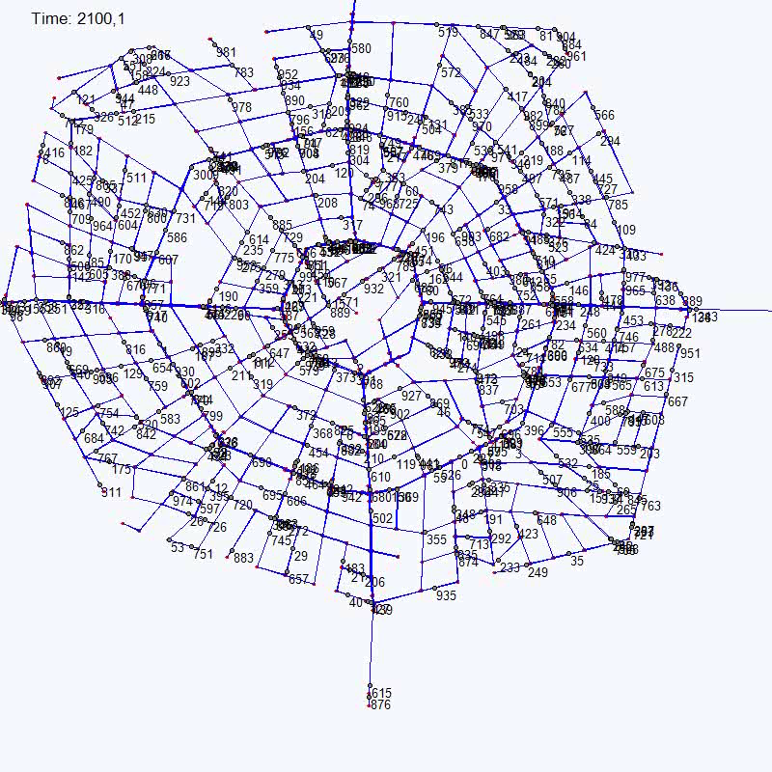
Computer simulations of a city traffic controlled by a central intelligence through radio posts

Slide 20

Algorithm Development for Smart Grids
Statistics based approach for Consumption Admission Control (A new approach for direct control of smart appliances)
Change point detection in time series using Jensen-Shannon Divergence (finding stationary segments of non-stationary series)
Outlier detection methods for smart grids
Tibor Vajnai
vajnai.tibor@gamf.kefo.hu

Slide 21
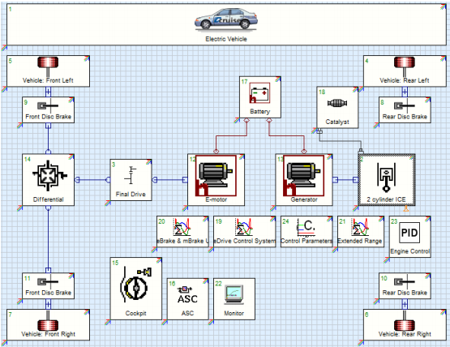
Vehicle concept and energy-management of hybrid drivetrain
Research for hybrid and electronic vehicle design
Vehicle dynamics and control
Optimization of the draintrain
Piroska Ailer
ailer.piroska@gamf.kefo.hu
Notes:
This is a joint project between the department of Vehicle Technology and our department. In this project our department developed various control solutions (based on ANN, fuzzy logic, genetic algorithm, and state machine) for several tasks like tracking a prescribed speed profile, optimizing the charge process of the batteries, etc.

Slide 22
Fuzzy systems for diverse purposes
Fuzzy modeling
Petrophysical properties prediction
Fuzzy modeling of an anaerob tapered fluidized bed reactor
Tool life prediction
Mechanical properties of composite materials
Prediction of the student enrollment number
Fuzzy expert system
Student evaluation
Zsolt Csaba Johanyák
johanyak.csaba@gamf.kefo.hu
Notes:
These are projects, wich are related to the today’s seminar. I am going to present them in details at the end of the presentation if there will be time for it.

Slide 23
Fuzzy Logic
Basic Concepts
Notes:
My research area is related to fuzzy logic and fuzzy inference based systems. After a short general introduction regarding the basic fuzzy concepts I am going to speak about the inference in sparse rule bases.

Slide 24
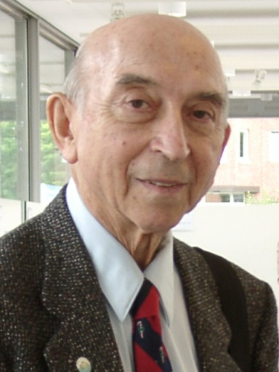
Fuzzy sets
Lotfi A. Zadeh
University of California at Berkeley - 1965
Imprecision in natural language
Notes:
The fuzzy concept was introduced by prof. Zadeh in the mid 60s to facilitate the description of the vagueness/imprecision in the natural languages. What is this imprecision?

Slide 25
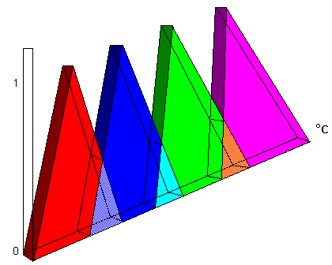
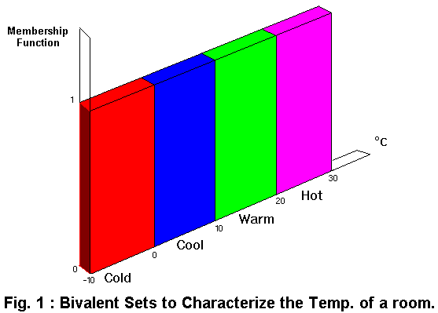
Crisp seets – Fuzzy sets
Membership
value
Membership
value
°C
°C
Hot
Hot
Warm
Warm
Cool
Cool
Cold
Room temperature
Cold
Room temperature
http://www.doc.ic.ac.uk/~nd/surprise_96/journal/vol4/sbaa/report.fuzzysets.html
Notes:
Everyone has met situations when although there was an exact numerical value for the characterization of a property (e.g. temperature, height of a person, points achieved by a student, etc.) we were not able (or confident) to assign our observation to one of the predefined categories. I emphasize the word one. We felt that it fitted in more than one categories. Of course not with the same measure/not with equal strength. For example 12 °C can be viewed as cool or cold at the same time.
The problem can be traced back to the (sometimes) vague borders between concepts. In case of traditional (crisp) sets for each value we define clearly to which category (set) it belongs. Thus we can say that its memebership value in a given set (group) is either 0 or 1. In case of fuzzy sets we enable for a value to belong to more than one set and we characterize this property by a membership value (usually) between 0 and 1.

Slide 26
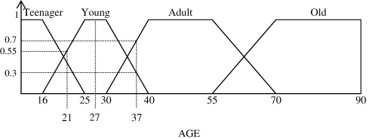
Membership function
Teenager
Young
Middle-aged
Elderly
110
x
Age
Linguistic variable: Age
Linguistic values: Teen, Young, Middle-Aged, Elderly
Notes:
For example a 37-year-old person belongs with a 0 value to the set „Teenager”, but he or she belongs with 0.3 to „Young” and with 0.7 to the set „Middle-aged”. The function that describes the measure of belonging is the membership function. We can attach labels to the sets, too. They give a description, a name for the fuzzy sets. They are called linguistic values.
A partition in general is a division of a set’s (universe of discourse’s) elements into several subsets. In the fuzzy case each element can belong to one or more subsets (so called fuzzy sets) with a measure expressed by the so called membership function.

Slide 27
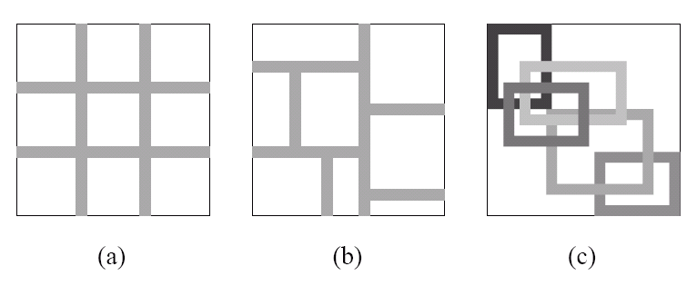
Partition Styles
Grid
Partition
Tree
Partition
Notes:
In case of multidimensional universe of discourses several types of partitioning are possible. This figure presents the most used two of them for a two-dimensional universe of discourse.

Slide 28
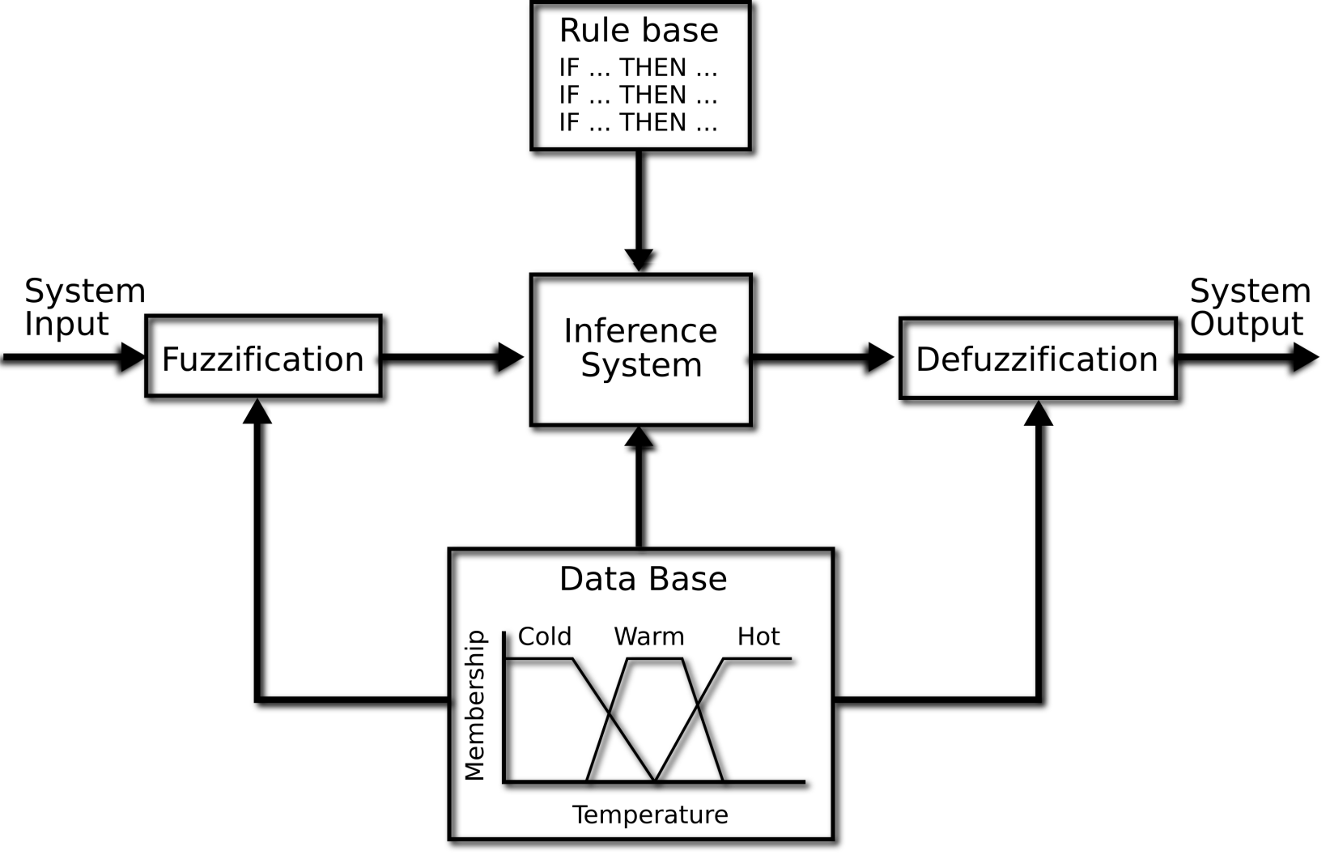
Fuzzy rule based systems
Fuzzy rule based systems – humanly interpretable, self explanatory knowledge representation
http://www.cs.bris.ac.uk/~kovacs/publications/gbml-survey/html-version/node16.html
Notes:
One of the biggest application areas of fuzzy set theory is the field of rule based systems. They became popular due to their self explanatory capability. An IF-THEN structure is easy to understand for everyone and the process called fuzzy inference is close to the human thinking. This figure depicts how a fuzzy rule based system works in general case. The system receives some input (fuzzy or crisp) and creates a corresponding output. The input value is usually called observation.
The process is called fuzzy inference. If the input is crisp at the begining there is a fuzzification step, which is a transformation of the original value into a fuzzy one. If a crisp output is needed there is a defuzzification step at the end, which transforms the resulting fuzzy set into a crisp value.

Slide 29
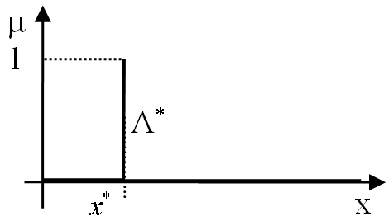
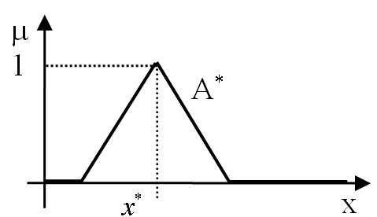
Fuzzification
Notes:
In course of the fuzzification one assigns a fuzzy set (A*) to the original crisp value (x*). There are several methods to do this. Two of them, the singleton and the triangle are presented in this slide. The singleton fuzzification is the most used one.

Slide 30
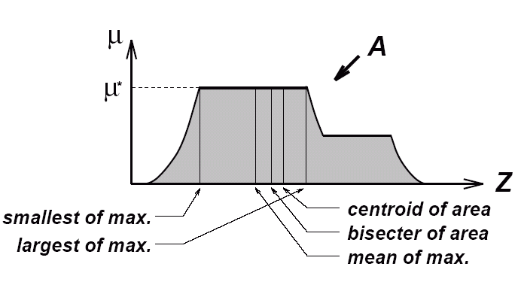
Defuzzification
Notes:
One applies defuzzification at the end of the inference process in case of systems that produce a fuzzy set as inference result and when a crisp value is needed as output (e.g. control systems). The fuzzy set gained as the result of the inference can have a quite strange membership function (like the one in the figure). There are several applicable methods, some of them are illustrated in the figure.

Slide 31
Fuzzy inference methods
Classical methods
  Zadeh, Mamdani, Takagi-Sugeno-Kang
  Larsen, Tsukamoto
Fuzzy rule interpolation based methods
  KH, FIVE, IMUL, MACI, CRF, FRISUV
  GM, IGRV, Chen&Ko, LESFRI, FRIPOC, VEIN
Notes:
One can select of a wide range from fuzzy inference methods. They form two main groups. Classical methods require a full coverage of the input space by rule antecedents, while FRI based methods can be used in sparse rule bases as well. I am going to presents in the following slides one of the most used classical techniques from this group, i.e. the Mamdani method.

Slide 32
Mamdani type fuzzy inference
IF x1 is A2 AND x2 is B3 THEN y is C3
IF x1 is A3 AND x2 is B3 THEN y is C2
…
X₁
X₂
Notes:
The original goal for the development of the Mamdani method was to simplify and make practicaly useable the rather complicated and computationaly expensive Zadeh method. It was applied firstly in the 70s for the control of a steam engine & boiler combination by a set of linguistic control rules obtained from experienced human operators.
To explain its algorithm let us consider a simple example. Let us suppose that there is a two-dimensional antecedent space with the linguistic variables x1 and x2. After singleton type fuzzification the two observation (input) fuzzy sets are X1 and X2. The antecedent and consequent partitions are presented in this slide. The rule base contains 3x3=9 rules. Two of them, which will be used in this example are also presented in the slide.

Slide 33
Evaluation of the first rule
A1
A2
A3
1
0.58
t-norm:
µ_{[A∩B]}(a)=min{µ_{A}(a), µ_{B}(a)}
0
C3
1
X₁
x1
B1
B2
B3
0.38
1
0
y
0.38
0
IF x1 is A2 AND X2 is B3 THEN y is C3
X₂
x2
Notes:
In the first step we apply (fire) the first rule, we apply a so called t-norm (intersection) to the observation sets X1, X2 and the antecedent sets A2,B3 of the rule. As a result we get two membership values: 0.58 and 0.38, respectively. The final firing strength of the rule will be given by the minimum of these two values. The result will be a fuzzy set gained by cutting the consequent set of the rule at the membership value defined by the firing strength.

Slide 34
Evaluation of the second rule
A1
A2
A3
1
0.19
0
C2
1
X₁
x1
B1
B2
B3
0.19
1
0
y
0.43
0
X₂
x2
Notes:
Next, we do the same thing in case of the second rule as well.

Slide 35
Result
s-norm:
µ_{[A∪B]}(a)=max{µ_{A}(a), µ_{B}(a)}
C2
C3
1
0.38
0.19
0
↑
z
y
Notes:
As a result of activating (firing) the two rules we got two parly overlapping fuzzy sets. We apply an s-norm (union) to them. Thus the fuzzy output of the inference will be the blue-painted area. After defuzzification we get the crisp output z. Its actual value depends on the chosen defuzzification method. So that is how it works.

Slide 36
Fuzzy inference in sparse rule bases
Fuzzy Rule Interpolation
Notes:
In the next part of my presentation I am going to talk about inference in sparse rule bases.

Slide 37
Introduction
Shortcoming – classical inference methods require a full coverage of the input space
Solution – approximate fuzzy inference – fuzzy rule interpolation based inference
Notes:
A disadvantage of the classical compositional fuzzy reasoning techniques (e.g. Mamdani, Takagi-Sugeno) is their demand on a full coverage of the input space by rules. This requirement can be only fulfilled with a high number of rules, which number increases exponentially with the number of linguistic values per antecedent dimension and the number of dimensions, which could make difficult their application in real time or embedded systems. Besides, for several possible reasons (e.g. missing or insufficient expertise/available sample data or storage/computational complexity constraints) rule-base construction may produce sparse or incomplete rule bases. Such rule bases thus do not completely (or sufficiently) cover the range of possible input. In sparse or incomplete rule bases, classical fuzzy inference approaches do not always generate meaningful output because the actual input is not guaranteed to fire any rule.
The recognition of the problem of reasoning in sparse rule bases led in the early 1990s to the emergence of inference methods capable of dealing with sparse rule bases. These approximate reasoning techniques usually apply fuzzy rule interpolation (FRI) methods in order to calculate interpretable results even in regions of the antecedent space where the rule base does not contain any applicable rules.

Slide 38
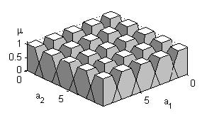
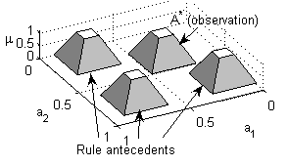
Dense and sparse rule base
Notes:
In this slide the first figure illustrates a two-dimensional antecedent space with a full-covering rule base. The truncated piramids represent the rule antecedents (trapezoidal fuzy sets). The second figure contains a sparse rule base with three rules and an observation that does not intersect any rule antecedent.

Slide 39
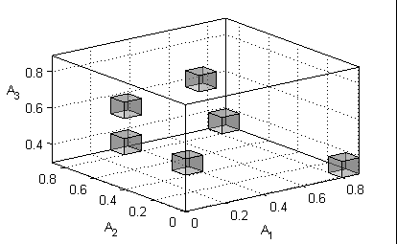
Fuzzy rule interpolation based inference methods
One-step FRI techniques
  KH, FIVE, IMUL, MACI, CRF, FRISUV, etc.
Two-step FRI techniques
  GM, IGRV, Chen&Ko, LESFRI, FRIPOC, VEIN, etc.
Notes:
The FRI methods form two main groups: the one-step and the two-step methods. The FRI techniques belonging to the first group calculate the conclusion directly from the observation and the known rules of the rule base. The most relevant representatives of this group are the linear interpolation that is also called KH method after its developers (Kóczy and Hirota) and which also proved to be an universal function approximator, the vague environment based reasoning FIVE developed by Kovács, the modified α-cut based interpolation (MACI) published by Tikk and Baranyi that avoids the abnormal conclusion by applying a coordinate transformation, the CRF (Kóczy, Hirota, and Gedeon) whose key idea is the conservation of the relative fuzziness, the IMUL method suggested by Wong, Tikk, Gedeon and Kóczy that combines the advantages of the MACI and CRM approaches, and FRISUV which applies the concept of fuzzy subsethood values.
The members of the second group determine the conclusion in two steps by first interpolating a new rule in the position corresponding to the observation and next, they infer the result using only the observation and the new rule applying a single rule reasoning technique. These methods follow the concept of the Generalized Methodology of fuzzy rule interpolation (GM) developed by Baranyi, Kóczy and Gedeon. Relevant members of this group are the LESFRI that applies the method of least squares for the calculation of the membership functions, the IGRV developed by Huang and Shen, the transformation based technique published by Chen and Ko as well as the polar cut based FRIPOC suggested by Johanyák and Kovács , VEIN. Some of the methods enlisted in this slide are emphasized in bold. These are the methods I am going to present in the next part of the presentation.

Slide 40
One-step Fuzzy Rule Interpolation
FRISUV
Notes:
As an example for the one-step methods I am going to present the method called FRISUV. The main goal during its development was to create a fast technique with low computational complexity and applicability in case of all the valid (convex and normal) fuzzy (CNF) sets to make possible the application of FRI methods in real-time or embedded systems. It extends the concept of fuzzy subsethood values and applies it in conjunction with a relative distance aiming the measurement of the similarity between rule antecedents and observations. Later the conclusion is calculated based on this similarity.

Slide 41
Options for the reference point and the related set distances
μ
d_{cc}(A₁,A₂)
RP_{cc}(A₁)
RP_{cc}(A₂)
1
A₁
A₂
RP_{gc}(A₁)
RP_{gc}(A₂)
d_{gc}(A₁,A₂)
x
RP_{ccp}(A₁)
RP_{sc}(A₁)
RP_{sc}(A₂)
RP_{ccp}(A₂)
d_{sc}(A₁,A₂)
Notes:
Let us start with the concept of reference point and similarity. The reference point of a fuzzy set ( RP(.) ) is that point of the universe of discourse, which is most characteristic to the set. Generally it is used for the definition of the set’s position and for the determination of the distance between two fuzzy sets. Most often applied choices for its selection are the centre of the core (RP_{CC}), the centre of the support (RP_{SC}), the centre of gravity (RP_{GC}) and the unweighted or weighted average of the abscissas of the characteristic (break) points of the shape (RP_{UAV}, RP_{WAV}). The figure presents the listed reference point types in case of trapezoid shaped fuzzy sets. The most used option is the centre of the core (RP_{CC}). [A]¹ is the alpha-cut of the fuzzy set A at the level of alpha=1. In the case of the polar cut based set interpolation and single rule reasoning methods RPcc offers the most advantages. Besides its information content about the middle one from the most relevant (having the maximal membership value) elements of the set it also reduces the need for calculations. The distance of the fuzzy sets is measured by the horizontal distance between the reference points of the sets. The reference point of a relation is that point of the multidimensional universe of discourse which is defined by the reference points of the component fuzzy sets.

Slide 42
Similarity
Components:
Shape similarity
Relative distance
Notes:
In interpolative fuzzy inference the similarity between the current fuzzy input and the antecedents of the known rules plays a determinant role in course of the calculation of the conclusion. The antecedent parts of the rules can be viewed as multidimensional fuzzy sets or n-ary fuzzy relations. The similarity between the n-dimensional observation represented by an n-ary relation and the rule antecedent represented by another n-ary relation depends on two components, i.e. the shape similarity and the distance between the reference points of the relations.

Slide 43
Similarity measure based on the fuzzy subsethood values
Fuzzy subsethood value of two sets
Fuzzy subsethood value of two relations
Intersection of two relations
Simplified measure of FSV
Notes:
The shape similarity measures the closeness of the shapes of two fuzzy sets that share their reference point. FRISUV uses a similarity measure based on fuzzy subsethood values. A fuzzy subsethood value represents the degree to which a fuzzy set is a subset of another fuzzy set. For example in case of two discrete fuzzy sets A and B belonging to the universe X the fuzzy subsethood value of A to B is expressed by the first equation in this slide. Here ∩ is an arbitrary t-norm. In order to apply FSV to the measurement of the similarity between fuzzy relations having an identical reference point we extend it to the multidimensional case. Thus the fuzzy subsethood value of the n-ary relation Q to the n-ary relation R is presented by the second equation. In order to keep low the computational complexity of the similarity measurement we introduce a simplified measure of the fuzzy subsethood value (SFSV) of two fuzzy relations. SFSV works with the projections of the relations in each dimension, where P_{i}(.) is the projection of the relation to the dimension i, i.e. the component fuzzy set of the relation in ith dimension.

Slide 44
Relative distance
Distance between the reference points
Maximum possible distance
Relative distance
Notes:
The second component of the similarity measure aiming the comparison of the observation and the rule antecedents is their relative distance. One calculates first the Euclidean distance between the reference points of the corresponding fuzzy relations. Next, we determine the relative distance by dividing d(.) with the maximum possible distance, i.e. the distance between the point defined by the lower endpoints of the input ranges and the point defined by the upper endpoints of the input ranges. Thus the relative distance will be the fraction of d and drel.

Slide 45
Similarity, dissimilarity, conclusion
Similarity of two fuzzy relations
Dissimilarity of two fuzzy relations
Position of the conclusion
Notes:
Having the previously mentioned two components the similarity of the relation describing the observation to the relation describing a rule antecedent will be calculated by the first equation supposing that both components have the same importance. Likewise, we can define the dissimilarity of two fuzzy relations as well. The key idea of the method is that the reference point of the conclusion should be calculated from the position of the known rules’ conclusion sets using the similarity between the current observation and the rule antecedents. The functional relationship is an extension of the well known Shepard crisp interpolation, which interpolates by calculating the weighted average of the known points’ ordinates. Supposing that the shapes of the consequent partitions’ linguistic terms are identical and the sets differ only in their position the shape of the interpolated conclusion also has to adhere to this regularity. Thus its form will be identical with the shapes of the known sets.

Slide 46
Characteristics
Applicable in case of any valid set shape type
Restriction: the linguistic terms of the consequent partition should have identical shapes
Results always a valid fuzzy set as conclusion
Ensures compatibility with the rule base
Most of the required calculations easily can be vectorized
Notes:
Some important features of the method are presented in this slide.

Slide 47
Two-step Fuzzy Rule Interpolation
LESFRI-FRIPOC
Notes:
Next, I am going to present two methods that belong to the group of two-step FRI methods. First, I will present some general properties that are common for both of them followed by the presentation of the individual techniques.

Slide 48
Two-step FRI methods
Reference point based distance calculation
Interpolation of an intermediate rule (A^{i}→B^{i})
  A^{i} set interpolation
  Interpolation of RP(B^{i})
  B^{i} set interpolation
Single rule reasoning
Notes:
In their first step, a new intermediate rule is interpolated, of which antecedent part contains fuzzy sets positioned at the same reference points as the sets describing the observation in each dimension. This task is done in three phases. First the antecedent part of the new rule is determined through a set interpolation method. Next the position of the fuzzy sets belonging to the consequent part of the new rule is calculated. Thirdly the shape of the consequent sets is determined using the same technique as in the case of the antecedent sets. The conclusion is determined in the second step by firing the interpolated rule. A special single rule reasoning technique is used for this task.

Slide 49
Linguistic term shifting
Fuzzy Set Interpolation Techniques
FEAT-P
FEAT-LS
Notes:
The two-step methods being presented follow the concept of linguistic term shifting. Its key idea is that in order to create a new set at a given position all the existent sets are shifted virtually horizontally so that their reference point becomes identical with the interpolation point (the point where we need the new set). Next, the shape (membership function) of the new set is determined from the shapes of the overlapping sets using a fuzzy set interpolation technique. Here it is assumed that a better set approximation can be attained by taking into consideration not only the two sets flanking the observation/conclusion like in case of several other methods, but all the available linguistic terms in the partition. Besides this approach makes possible the set interpolation technique to be applied for extrapolation, too. There are some applicable methods for this task. Two of them are going to be presented in the following slides.

Slide 50
FEAT-p
Fuzzy sEt InterpolAtion Technique based on polar cuts
Polar cut
A_{j1θ}, A_{j2θ} original sets of the partition
A^{i}_{jθ} interpolated set
μ
ρ{A_{j2θ}}
ρ{A^{i}_{jθ}}
ρ{A_{j1θ}}
θ
μ
Notes:
The task of fuzzy set interpolation is to determine the antecedent and consequent sets that belong to the new rule. The method FEAT-p introduces the concept of polar cut for this task. It is strong related to the application of a polar co-ordinate system whose origin coincides with the reference point of the observation (conclusion). A polar cut is defined by a value pair {rho, θ} that determines a point on the shape of the linguistic term. The value rho denotes the polar distance at the angle theta. The basic assumption is that an extension and a resolution principle of the fuzzy sets can be defined for polar cuts, too. This extension principle states that the solution of a problem for fuzzy sets can be found in the form of solving it first for its polar cuts and then extending the solution to the fuzzy case. The resolution principle states in this case that a fuzzy set can be decomposed into polar cuts.
The shape calculation technique of FEAT-p is based on this extension and resolution principle. The interpolated set is determined by its polar cuts, whose polar distances are calculated as weighted averages of the polar distances of the shifted sets for the same theta angle using the formula presented on the next slide.

Slide 51
A^{i}_{j} - the interpolated set in the j^{th} dimension
θ – polar level
w_{jk} - wheighting factor of the k^{th} set in the j^{th}
dimension
Notes:
Here rho denotes the length of a polar cut, j is the current antecedent (consequent) dimension, theta is the angle of the actual cut, n_{j} is the number of the sets in the partition, A_{jk\theta} is the polar cut of the k^{th} set, w_{jk} is the weighting factor of the k^{th} set, A^{i}_{j\theta} is the interpolated polar cut and the superscript i denotes that the set is an interpolated one. The collection of the angles, the so called polar levels, for which the calculations are done, should be set-up in such mode to include the values 0, pi/2 and pi.
The formula separates the case when the position of the interpolation coincides with the current set of the partition (d(A^{*}_{j},A_{jk})=0. Its reason is that the weighting factor contains the distance in the denominator. Thus if the reference point of the observation (conclusion) is the same as one of the original sets of the partition the interpolated set will be the same as that linguistic term. This feature ensures the fulfilment of the condition on the compatibility with the rule base, for the rule interpolation method based on the method FEAT-p. It seems to be natural that the sets whose original position were in the neighbourhood of the reference point of the observation to exercise higher influence as those ones situated in farther regions of the partition. Therefore the weighting factor is the reciprocal value of the distance.

Slide 52
FEAT-p characteristics
Advantages
  Applicable in case of any valid set shape
  Even in case of different shape types
  Interpolation & Extrapolation
Disadvantages
  Does not preserve the piece-wise linear membership function

Slide 53
FEAT-LS
Optimal solution if the partition is uniform shaped
The ordinate values of the characteristic points predetermined by the characteristic shape of the partition
Abscissas calculated by the method of weighted least squares
1
μ
1
μ
0.8
0.8
0.6
0.6
A
A
A
A
0.4
1
2
3
4
0.4
0.2
0.2
0
0
x
0
0.5
1
1.5
2
x
0.8
1
1.2
Notes:
The second fuzzy set interpolation method being presented is Fuzzy sEt interpolAtion Technique based on the method of weighted Least Squares (FEAT-LS). It was developed especially for the case when all sets of a partition belong to the same shape type and the characteristic (break) points of the membership function are also situated at the same alpha-level. In such cases it seems to be a natural condition on the new linguistic term created in the interpolation point to suit this regularity as well.
The abscissas of the characterisic points are determined from the corresponding points of the overlapped sets applying the method of weighted least squares in light of the requirement that the resulting set should be a valid one and should fit the typical shape type of the partition. The weighting here also expresses that the neighbouring sets should have a higher influence by the calculations. Here one can use the same weighting factors as in case of FEAT-p.

Slide 54
FEAT-LS
1
μ
1
μ
0.8
0.8
0.6
0.6
A
A
A
A
0.4
1
2
3
4
0.4
0.2
0.2
0
0
x
0
0.5
1
1.5
2
x
0.8
1
1.2

Slide 55
FEAT-LS characteristics
Advantages
  Low computational complexity
  Conserving the characteristic shape type of the partition
  Interpretable results even in case of different shape types
  Interpolation & Extrapolation
Disadvantage
  The height of each fuzzy set must be the same

Slide 56
The position of the consequent sets
Hypersurface representing the rules
Notes:
The second stage of the first step of the method FRIPOC/LESFRI is the determination of the position of the fuzzy sets belonging to the consequent part of the new rule. They are calculated independently in each output dimension. The task can be defined as a problem of finding a point on a hyper-surface defined by the reference points of the antecedent sets (sets belonging to the antecedent parts of the existing rules) and the consequent sets in the current output dimension. Due to the sparse character of the rule base an n_{a} dimensional interpolation has to be done for irregularly spaced data, where n_{a} is the number of the input dimensions. It can be expressed in general by the formula presented on the next slide.

Slide 57
The position of the consequent sets in the l^{th} output dimension
Notes:
Where RP( B^{i}_{l}) is the reference point of the interpolated consequent set in the l^{th} output dimension and RP( A^{i}_{j}) is the reference point of the interpolated antecedent set in the j^{th} input dimension. The function should pass through the known points of the hyper-surface.
There are several applicable linear or non-linear functions that take into consideration either only the points (rules) situated in the closest neighbourhood of the interpolation or all the known points. Both methods use an interpolation function that is an extension and adaptation of the Shepard interpolator for the case of arbitrary number of antecedent dimensions.
The antecedent part of each rule can be thought of as a point in the antecedent hyper-space. Its co-ordinates are given by the reference points of the sets belonging to it. The point corresponding to the antecedent part of the interpolated rule is at the same time also the representing point of the observation. Further on the Euclidean distance between these points is used as the measure of the closeness of the antecedents and by this means also the closeness of the rules. The proposed interpolation function determines the reference point of the conclusion as a weighted average of the reference points of the consequent sets of the known rules in the current output dimension.

Slide 58
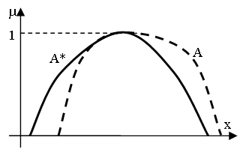
Single Rule reasoning
The observation (A*) overlaps only partly the antecedent set of the conclusion
Generalized Modus Ponens
Observation: x is A*
Rule: IF x is A THEN y is B
Conclusion: y is B*
Notes:
In the second step of the inference the conclusion is generated by firing the new rule. The reference point of the interpolated conclusion in the current dimension will be the same as the reference point of the consequent set of the new rule in the current dimension. Usually the antecedent part of the rule does not fit perfectly the observation. Therefore a special single rule reasoning technique is needed. There are several methods for this task. Further on two of them are going to be presented.

Slide 59
Single rule reasoning based on polar cuts
SURE-p
μ
θ
x
Notes:
The technique SURE-p (Single rUle REasoning based on polar cuts) is based on the concept of polar cuts. First, in each dimension and for each polar cut one calculates the difference between the polar distance of the antecedent set and the polar distance of the observation and the result is divided by the range of the linguistic variable. Here r_{j theta} is the relative difference at the \theta level in the j^{th} antecedent dimension, rho( A^{i}_{j theta}) the polar distance of the antecedent set, rho( A^{*}_{j}) is the polar distance of the observation and $range_{aj}$ is the range of the antecedent linguistic variable in the j^{th} dimension. Next, an average relative difference is calculated taking into consideration the relative differences in all antecedent dimensions. Here \overline{r}_{theta} is the average relative difference at the theta level, n_{a} is the number of the antecedent dimensions. SURE-p is usualy used as a counterpart of the FEAT-p method.

Slide 60
The shape of the consequent set
Conservation of the average relative differences
Maximizing the height of the set to 1:
Notes:
In each consequent dimension the corresponding polar cut of the conclusion is calculated supposing that the relative difference at theta level between the polar distances of the rule consequent and the conclusion is equal to overline{r}_{theta}. Here rho( B^{i}_{l theta}) the polar distance of the interpolated consequent set, rho( B^{*}_{l theta}) is the polar distance of the conclusion, range_{cl} is the range of the consequent linguistic variable in the l^{th} output dimension and theta is the polar angle. Due to the nature of the fuzzy sets the resulting height of the conclusion has to be maximized to 1. Thus arises the second formula.

Slide 61
SURE-p characteristics
Advantages
  Applicable in case of each valid membership function
  Subnormal sets also can be handled
Disadvantage
  Does not conserve the characteristic shape type of the partition

Slide 62
SURE-LS
Set of α-levels
Differences measured on the antecedent side
Notes:
The second single rule reasoning method being presented is SURE-LS (Single rUle REasoning based on the method of Least Squares). It was developed for the case when all linguistic terms of a consequent partition belong to the same shape type (e.g. singleton, triangle, trapezoid, etc.) and all characteristic (break) points are situated at the same alpha-levels. It also means that the height of all sets is the same. Thus the method seeks a special shape form with predetermined ordinate values of the characteristic points. Therefore only the abscissas of the characteristic points have to be calculated.
SURE-LS applies an alpha-cut based approach for this task. It uses a set of alpha-levels compiled together by taking into consideration the break-point levels of all antecedent dimensions and the current consequent partition. The calculations are done separately for the left and right flanks. On each side for each level it calculates the weighted average of the distances between the endpoints of the a-cuts of the rule antecedent and the observation set. The weighting makes possible to take into consideration the different antecedent dimensions (input state variables) with different influence.
Az antecedens oldalon α-vágatonként mért eltérések súlyozott átlaga határozza meg a konzekvens módosítását

Slide 63
SURE-LS₂
Conservation of the weighted average difference
Conditions on the result:
  Valid set shape
  The shape should adhere
  to the characteristic set
  shape of the partition
μ
h
α_{i}
x
Notes:
The basic idea of the method is the conservation of the weighted average differences measured on the antecedent side. Applying these modifications on the consequent side usually results in a set of characteristic points that do not fit the default set shape type of the partition. Therefore the method of Least Squares is used in order to find the break-points of an acceptable conclusion.

Slide 64
SURE-LS characteristics
Advantage
  Preserves the characteristic shape type of the consequent partition
Disadvatage
  The height of all sets must be the same

Slide 65
Rule base generation
Notes:
The next part of my presentation will be about some rule base identification methods that are implemented in the SFMI Matlab ToolBox (developed by the lecturer) and mostly aim the creation of a sparse rule base.

Slide 66
Fuzzy Rule Base Generation
Initial rule base
  Employing human experts
  Automatic from sample data
Parameter tuning
  Global search
  Local search
  Hybrid
Notes:
The performance of a fuzzy inference based system is determined in a significant measure by its rule base. The rule base can be compiled manually based entirely on human knowledge and expertise (based on Zadeh’s initial linguistic variable concept) and/or using methods and software that allow the automatic rule extraction and parameter tuning using machine learning approaches.
Usually the rule base generation consists of two steps. First, an initial rule base is created and next, the quasi-optimal values of the parameters are determined through a process called parameter tuning. There are several different approaches supporting the first step, e.g. employing human experts, fuzzy clustering, grid partitioning, or finding the extreme values of the modeled functional relation. The second step can apply a global, a local, or a hybrid search technique.

Slide 67
Automatic Fuzzy Model Identification
Training data set
Tuning → minimizing the difference between the training output and the system output
Approaches for initial rule base generation
  Fuzzy clustering
  2 rules
  2^{n}+2 rules
  Grid partition
Notes:
Further on I will concentrate on the automatic creation of rule bases from sample data. In case of automatic fuzzy model identification one possesses a training data set that describes the expected behavior of the system in several points, i.e. contains a list of mating input-output values. The model identification algorithm seeks for those values of the system parameters for which the difference between the output values of the training data set and the output provided by the current fuzzy system in case of the same input is small. In most of the cases especially when the training data set contains a large amount of data an exact match cannot be reached. Therefore the fuzzy system gives only a more or less good approximation of the modeled input-output relation described by the sample data. Usually the approximation can be improved by increasing the number of linguistic terms and rules.
Further on I will present four initial rule base generation methods that are implemented in the SFMI toolbox

Slide 68
Fuzzy Clustering Based Initial Rule Base Generation
Automatic fuzzy system generation based on fuzzy clustering and projection (ACP)
One dimensional FCM on the output data
Projection into the antecedent space
One dimensional FCM on the input data
Rule creation
Notes:
The ACP method consists of four steps. It starts with a one dimensional clustering of the sample output data. Next, for each fuzzy set one selects the corresponding data rows from the sample data, which is followed by a one dimensional fuzzy c-mean clustering of the selected data in each antecedent dimension. This step is also called projection into the antecedent space. In each antecedent dimension the obtained cluster centers are collected into a single group and are examined against some cluster mergeability conditions. The final fuzzy sets are generated from the remaining clusters using the same horizontal cut based technique as in the case of the consequent partition. Having the antecedent and consequent partitions generated the rules are created based on the sample data rows that correspond to the individual output fuzzy sets.

Slide 69
Output partition
Optimal cluster number determination
Hybrid cluster validity index (Chong, Gedeon and Kóczy)
Upper limit for the cluster number
One-dimensional FCM clustering on the output data
Ruspini partition with trapezoidal shaped fuzzy sets by cutting
Notes:
The rule base generation starts with the determination of the optimal cluster number for a fuzzy c‑mean (FCM) clustering of the output sample data. It is calculated by the help of a cluster validity index (CVI). ACP adapted the hybrid approach proposed by Chong, Gedeon and Kóczy enhanced by the application of an upper limit for the cluster number. After determining the optimal output cluster number one does a one-dimensional FCM clustering on the output data. The applied technique is based on the FCM proposed by Bezdek. One estimates the output partition’s fuzzy sets from the previously identified clusters. The Ruspini type partition with trapezoidal shaped fuzzy sets is produced by cutting the clusters at an alpha-level (usually alpha=0.85) and creating the set’s cores from the width values of the cuts. One determines the supports of the sets automatically from the corresponding endpoints of the adjacent linguistic terms’ cores.

Slide 70
Projection into the antecedent space
For each output fuzzy set (B_{j})
  Select the data rows whose output falls into the support of the set
  1D FCM clustering
  Keep the cluster centers (A_{i,j,k})
  Define rules
In each input dimension
  Interleave and renumber cluster centers
  Merge identical cluster centers
  Correct rules
  Ruspini partition with trapezoidal shaped fuzzy sets by cutting
Notes:
Next, the consequent linguistic terms are projected into the antecedent space. For each output fuzzy set one selects the data rows whose output fall into the support of the set. Then one does a one dimensional fuzzy clustering in each antecedent dimension on the current subset of the sample data. The cluster centers will be used later as reference points of the estimated antecedent fuzzy sets.
An identifier with three indices (A_{i,j,k}) is assigned to each cluster, where i is the ordinal number of the antecedent dimension, j is the ordinal number of the consequent fuzzy set in its partition, and k is the ordinal number of the cluster in the current clustering.
One can generate two or more rules for each output fuzzy set. Thus one obtains several groups of cluster centers in each input dimension. Next, they are interleaved and renumbered in order to get a cluster partition in each dimension. Some of the cluster centers will be identical or nearly identical. They are united applying a prescribed distance threshold whose value is a parameter of the method. After a cluster union the related rules are also corrected or united. One estimates the antecedent partitions and linguistic terms using the same methods as in the case of the consequent partition.

Slide 71
Sample data and the generated rules’ antecedent sets
Notes:
This slide shows the resulting rule base in case of a synthetic sample data obtained by the application of the function z.

Slide 72
System with two initial rules
Select two data rows from the sample data set
  Lowest output value
  Highest output value
Meta rules
  If the reference point of a new set would be close to the RP of an existent set the new set is not inserted into the system
  If the new set is similar enough to an old one the new set is not inserted into the system
Notes:
The “two initial rules” based method first selects two data rows from the sample data set: one that represents the lowest output value, and one that contains the highest output value. If more than one data row contains the same extreme output value that one is selected which is closer to the lower or upper bound of the antecedent space. Next, two rules are created that describe the two specified output values. The fuzzy sets contained in the antecedent and consequent parts of the rules are created with trapezoidal membership functions where the width of the core (w_{c}) and support (w_{s}) are defined in function of the range of the actual partition and the reference point is identical with the respective element of the selected data row. Optionally one can select the application of the following two meta rules as well.
If the distance between the reference point of the new fuzzy set and the reference point of an old fuzzy set is smaller or equal than a specified threshold value (d_{min}), the old set is used as antecedent/consequent of the new rule in the current input/output dimension (the algorithm does not create a new fuzzy set).
2. If the average distance between the corresponding parameters of the new set and an old set is smaller or equal than a specified threshold (dp_{min}) the two sets are merged into one.

Slide 73
Sample data and the generated rules’ antecedent sets

Slide 74
System with 2^{n}+2 rules
Two rules approach
  Sometimes slow tuning
  Requires extrapolation capability from the FRI method
Solution: rules at the corner points of the antecedent space (max. 2^{n}+2 rules)
Notes:
The rule base generation method that applies the above presented “two rules” approach usually ensures after the parameter optimization a final fuzzy system with a low number of rules; however, the process can be very time consuming. Besides, another problem could arise from the deficiency that not all the FRI methods have extrapolation capability. In order to alleviate the above mentioned problems the SFMI toolbox offers as a new feature an initial rule base generation mode that beside the above specified two rules also creates a rule for each corner point of the hypercube of the antecedent space.
This approach results in (at most) four rules in case of a one dimensional antecedent space, and ten rules in case of a two dimensional antecedent space. In the general case the number of rules will be 2^{n}+2where n is the number of input dimensions. Sometimes the actual number of rules can be less than the value specified in (2) because one or both of the extreme outputs could correspond to corner-points of the antecedent hypercube. For example in case of our synthetic data set one gets a rule base with only five rules because the rule describing the corner point x=0, y=50 is identical with the rule corresponding to the lowest output. The main steps of the algorithm are presented on the next slide.

Slide 75
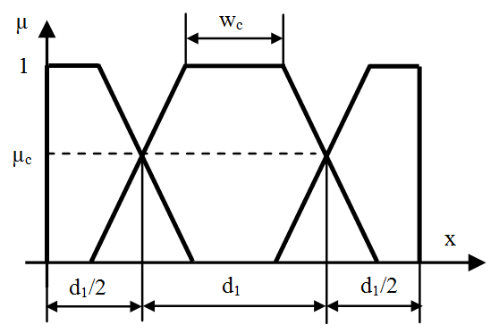
System Based on Grid Partitioning
Notes:
All the three previously presented methods create a sparse rule base, i.e. for some possible observations (allowed input values) there are no applicable rules. As an extension of its functionality the 1.1.6 version of the SFMI toolbox also supports the creation of a rule base that ensures a full coverage of the input space.
allowing the system architect the specification of the coverage level, the number of the fuzzy sets in the current partition, and the width of the fuzzy sets’ core as well (see Figure 8).
The algorithm defines the characteristics of the grid partitioning conform Figure 9, where µ_{c} is the coverage level,

Slide 76
Tuning of the Rule Base Parameters
Hill climbing (ACP)
Hill climbing + new rules (RBE-DSS + RBE-SI)
Clonal selection
Direct local search
Notes:
The current version of the SFMI toolbox supports four main approaches for the tuning of the rules base parameters. The first one applies a local search approach. The second one extends it with the incremental extension of the rule base. The third one applies an artificial immune system algorithm. The last one is a variation of the classical Nelder-Mead. Further on I will present briefly the key ideas of the most used approaches.

Slide 77
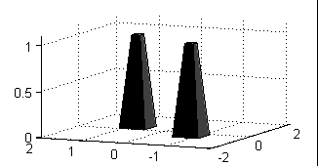
Rule Base Extension
Tune the initial rule base
Create new rule when the step becomes too small
Position: where the difference between the sample output and
the calculated output is maximal
RBE-DSS & RBE-SI
Notes:
The key idea of rule base extension is that when the optimization stuck in a local optima a new rule is inserted into the rule base where the difference between the sample output and the calculated output is maximal. Further on two variants of this approach are going to be presented.

Slide 78
Tuning with RBE (DSS & SI)
Hill climbing approach
Performance indices (error measures)
Algorithm:
While PI>PI_{tr} and N_{iter}<N_{max} and st>st_{min}
  For each dimension
    For each parameter
      One step right evaluate the system
      One step left evaluate the system
      Keep the best
  If PI does not improve halve the step
  If the step is too small generate a new rule
Notes:
The algorithm uses an iterative hill climbing approach. After each step (each parameter modification) the resulting fuzzy system is evaluated by the means of a performance index, which gives information about the difference between the prescribed output given by the sample data set and the calculated data set using the fuzzy system. The algorithm investigates the parameters one-by-one in course of each iteration cycle. First the system is evaluated with the current parameter set. Next one calculates two new values for the actual parameter one by decreasing the original value and one by increasing the original value. The step is calculated in function of the range in the actual dimension, After the evaluation of the system with the two new parameter values one keeps that value from the available three ones (original and two new values), which results the best system performance. An iteration cycle contains the investigation of all parameters once. At the end of the cycle one compares the actual performance with the performance of the system measured at the end of the previous cycle. If the amelioration of PI is greater than a threshold value the step is doubled otherwise it is halved. When it becomes smaller than a threshold for the first time the process receives a second chance by increasing the step to its original value. The algorithm stops when either when the step reaches its minimum for the second time or the prescribed number of iteration cycles is reached or the performance index of the system becomes better than a threshold value.

Slide 79
Clonal Selection Algorithm
Clonal Selection Principle
  Clonal selection
  Clonal expansion
  Somatic hypermutation
Notes:
The Clonal Selection Algorithm mimics the biological Clonal Selection Principle by implementing mechanisms like clonal selection, clonal expansion, and somatic hypermutation. The algorithm was originally suggested by de Castro and Von Zuben. Clonal selection based algorithms have been applied successfully for several diverse problems. Further on I will present a variant of CLONALG that was used for the optimization of the rule base’s parameters. It follows an iterative approach and applies global as well as local search steps in the parameter space.

Slide 80
The Applied Algorithm
Create starting repertoire of antibodies
  Generate (random) antibodies: N x (BitArray of length L)
  Measure antibody affinity
Create clones
  Sort antibodies based on affinity in descending order
  Select first n instances
  Clone selected instances (Nc copies of each instance)
Do hypermutation (antibody maturation)
  Mutation controlled by p
  Measure antibody affinity (mutated antibodies)
Extend repertoire of antibodies
  Attache clones to the original pool of antibodies
Create next generation repertoire of antibodies
  Sort antibodies based on affinity in descending order
  Select first N-d instances (drop the rest)
  Generate new (random) antibodies: d x (BitArray of length L)
Notes:
L=number of the bits used to encode the k system parameters
The algorithm starts with the generation of N bit-arrays of length L, where each instance represents a candidate solution containing one value for each parameter of the fuzzy system. These arrays (instances) are called antibodies in the AIS terminology. Next, one measures the affinity of each antibody, i.e. it calculates the performance of that fuzzy system which applies as parameters the values stored in the antibody. After ranking the antibodies based on their affinity the best ones (the first n instances) are selected for cloning. The cloning means that Nc
copies are made from each selected antibody [3], where β∈(0,1] is a user parameter. In order to increase the diversity of the solutions the clones are subjected to an intensive mutation (hypermutation) which process is also called maturation of the antibodies. The mutation is done by changing (inverting) the values of some bits. It is controlled by the probability distribution [3]p.
where PI (PI∈[0,1]) is the performance indicator of the fuzzy system and ρ (ρ∈(0,1]) is a user parameter. In case of PI the lowest possible value corresponds to the worst performance while the highest value indicates the best performance.
In practice in case of each bit of an antibody a random r (r∈(0,1]) value is generated. If r<p the bit is inverted (flipped). Next, one calculates the affinity of each new antibody (performance of the fuzzy system represented by the antibody). This process is called antibody maturation. It performs a local search in the neighborhood of each instance belonging to the elite group. The neighborhood is closer in case of antibodies with better performance than in case of antibodies showing worse affinity.
The resulting pool of antibodies is attached to the original group and the whole repertoire is sorted in descending order based on the affinity (performance) values. The first N-d antibodies are selected for the next generation and the rest of them are dropped. Then d new instances are created with random bit patterns in order to ensure the diversity of the repertoire. This randomness ensures a global search character to the method.

Slide 81
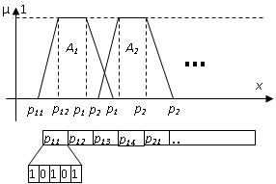
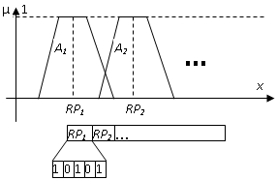
Encoding Scheme

Slide 82
Applications
Fuzzy rule interpolation based systems

Slide 83
Practical applications
Fuzzy control
  Automated guided vehicle
  Automated mobile robot room surveillance navigation control
Fuzzy modeling
  Petrophysical properties prediction
  Fuzzy modeling of an anaerob tapered fluidized bed reactor
  Tool life prediction
  Mechanical properties of composite materials
  Prediction of the student enrollment number
Fuzzy expert system
  Student evaluation

Slide 84
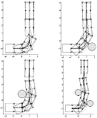
Fuzzy Control₁
Automated guided vehicle
main goals: path tracking and collision avoidance
FIVE
12 rules for steering
5 rules for speed

Slide 85
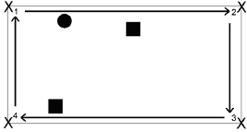
Fuzzy Control₂
Automated mobile robot room surveillance navigation control
Task: go through the "waypoints" 1..4, avoid the collisions (obstacles, walls)
FIVE
Full rule base: 1040 rules
Applied sparse rule: 51 rules

Slide 86
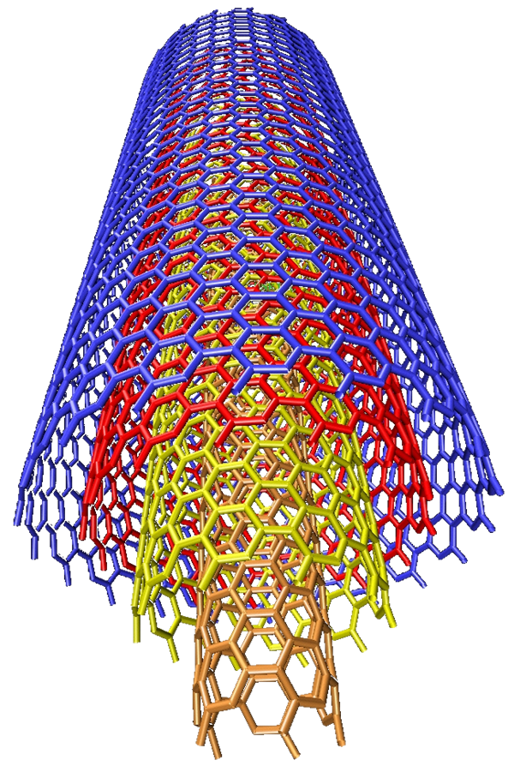
Prediction of some Composites’ Mechanical Properties
Thermoplastic composites’ yield strength and Charpy impact strength prediction as a function of the percent amount of the components
  Multiwall Carbon Nanotube (MB-6015-00)
  ABS (POLYMAN HH 3)
  Polycarbonate
http://www.umi.surrey.ac.uk/people/profiles/postgrads?s_id=315

Slide 87
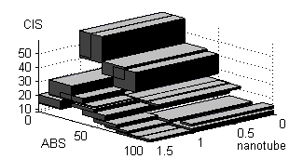
Charpy impact strength
Training: RMSEP 2.1594 %
Test: RMSEP 2.9305 %
Size reduction of the rule base 27.27 %

Slide 88
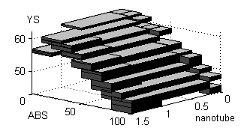
Yield strength
Training: RMSEP 0.4795 %
Test: RMSEP 0.7732 %
Size reduction of the rule base 31.82 %

Slide 89
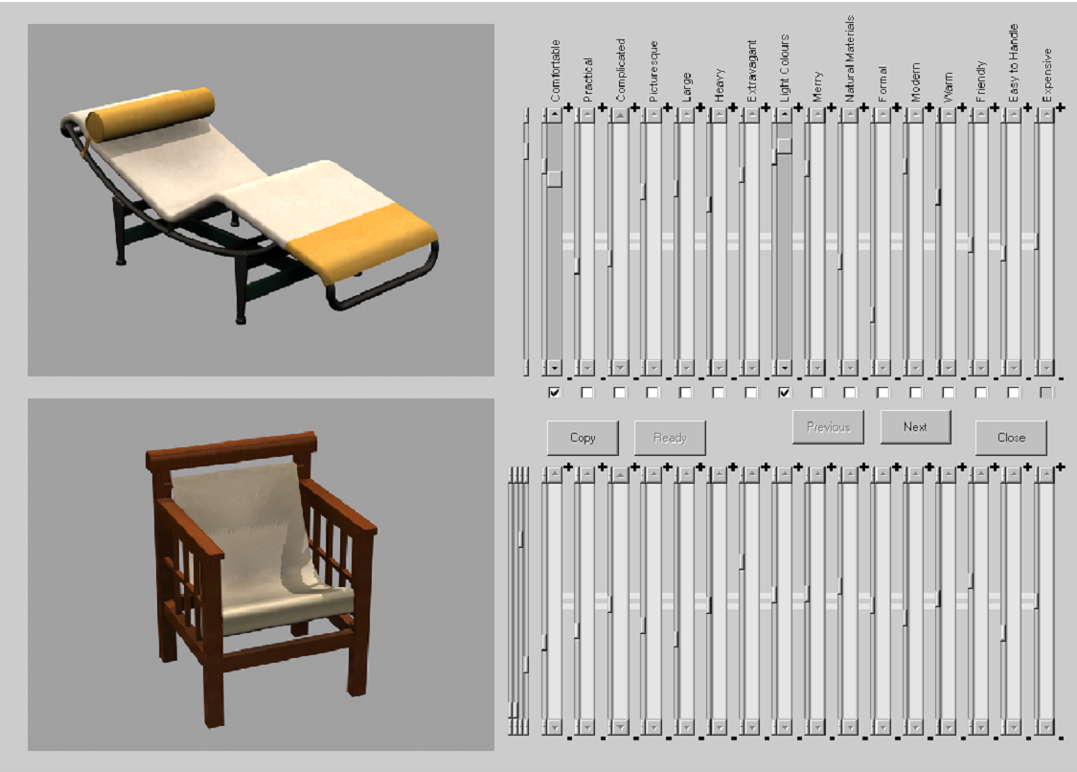
Furniture selection

Slide 90
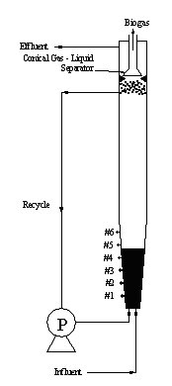
Fuzzy modeling of an anaerob tapered fluidized bed reactor
4 inputs 5 outputs
Kimenet | PI_{RMSE}
COD_{out} | 30,1954
Biogas | 0,8012
VFA | 18,2828
Alkalinity | 76,0786
BOD_{out} | 88,4201

Slide 91
Petrophysical properties prediction - analysis of petroleum well log data
3 inputs 1 output
PHI=f(GR,ILD,DT)
GR - gamma rediation
ILD - deep induction resistivity
DT – acustic travel time
PHI - porosity
Applied method | Correlation c.
 | Training data | Test data | Rule no.
MACI | 0,917 | 0,865 | 63
LESFRI | 0,934 | 0,890 | 9
FRIPOC | 0,966 | 0,880 | 37

Slide 92
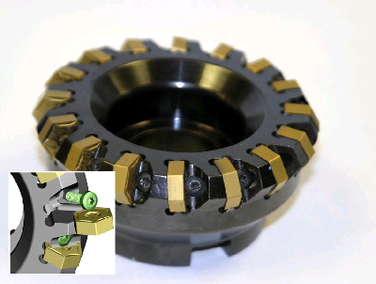
Tool life prediction in case of machining operations
Input: Cutting speed + Feed rate
Output: Tool life
Traditional models: exponential, Taylor, corrected Taylor, Gilbert, Kronenberg, etc.
 | Exp. | Taylor | T. corr | RBE-SI+ FRIPOC
DA20 | 1.1223% | 2.8816% | 4.7610% | 0.0146 %
DA25 | 0.7045% | 3.9486% | 7.2525% | 0.0005 %

Slide 93
Ground Level Ozone Concentration
Most important factors: NO, NO2, NOx, T, RH, and O3
259 measurements for system training purposes
84 measurements for testing purposes
The test data were selected randomly from the original sample
Notes:
Ground-level ozone (O₃) is a very dangerous air pollutant. It is an irritating and reactive component in atmosphere that has negative impacts on human health, climate, vegetation and materials. Therefore it is important to develop models that are able to predict its concentration.
The experimental data were collected in an urban site of Northern Portugal [31]. In course of the experiments 10 characteristics were measured: the hourly average concentrations (in µg/m³) of carbon monoxide (CO), nitrogen oxides (NO, NO2 and NOx) and O3; hourly averages of air temperature (T), solar radiation (RAD), relative humidity (RH) and wind speed (WS); the day of week (DW; the O₃ behavior is different on weekdays and on weekend).
Based on the results published in [30] we took into consideration in course of the modeling only the most important factors those are NO, NO2, NOx, T, RH, and O3. We formed two groups of the experimental data: one containing 259 measurements for system training purposes and one with 84 measurements for testing purposes. The test data were selected randomly from the original sample.

Slide 94
Student evaluation
Evaluation of narrative student responses
Aspects of the scoring of each response
  the accuracy of the response → fuzzy number → average fuzzy evaluation
  the time necessary for answering the questions → crisp number → fuzzy average time
  the correct use of the technical terms → fuzzy number → average fuzzy evaluation
General fuzzy evaluation of the student using fuzzy inference – 74 rules

Slide 95
Input and output partitions

Slide 96
Prediction of the student enrollment number
Aim: predict the number of students who will enroll into the Network Administration course
  Probability of passing the NA exam for each student
  Average probability for the whole group
  Estimated number of the students who will pass the exam

Slide 97
Input - Output
Input
What was the result of the student’s last (successful) CNI exam? Variable: N1R, possible values: 2..5.
Is this the 1st, 2nd, or 3rd enrolment of the student into the Network Administration course? Variable: NEN, possible values: 1..3.
How many credits has the student collected until now? Variable: NCr, possible values: SM, AV, BG
Output
Probability of passing the exam. Variable: PS, possible values: SM, AL, AH, BG

Slide 98
Results
Original rule base
  Training: PI=0.73 Test: PI=0.74
Final rule base
  Training: PI=0.81 Test: PI=0.76

Slide 99
FRI Software
FRI Matlab Toolbox

Slide 100
FRI Matlab Toolbox
Extension of the standard Fuzzy Logic Toolbox
Supported FRI methods:
  KH, the stabilized version of the KH, MACI, IMUL, CRF, FIVE, VKK, GM with SCM, FERI, and FPL, and GM with FEAT-p, FERI, and FPL or FEFRI, LESFRI, FRIPOC, VEIN, FRISUV
Matlab 7
http://fri.gamf.hu
Notes:
We have developed a Matlab toolbox that implements several FRI methods. It is freely available under the GPL license. Our aim was to facilitate the practical application as well as the comparison of the implemented methods. We choose Matlab because it ensured an easy-to-learn and program framework.

Slide 101
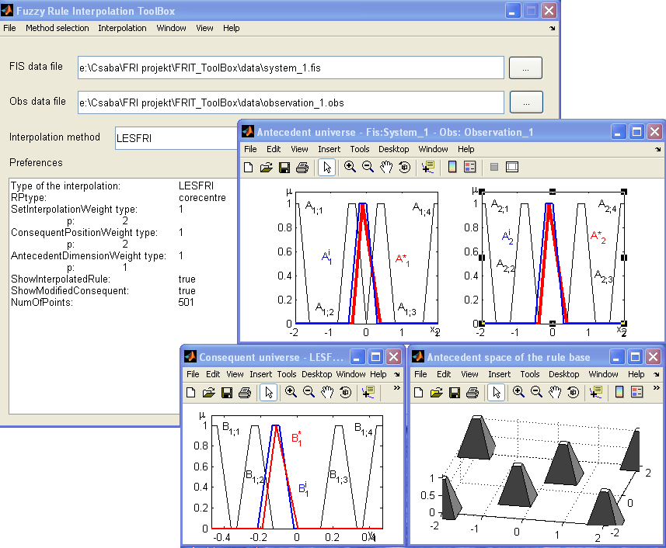
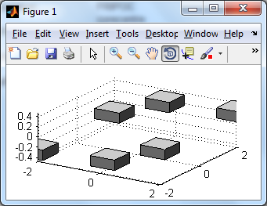
FRIT

Slide 102
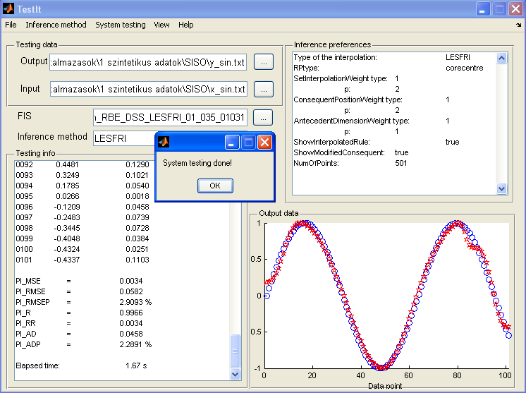
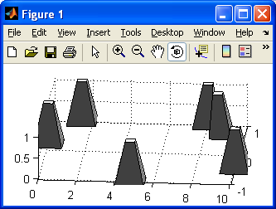
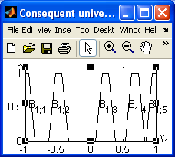
TestIt

Slide 103
SFMI toolbox GUI

Slide 104
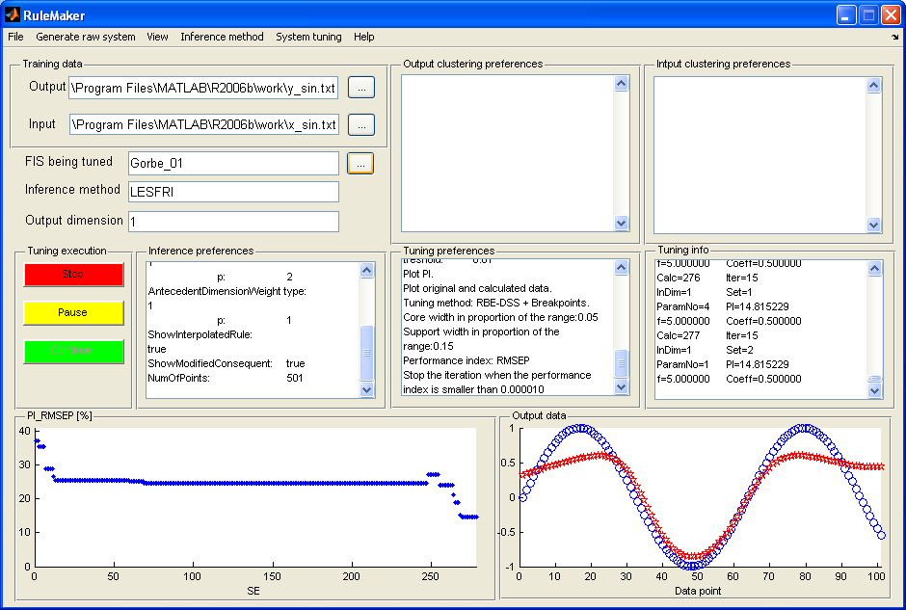
GUI program

Slide 105
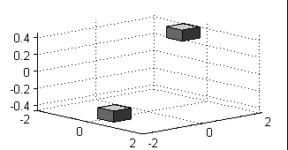
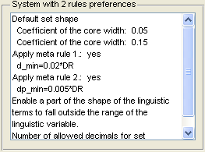
GUI program
Raw fuzzy system generation from the sample data
  Separate raw system for each output dimension
  Graphical repr.
Notes:
The graphical user interface of the toolbox can be started by typing in the Matlab Command Window the command RuleMaker. Conform to the implemented fuzzy model identification methods one can distinguish two main areas in the functionality of the GUI program. The first one deals with the generation of the raw fuzzy system from the sample data. The training data should be loaded in two separate text files, one containing the output values and one containing the input values. In both cases each row corresponds to one data point. If the input or output is multi-dimensional the co-ordinates in the different dimensions are separated by tabulators. Figure 4. Parameters of the raw fuzzy system generation
One can generate the raw fuzzy system either by clustering or by the extreme values based approach. The system can be saved in a text file using the same format as the Fuzzy Rule Interpolation Matlab toolbox [17]. The program generates a separate raw system for each output dimension in case of sample data with multi-dimensional output.
The current version (1.0.0) of the toolbox supports only the trapezoidal shaped membership functions, which includes with corresponding parameterization the triangle and the singleton shaped fuzzy sets as well. The default core and support width values and some other parameters can be set by the user through dialog boxes. They are also displayed in a textbox in the main window (see fig. 4).
The program makes possible the graphical representation of the input and output partitions (see e.g. fig. 5) separately, as well as a three dimensional representation of the rule base or antecedent space if the number of antecedent dimensions does not exceed three. If the fuzzy model has only one input dimension the program offers a three dimensional representation of the rule base each rule being indicated by a pyramid defined by the antecedent and consequent membership functions (see e.g. fig. 6). If the number of input dimensions is two one can use the pyramid-type representation for the visualization of the antecedent space. Here the pyramids are defined by the antecedent fuzzy sets. However, the user can choose the cuboid-type representation (e.g. fig. 1) where the rule consequents still can be drawn into the visualization. In this case the edges of a cuboid represent the supports of the antecedent and consequent linguistic terms of a rule. The drawback of this type is that other parts of the sets’ shape cannot be visualized. In case of fuzzy systems having three input dimensions only the cuboid-type representation is available. It can be used for the visualization of the rule antecedents.

Slide 106
Thank you for your attention!
Johanyak.csaba@gamf.kefo.hu

