Slide 1
Fuzzy Inference in Sparse Rule Bases and Related Model Identification Techniques
Zsolt Csaba Johanyák
Kecskemét College,
Department of Information Technologies
johanyak.csaba@gamf.kefo.hu
Notes:
Dear … .
First

Slide 2
Contents
Introduction
Basic concepts
Fuzzy inference in sparse rule bases
Creation of sparse fuzzy models from sample data
Practical applications
Notes:
The presentation will consist of four parts. First I would like to introduce myself shortly, followed ba a short recapitulation of some fuzzy logic related basic concepts.
The third part of the presentation will be a bigger one concerning fuzzy rule interpolation and the software support available in Matlab. The fourth part introduces some methods applicable for automatic sparse model generation from sample data.

Slide 3
City- College -Department

Slide 4
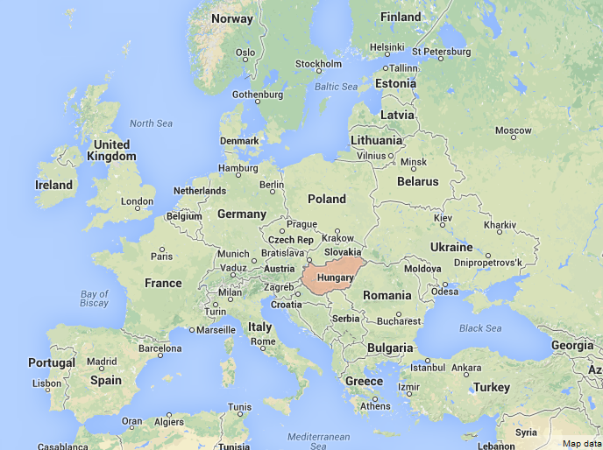

Slide 5
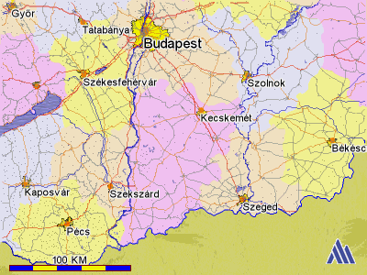
Where is Kecskemét?

Slide 6



Historic places
Notes:
Kecskemét was mentioned as a market-town of the first time in a charter from 1368.
The Main Square was the former market-place and is known as one of the most beautiful city centres of Hungary.

Slide 7



Historic places

Slide 8
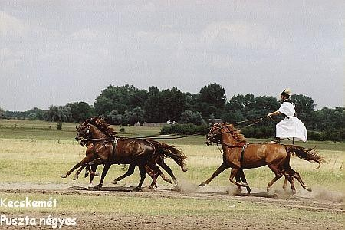
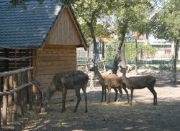
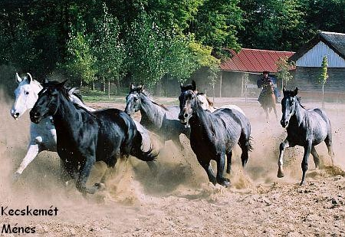

Traditions

Slide 9


Wellness Tourism
The region of the Southern Great Plain is the sunniest part of Hungary.
It is the favourite place of the visitors looking for recovery, and recreation.

Slide 10


Kecskemét College
Faculty of Mechanical Engineering and Automation
Department of Information Technologies

Slide 11
Facts and Details - Faculty
Founded: 1964
Number of teaching staff: 90
Total number of students: 2400
Full-time students: 1400
Part-time students: 1000

Slide 12
Courses
Information Technology
Materials Engineering
Mechanical Engineering
Technological Manager
Vehicle Engineering
Dual System – Vehicle Engineering

Slide 13
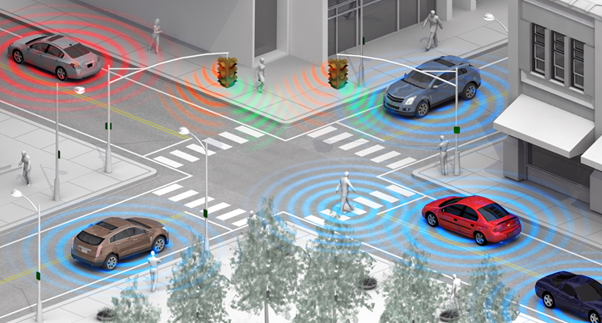
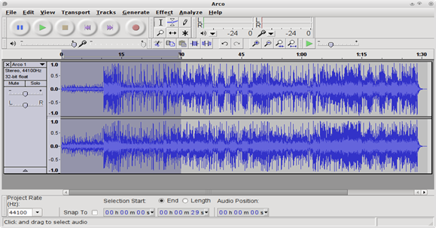

Information Technology
Specializations
Network and WEB Technologies
Industrial Informatics and Microcontrollers
Mobile Application Development
Media Informatics
Vehicle Informatics
Notes:
Engineering Information Technology

Slide 14
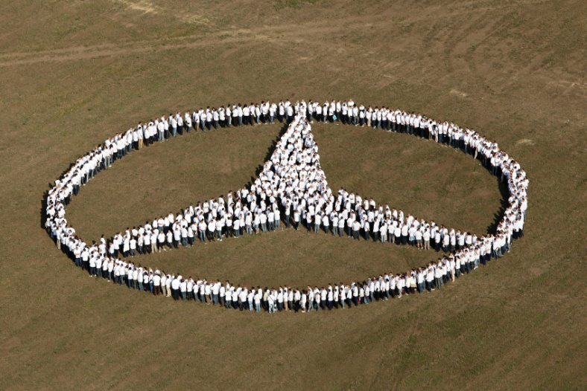

Dual System
Cooperation with the Industry (Daimler AG MBMH Kft., Knorr-Bremse Fékrendszerek Kft., etc.)
Practice-oriented Training

Slide 15
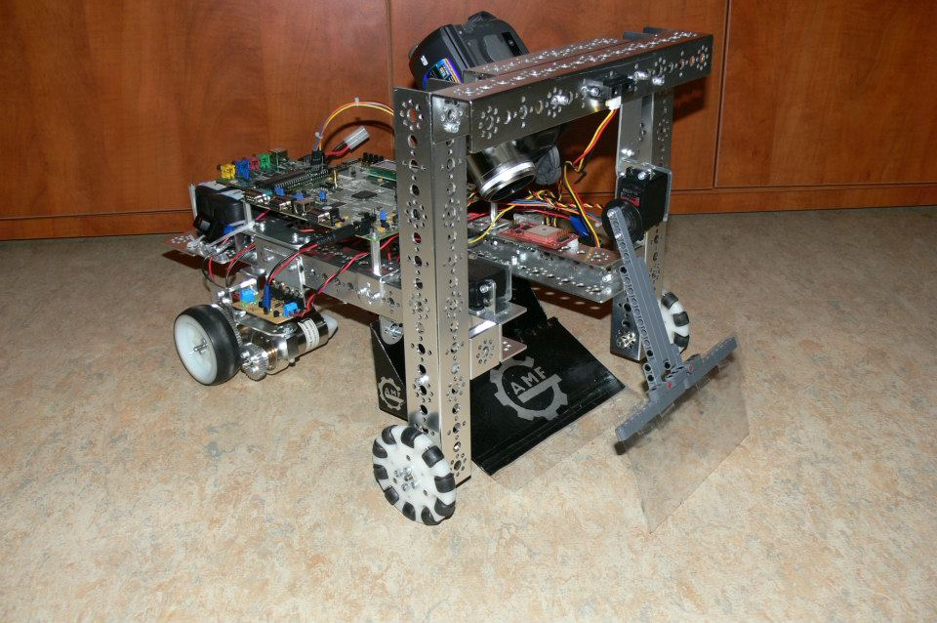
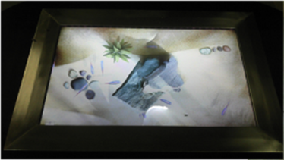
Student projects
Czuprák Zsolt
Éva Róbert
Abonyi Gergő
Zsupányi Krisztián
Notes:
Our students usualy do software projects but sometime they volunteer for harware projects as well.
This slide presents two of such projects done by our students. The first one is a concept prototype of a cleaning robot and the second one is a touch screen.

Slide 16

Partners
Notes:
Some of our main partners and sponsors

Slide 17
Research at our Department
Notes:
Next I will give you a short overview of some research projects related to our department.

Slide 18
Effects of innovative teaching methods in IT education
Experiments to apply innovative methods into our courses
Possibilities and effectiveness of cooperative learning in IT education
Project method and model robots in teaching of programming
Robert Pap-Szigeti
pap-szigeti.robert@gamf.kefo.hu
Notes:
In the last few years the number of students interested in software development decreased drastically. Therefore we were motivated to find new ways of programming teaching to increase the motivation of the students.

Slide 19
Articles
Pásztor, A., Pap-Szigeti, R. & Lakatos Török, E. (2010): Effects of using model robots in the education of programming. Informatics in Education, 9. 1. sz. 133-140.
Pap-Szigeti, R. (2007): Cooperative Strategies in Teaching of Web-Programming. Practice and Theory in Systems of Education, 2. 3-4. sz. 51-64.

Slide 20
Smarter Transport – cooperative communication in transport systems
Development of an evaluation testbed (vehicle and roadside communication units)
Development of microscopic traffic simulation software
Visual Driver Assistant: 3D reconstruction based on omnidirectional cameras
Contact: kovacs.lorant@gamf.kefo.hu

Slide 21
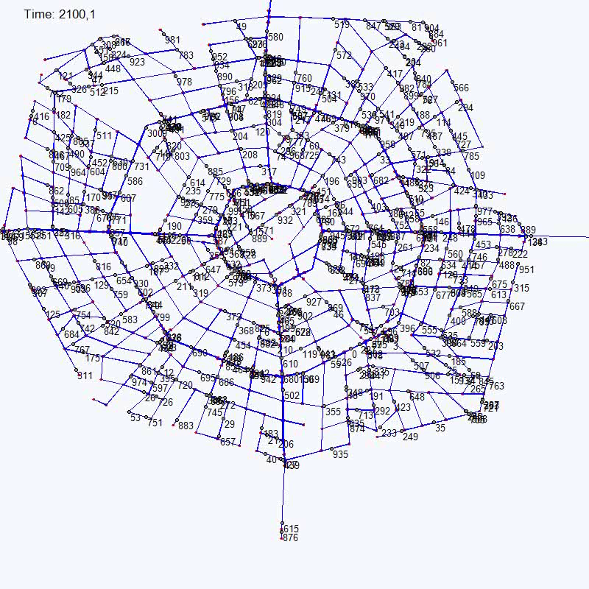
Computer simulations of a city traffic controlled by a central intelligence through radio posts

Slide 22
Algorithm Development for Smart Grids
Statistics based approach for Consumption Admission Control (A new approach for direct control of smart appliances)
Change point detection in time series using Jensen-Shannon Divergence (finding stationary segments of non-stationary series)
Outlier detection methods for smart grids
Contact: kovacs.tamas@gamf.kefo.hu

Slide 23
Gathering and area exploration algorithms for robot swarm
Area exploration by a swarm of autonomous mobile robots with wireless communication links
(T. Kovács, A. Pásztor, Z. Istenes: A multi-robot exploration algorithm based on a static Bluetooth communication chain, Robotics and Autonomous Systems 59 (2011) pp. 530–542.
T. Kovács, A. Pásztor, Z. Istenes: Connectivity in a wireless network of mobile robots doing a searching and collecting task, SACI (2009), pp.183-186)
Gathering algorithms for a swarm of oblivious, non-communicating robots with limited visibility
(K. Bolla, T.s Kovacs, G. Fazekas: Gathering of Fat Robots with Limited Visibility and without Global Navigation, Lecture Notes in Computer Science Volume 7269, (2012), pp 30-38)
Student projects on mobile robot building and robot swarm implementations
Contact: kovacs.tamas@gamf.kefo.hu

Slide 24
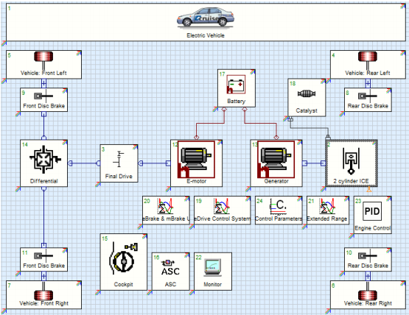
Vehicle concept and energy-management of hybrid drivetrain
Research for hybrid and electronic vehicle design
Vehicle dynamics and control
Optimization of the draintrain
Notes:
Villamos hajtású jármű, kiegészítve „Range Extender”-rel
Az akkumulátorokat szükség esetén egy belső égésű motor tölti

Slide 25
Fuzzy systems for diverse purposes
Fuzzy modeling
Petrophysical properties prediction
Fuzzy modeling of an anaerob tapered fluidized bed reactor
Tool life prediction
Mechanical properties of composite materials
Prediction of the student enrollment number
Fuzzy expert system
Student evaluation
Notes:
These are projects wich are related to the today’s seminar. I will present them in details at the end of the presentation.

Slide 26
Fuzzy Logic
Basic Concepts

Slide 27

Fuzzy sets
Lotfi A. Zadeh
University of California at Berkeley - 1965
Imprecision in natural language
Notes:
The fuzzy concept was introduced by prof. Zadeh in the mid 60s to facilitate the description of the vagueness/imprecision in the natural languages. What is this imprecision?

Slide 28
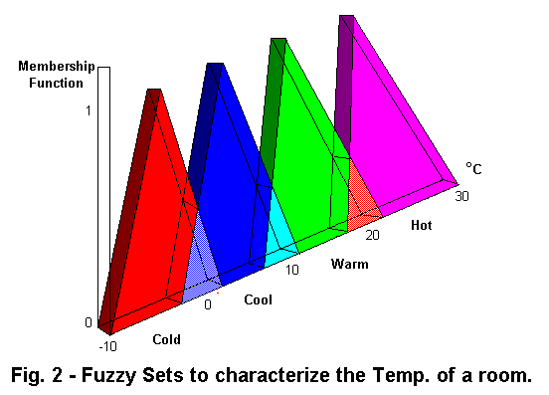
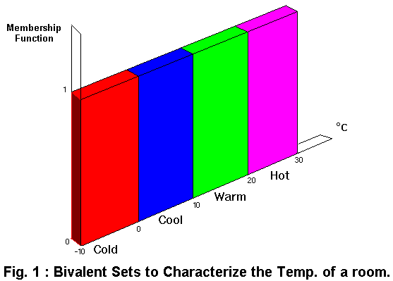
Crisp seets – Fuzzy sets
Membership
Membership
°C
°C
Hot
Hot
Warm
Warm
Cool
Cool
Cold
Room temperature
Cold
Room temperature
http://www.doc.ic.ac.uk/~nd/surprise_96/journal/vol4/sbaa/report.fuzzysets.html
Notes:
Everyone has met situations when although there is an exact numerical value for the characterization of a property (e.g. temperature, height of a person, points achieved by a student) we are not able (or sure) to put into one of the predefined categories. I emphasize the word one. We feel that it fits in more categories. O course not with the same measure. For example 12 C can be viewed as cool or cold as well.
The problem can be traced back to the (sometimes) vague borders between concepts.
In case of traditional (crisp) sets in case of each value we define clearly to which category (set) it belongs. Thus we can say that its memebership value is either 0 or 1 in a given set.
In case of fuzzy sets we enable the value to belong to more sets and we characterize this property by a membership value (usually ) between 0 and 1.

Slide 29
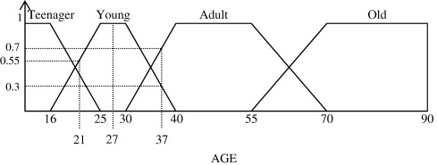
Membership function
Teen
Young
Middle-aged
Elderly
110
x
Age
Linguistic variable: Age
Linguistic values: Teen, Young, Middle-Aged, Elderly
Notes:
For example a 37 years aged person belongs with a 0 value to the set teenagers, but they belong with 0.3 to youngs and with 0.7 to the set of middle-aged people.
The function that describes the measure of belonging is the membership function.

Slide 30
Basic concepts
Universe of discourse
(e.g. -10..30°C, 0..90 years)
Linguistic variable
(e.g. Age)
Linguistic value
Membership value: 0..1
Membership
function: µ_{Young}(x)
Fuzzy set
Partition
μ
A₁
A₂
A₃
x
Notes:
A partition in general is a division of a sets (universe of discourse) elements into several subsets.
Each element can belong to only one subset (category). In the fuzzy case each element can belong to more subsets (so called fuzzy sets) with a measure expressed by the so called memebership function.

Slide 31
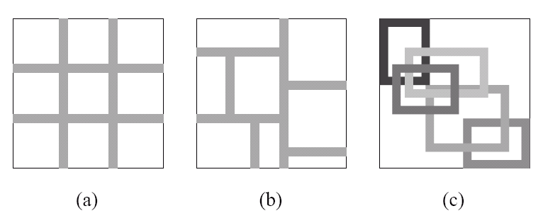
Partition Styles
Grid
Partition
Tree
Partition
Notes:
In case of multidimensional universe of discourse several types of partitioning are possible. This figure presents the most used two of them.

Slide 32
Various Fuzzy Set Operations
Definition: (t-norm, Intersection) The membership function µ_{C(x)} of the set C = A ∩ B is defined as µ_{C(x)} = min {µ_{A(x),} µ_{B(x)}}, x ∈ X.
Definition: (s-norm, Union) The membership function µ_{C(x)} of C = A ∪ B is defined as µ_{C(x)} = max{µ_{A(x)} , µ_{B(x)} }, x ∈ X.
Example: Let X = { 1,2,3,4,5,6,7}
A = { (3, 0.7), (5, 1), (6, 0.8) } and B = {(3, 0.9), (4, 1), (6, 0.6) }
A ∩ B = { (3, 0.7), (6, 0.6) }
A ∪ B = { (3, 0.9), (4, 1), (5, 1), (6, 0.8) }
A’ = { (1, 1), (2, 1), (3, 0.3), (4, 1), (6, 0.2), (7, 1) }

Slide 33
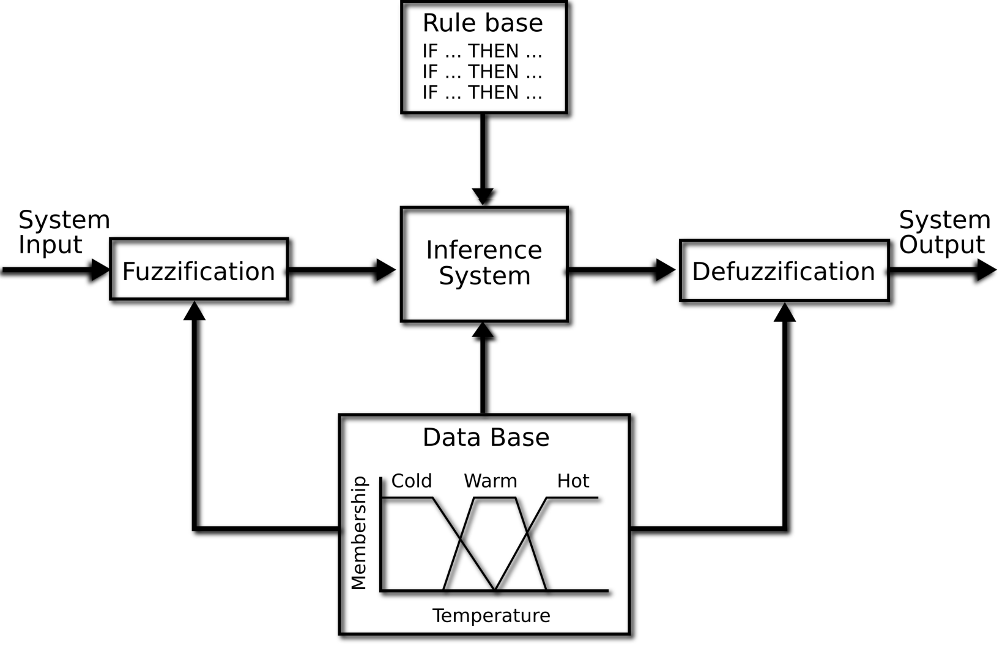
Fuzzy rule based system
http://www.cs.bris.ac.uk/~kovacs/publications/gbml-survey/html-version/node16.html
Notes:
This figure depicts how a fuzzy rule based system works in general case.
The system receives some input (fuzzy or crisp) and creates a corresponding output.
The input value is usually called observation.
The process is called fuzzy inference. If the input is crisp at the begining there is a fuzzification step a transformation of the original value into a fuzzy one.
If a crisp output is needed then at the end there is defuzzification step which transforms the resulting fuzzy set into a crisp value.

Slide 34
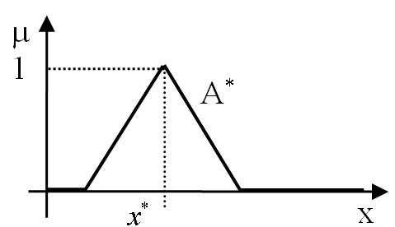
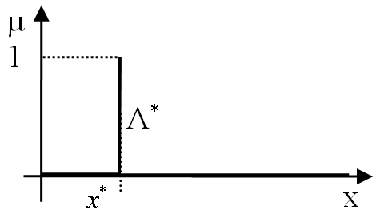
Fuzzification
Notes:
A fuzzifikálás során egy mért, megfigyelt vagy bármilyen más forrásból rendelkezésre álló éles értéket (x*) a fuzzy világba transzformálunk, azaz fuzzy halmazt (A*) rendelünk hozzá. Az így előálló halmazt megfigyelésnek nevezzük. Egyszerűsége miatt leggyakrabban a szingleton (szálka) típusú fuzzifikálást alkalmazzák
Más halmazalakok esetén a tagsági függvényt úgy választják meg, hogy a referencia pont (leggyakrabban a mag középpontja) essen egybe az éles értékkel.

Slide 35
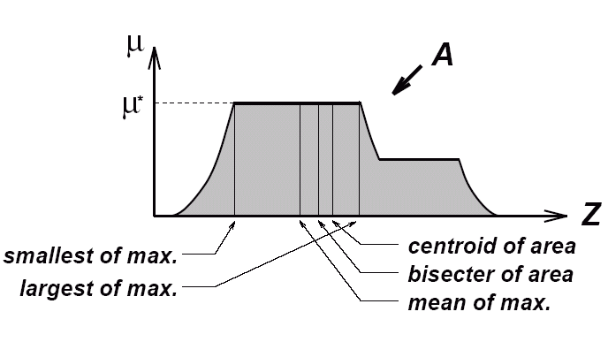
Defuzzification
Notes:
We apply defuzzification at the end by systems that produce a fuzzy set as inference result when a crisp value is needed as output (e.g. control systems).
The resulting seet can have a quite strange membership function (like the one on the figure). The several applicable method, some of them are listed on the next slide.

Slide 36
Defuzzification methods
AI (adaptive integration)
BADD (basic defuzzification distributions)
CDD (constraint decision defuzzification)
COA (center of area)
COG (center of gravity)
ECOA (extended center of area)
EQM (extended quality method)
FCD (fuzzy clustering defuzzification)
FM (fuzzy mean)
FOM (first of maximum)
GLSD (generalized level set defuzzification)
ICOG (indexed center of gravity)
IV (influence value) LOM (last of maximum)
MeOM (mean of maxima)
MOM (middle of maximum)
QM (quality method)
RCOM (random choice of maximum)
SLIDE (semi-linear defuzzification)
WFM (weighted fuzzy mean)

Slide 37
Fuzzy Inference
Classical Methods

Slide 38
Classical fuzzy inference methods
Mamdani
Takagi-Sugeno-Kang

Slide 39
Mamdani type fuzzy inference
IF x1 is A2 AND x2 is B3 THEN y is C3
IF x1 is A3 AND x2 is B3 THEN y is C2
…
x_{1M}
x_{2M}
Notes:
Original Goal: Control a steam engine & boiler combination by a set of linguistic control rules obtained from experienced human operators.
Tegyük fel, hogy a megfigyelés kétdimenziós (x1 és x2), az első érték (x1) univerzumának partíciója három halmazból (nyelvi értékből) áll, ezek A1, A2 és A3. Továbbá a második érték (x2) univerzumának partíciója szintén három halmazból áll, amelyek a B1, B2 és B3 azonosítókkal rendelkeznek. A következmény univerzum négy nyelvi értéket tartalmaz (C1, C2, C3 és C4). A megfigyelés és következmény univerzumok partícióit a 6.2. ábra tartalmazza. A tudásbázis az alábbi szabályokat tartalmazza:

Slide 40
Evaluation of the first rule
A1
A2
A3
1
0.58
AND:
µ_{[A∩B]}(a)=min{µ_{A}(a), µ_{B}(a)}
0
C3
1
x_{1M}
x1
B1
B2
B3
0.38
1
0
y
0.38
0
IF x1 is A2 AND x2 is B3 THEN y is C3
x_{2M}
x2

Slide 41
Evaluation of the second rule
A1
A2
A3
1
0,19
0
C2
1
x_{1M}
x1
B1
B2
B3
0.19
1
0
y
0,43
0
x_{2M}
x2

Slide 42
Result
C2
C3
1
0.38
0.19
0
↑
z
y
Notes:
The fuzzy output of the inference is the blue-painted area. After defuzzification we get the crisp output z.

Slide 43
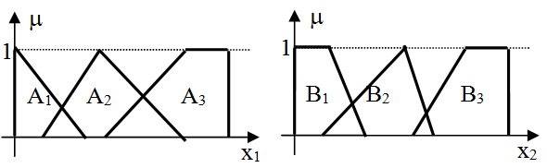
Takagi, Sugeno & Kang
Rules
IF x₁ is A₂ AND x₂ is B₃ THEN y = x₁ + x₂ + 1
IF x₁ is A₃ AND x₂ is B₃ THEN y = x₁ - x₂ + 1
Current input: x_{1M}=6 and x_{2M}=7
Notes:
, 1985Goal: Generation of fuzzy rules from a given input-output data set.
Main motivation
to reduce the number of rules required by the Mamdani model
For complex and high-dimensional problems
develop a systematic approach to generate fuzzy rules from a given input-output data set
TSK model replaces the fuzzy consequent,
(then part), of Mamdani rule with function (equation) of the input variables
If x is A and y is B then z = f(x,y)
Where A and B are fuzzy sets in the antecedent, and
Z = f(x,y) is a crisp function in the consequence, e.g f(x,y)=ax+by+c.
Usually f(x,y) is a polynomial in the input variables x and y, but it can be any function describe the output of the model within the fuzzy region specified by the antecedence of the rule.

Slide 44
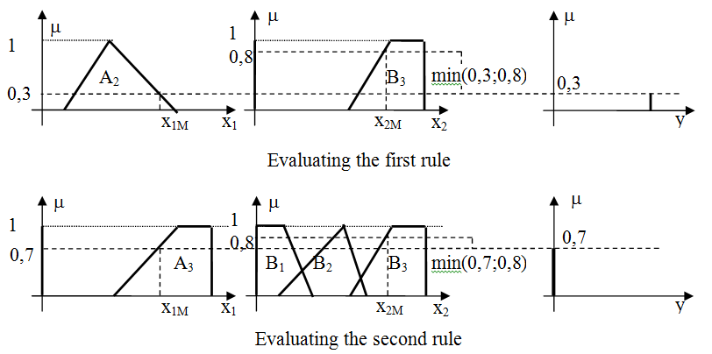
TSK fuzzy inference

Slide 45
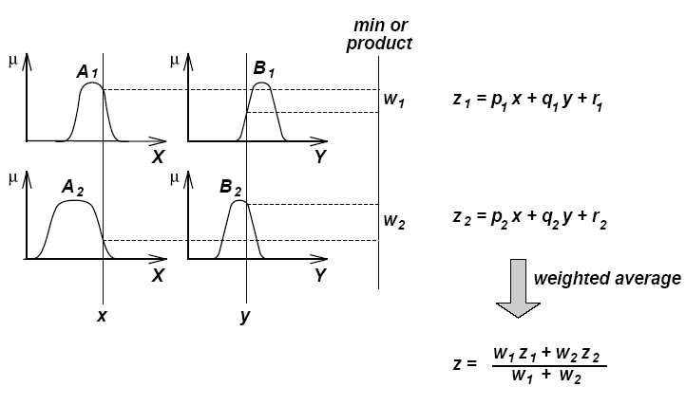
Inference in TSK systems
*Neuro-fuzzy and Soft Computing - J.Jang, C. Sun, and, E. Mizutani, Prentice Hall 1997

Slide 46
Tsukamoto Fuzzy Models
*Neuro-fuzzy and Soft Computing - J.Jang, C. Sun, and, E. Mizutani, Prentice Hall 1997
Notes:
The consequent of each fuzzy if-then rule is represented by a fuzzy set with monotonical MF. As a result, the inferred output of each rule is defined as a crisp value induced by the rules’ firing strength. The overall output is taken as the weighted average of each rule’s output.

Slide 47
Applications
Notes:
Fuzzy logic became very popular in the last decades finding applications in a wide range of fields, e.g. fuzzy control, road transport optimization, management decision support, quality assurance, cognitive maps, parameter prediction, student evaluation, machine learning, etc.

Slide 48
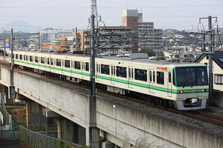
The first serious application - 1985
Sendai Subway 1000
Hitachi
Velocity control
http://en.wikipedia.org/wiki/Sendai_Subway_1000_series

Slide 49
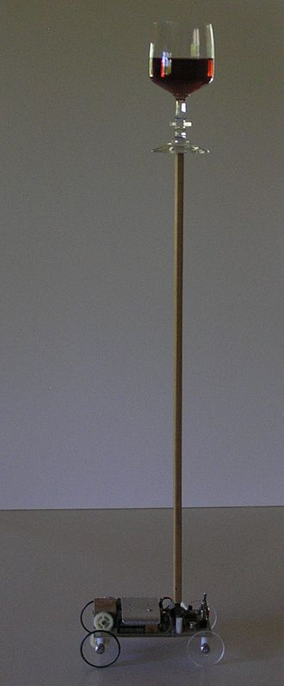
Inverted pendulum
http://en.wikipedia.org/wiki/Inverted_pendulum

Slide 50
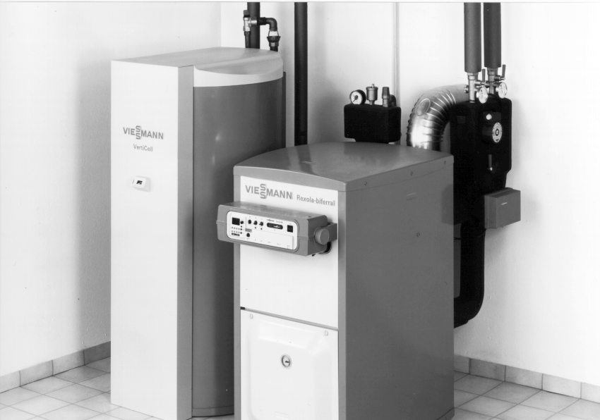
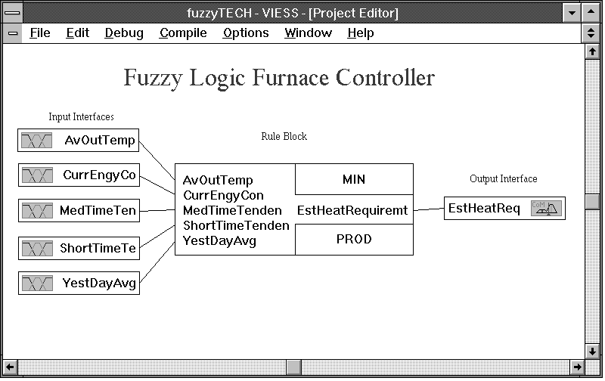
Adaptive heating system
Notes:
Current energy consumption, indicating current load. <
Medium term tendency (I), indicating heating-up and heating-down phases.
Short term tendency (II), indicating disturbances like door/window openings.
Yesterday average energy consumption, indicating the general situation and house heating level.

Slide 51
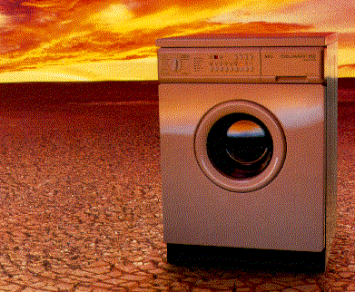
Environment friendly washing machine (AEG)
Notes:
Tachometer for the drum spin.
Analog pressure sensor for the water level.
Digital sensor to detect strong unevenness during spinning.
Digital sensor to detect excessive foam.

Slide 52
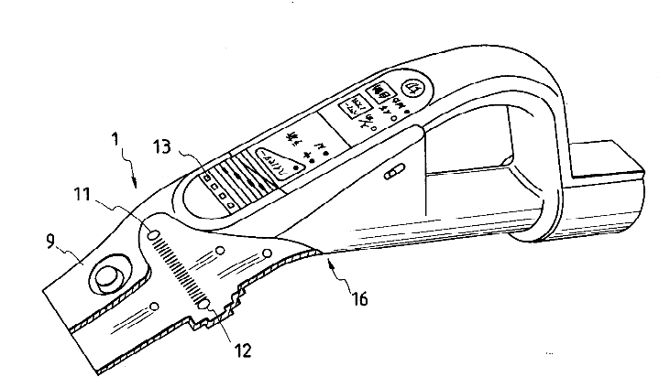
Vacuum cleaner
Matsushita patent US 5251358 A
http://www.google.com/patents/US5251358
http://www.google.com/patents/EP0451787B1?cl=en

Slide 53

Rice cooker
Sanyo
ECJ-5205SN

Slide 54
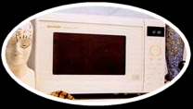
Mikrowave owen
Sharp

Slide 55
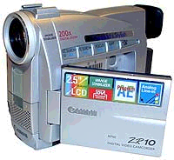
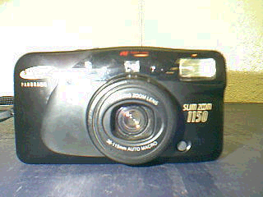
Kamera
Cannon
Képélesség beállítása
Samsung
Képélesség állítása

Slide 56
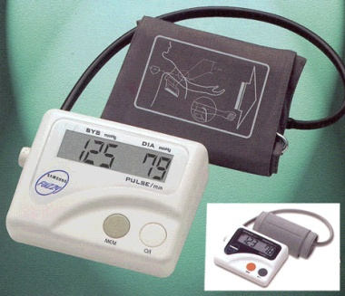
Vérnyomásmérő
Samsung
A vérnyomásmérési folyamat vezérlése

Slide 57
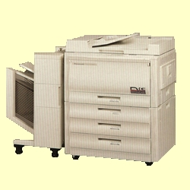
Copy machine
Canon
Toner usage
Panasonic

Slide 58

Break system
BMW
ABS

Slide 59
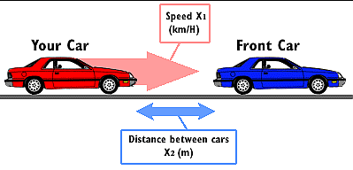
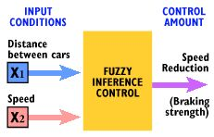
Fuzzy Control of Platoons of Smart Cars
Notes:
Platoons
= high speed groups of smart cars in single lanes.
The lead car plans the course of the platoon – picks the velocity, car spacing, maneuvers to perform
Increase the throughput of the highways
The fuzzy platoon controller (FPC) = distributed control system for future freeways that drive a car in or out of a platoon.
The FPC includes an integrated maneuver controller (IMC) for course selection and an individual vehicle controller (IVC) for throttle, brake and steering control.
Course selection in IMC involves merge, split, velocity change and lane change.
Fuzzy throttle controller for velocity and gap control.
The controller gets information from its own sensors, the car ahead, and from the platoon goals.

Slide 60
Rules
Rule 1: If the distance between two cars is short and the speed of your car is high(er than the other one’s), then brake hard.
Rule 2: If the distance between two cars is moderately long and the speed of your car is high(er than the other one’s), then brake moderately hard.

Slide 61
Fuzzy inference in sparse rule bases
Fuzzy Rule Interpolation

Slide 62
Introduction
Fuzzy rule based systems – humanly interpretable, self explanatory knowledge representation
Shortcoming – classical inference methods require a full coverage of the input space
Solution – approximate fuzzy inference – fuzzy rule interpolation based inference
Notes:
Fuzzy rule based systems became popular due to their self explanatory capability. An IF-THEN structure is easy to understand for everyone and the process called fuzzy inference is close to the human thinking.
A disadvantage of the classical compositional fuzzy reasoning techniques (e.g. Mamdani, Takagi-Sugeno) became their demand on a full coverage of the input space by rules. This requirement can be only fulfilled with a high number of rules, which number increases exponentially with the number of linguistic values per antecedent dimension and the number of dimensions, which could make difficult their application in real time or embedded systems (e.g. Lego robots [23]).
Besides, for several possible reasons (e.g. missing or insufficient expertise/available sample data or storage/computational complexity constraints) rule-base construction may produce sparse or incomplete rule bases. Such rule bases thus do not completely (or sufficiently) cover the range of possible input. In sparse or incomplete rule bases, classical fuzzy inference approaches do not always generate meaningful output because actual input is not guaranteed to fire any rule.

Slide 63
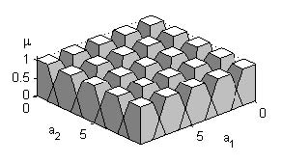
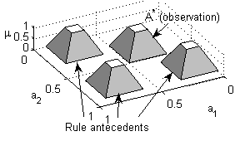
Dense and sparse rule base

Slide 64
Sparse rule base
Notes:
In the multidimensional case a rule base might as well be sparse even when its partitions does not contain „gaps” between their fuzzy sets (having a nonzero coverage on all the antecedent partitions). For example in case of a two dimensional input universe (A and B) and each dimension having three linguistic terms a dense rule base would contain nine rules. Easily can be specified three rules in such way that they involve all the six sets. The figure on this slide presents the case when the antecedent parts of the three rules are the set pairs A1B1, A2B2 and A3B3. Hereby there are no gaps in the two partitions, i.e. the input partitions are dense, and the rule base is still sparse. Considering e.g. the observation A*B* one can find no applicable rules.

Slide 65
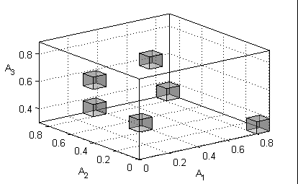
Fuzzy rule interpolation based inference methods
One-step FRI techniques
  KH, FIVE, IMUL, MACI, CRF, FRISUV, etc.
Two-step FRI techniques
  GM, IGRV, Chen&Ko, LESFRI, FRIPOC, VEIN, etc.
Notes:
The recognition of the problem of reasoning in sparse rule bases led in the early 1990s to the emergence of inference methods capable of dealing with sparse rule bases. These approximate reasoning techniques usually apply fuzzy rule interpolation (FRI) methods in order to calculate interpretable results even in regions of the antecedent space where the rule base does not contain any applicable rules.
The FRI methods form two main groups: the one-step and the two-step methods. The FRI techniques belonging to the first group calculate the conclusion directly from the observation and the known rules of the rule base. The most relevant representatives of this group are the linear interpolation that is also called KH method after its developers (Kóczy and Hirota) and which also proved to be an universal function approximator, the vague environment based reasoning FIVE developed by Kovács, the modified α-cut based interpolation (MACI) published by Tikk and Baranyi that avoids the abnormal conclusion by applying a coordinate transformation, the CRF (Kóczy, Hirota, and Gedeon) whose key idea is the conservation of the relative fuzziness, the IMUL method suggested by Wong, Tikk, Gedeon and Kóczy that combines the advantages of the MACI and CRM approaches, and FRISUV which applies the concept of fuzzy subsethood values.
The members of the second group determine the conclusion in two steps by first interpolating a new rule in the position corresponding to the observation and next, they infer the result using only the observation and the new rule applying a single rule reasoning technique. These methods follow the concept of the Generalized Methodology of fuzzy rule interpolation (GM) developed by Baranyi, Kóczy and Gedeon. Relevant members of this group are the LESFRI that applies the method of least squares for the calculation of the membership functions, the IGRV developed by Huang and Shen, the transformation based technique published by Chen and Ko as well as the polar cut based FRIPOC suggested by Johanyák and Kovács , VEIN.
Some of the methods enliosted on the slide are emphasized in bold. These are the methods I am going to present in the next part of the presentation.

Slide 66
One-step Fuzzy Rule Interpolation
FRISUV
Notes:
As an example for the one-step methods I am going to present the method called FRISUV. The main goal during its development was to create a fast technique with low computational complexity and applicability in case of all the valid (convex and normal) fuzzy (CNF) sets to make possible the application of FRI methods in real-time or embedded systems. It extends the concept of the fuzzy subsethood values and applies it in conjunction with a relative distance aiming the measurement of the similarity between rule antecedents and observations. Later the conclusion is calculated based on this similarity.

Slide 67
Reference point
Notes:
Let us start with the concept of reference point and similarity. The reference point of a fuzzy set ( RP(.) ) is that point of the universe of discourse, which is most characteristic to the set. Generally it is used for the definition of the set’s position and for the determination of the distance between the fuzzy sets. Most often applied choices for its selection are the centre of the core (RP_{CC}), the centre of the support (RP_{SC}) [3], the centre of gravity (RP_{GC}) [6] and the unweighted or weighted average of the abscissas of the characteristic (break) points of the shape (RP_{UAV}, RP_{WAV}) [6]. Fig. 4 presents the listed reference point types in case of a trapezoid shaped fuzzy set. Further on we will use the centre of the core (RP_{CC}) as reference point of the fuzzy sets. [A]¹ is the α-cut of the fuzzy set A at the level of α=1. The reference point of a relation is that point of the multidimensional universe of discourse which is defined by the reference points of the component fuzzy sets.

Slide 68
Similarity
Components:
Shape similarity
Relative distance
Notes:
In interpolative fuzzy inference the similarity between the current fuzzy input and the antecedents of the known rules plays a determinant role in course of the calculation of the conclusion. Suppose the rules being of form IF-THEN where x_{i} is the linguistic variable in the ith i∈[1,n] antecedent dimension, A_{i1} (A_{i1}∈X_{i}) is a linguistic value in the same dimension, X_{i} is the universe of discourse of the ith i∈[1,n] antecedent dimension, and y is the linguistic variable in the consequent dimension. The antecedent parts of the rules can be viewed as multidimensional fuzzy sets or n-ary fuzzy relations of form.
The similarity between the n-dimensional observation represented by the n-ary relation and the rule antecedent represented by the n-ary relation depends on two components, i.e. the shape similarity and the distance between the reference points of the relations.

Slide 69
Shape similarity measures
α-cut based techniques that are based on the differences between the endpoints of the sets’ α-cuts
Polar-cut based techniques that apply a polar coordinate system in the reference point of the sets and measure polar distances
Fixed point based techniques that compare the membership values at the same point
The vague environment based techniques
Notes:
The shape similarity measures the closeness of the shapes of two fuzzy sets that share the same reference point. There are several solutions in the literature for this task. They can be grouped in four main categories.

Slide 70
Similarity measure based on the fuzzy subsethood values
Notes:
FRISUV follows the third approach using a similarity measure based on the fuzzy subsethood values [17]. The fuzzy subsethood value represents the degree to which a fuzzy set is a subset of another fuzzy set. For example in case of two discrete fuzzy sets A and B belonging to the universe X the fuzzy subsethood value of A to B is (7) where ∩ is an arbitrary t-norm. The value of FSV(.)∈[0,1], the highest possible value corresponds to the case of two identical fuzzy sets. In order to apply FSV to the measurement of the similarity between fuzzy relations having an identical reference point we extend it to the multidimensional case. Thus the fuzzy subsethood value of the n-ary relation to the n-ary relation will be (8)
where ∩ is the intersection between two relations, which is calculated by (9) where t is an arbitrary t-norm.
In order to keep low the computational complexity of the similarity measurement we introduce a simplified measure of the fuzzy subsethood value (SFSV) of two fuzzy relations. SFSV works with the projections of the relations in each dimension (10)
where P_{i}(.) is the projection of the relation to the dimension i, i.e. the component fuzzy set of the relation in ith dimension. The value of SFSV(.)∈[0,1], the highest possible value corresponds to the case of two identical fuzzy relations.

Slide 71
Relative distance
Notes:
The second component of the proposed similarity measure aiming the comparison of the observation and the rule antecedents is their relative distance. One calculates first the
Euclidean distance between the reference points of the corresponding fuzzy relations by
(11)
where RP_{i}(.) is the reference point of the relation in the ith dimension. Next, we determine the relative distance by dividing d(.) with the maximum possible distance, i.e. the distance between the point defined by the lower endpoints of the input ranges and the point defined by the upper endpoints of the input ranges
(12)
Thus the relative distance will be
(13)
The value of d_{rel}(.)∈[0,1], the highest possible value corresponds to the maximum possible distance.

Slide 72
Similarity and dissimilarity
Notes:
Using the above mentioned two components the similarity of the relation describing the observation to the relation describing a rule antecedent will be (14) supposing that both components have the same importance. Likewise, we can define the dissimilarity of two fuzzy relations as
(15).

Slide 73
Position of the conclusion
Extension of the Shepard interpolation
Notes:
The key idea of the method is that the reference point of the conclusion should be calculated from the position of the known rules’ conclusion sets using the similarity between the current observation and the rule antecedents. The functional relationship is an extension of the well known Shepard crisp interpolation [18] which interpolates by calculating the weighted average of the known points’ ordinates. Using this concept the reference point of the interpolated conclusion B* will be.
Supposing that the shapes of the consequent partitions’ linguistic terms are identical and the sets differ only in their position the shape of the interpolated conclusion also has to adhere to this regularity. Thus its form will be identical with the shapes of the known sets.

Slide 74
Numerical example

Slide 75
Characteristics
Applicable in case of any valid set shape type
Restriction: the linguistic terms of the consequent partition should have identical shapes
Results always a valid fuzzy set as conclusion
Ensures compatibility with the rule base
Most of the required calculations easily can be vectorized

Slide 76
Fuzzy rule interpolation based inference methods
One-step FRI techniques
  KH, FIVE, IMUL, MACI, CRF, FRISUV, etc.
Two-step FRI techniques
  GM, IGRV, Chen&Ko, LESFRI, FRIPOC, VEIN, etc.
Notes:
Next, I am going to present two methods that belong to the group of two-step FRI methods. Firsrt I will present some general properties that are common for all of them followed by the presentation of the individual techniques.

Slide 77
Two-step Fuzzy Rule Interpolation
LESFRI-FRIPOC

Slide 78
Two-step FRI methods
Reference point (RP) – e.g. centre of the core, centre of the support, centre of gravity, etc.
d(A₁, A₂)=|RP(A₁)-RP(A₂)|
Interpolation of an intermediate rule (A^{i}→B^{i})
  A^{i} set interpolation
  Interpolation of RP(B^{i})
  B^{i} set interpolation
Single rule reasoning
Notes:
The two-step FRI methods essentially follow the concepts of the generalized methodology of fuzzy rule interpolation (GM) introduced by Baranyi et al. The position of the fuzzy sets is characterized by a reference point (see next slide) during the calculations. The method consist of two steps.
First a new intermediate rule is interpolated, of which antecedent part contains fuzzy sets whose position is identical with the position of the sets describing the observation in each dimension. This task is done in three phases. First the antecedent part of the new rule is determined through a set interpolation method. Next the position of the fuzzy sets belonging to the consequent part of the new rule is calculated. Thirdly the shape of the consequent sets is determined using the same technique as in the case of the antecedent sets. The conclusion is determined in the second step by firing the interpolated rule. A special single rule reasoning technique is used for this task.

Slide 79
Options for the reference point and the related set distances
μ
d_{cc}(A₁,A₂)
RP_{cc}(A₁)
RP_{cc}(A₂)
1
A₁
A₂
RP_{gc}(A₁)
RP_{gc}(A₂)
d_{gc}(A₁,A₂)
x
RP_{ccp}(A₁)
RP_{sc}(A₁)
RP_{sc}(A₂)
RP_{ccp}(A₂)
d_{sc}(A₁,A₂)
d_{ccp}(A₁,A₂)
Notes:
For example the centre of the core, the centre of gravity, the centre of the support or the projection of the centre of the core to the horizontal axis can play this role. In the case of the polar cut based set interpolation and single rule reasoning methods the latter choice offers the most advantages. Besides its information content about the middle one from the most relevant (having the maximal membership value) elements of the set it also reduces the need for calculations. Further on this type of reference point is used during the calculations. The distance of the fuzzy sets is measured by the horizontal distance between the reference points of the sets.

Slide 80
Linguistic term shifting
Notes:
The two-step methods being presented follow the concept of linguistic term shifting.

Slide 81
Fuzzy Set Interpolation Techniques
FEAT-P
FEAT-LS
Notes:
Next I will present two possible solutions for the task of the creation of the antecedent and consequent part of the new (interpolated) rule. They are so called fuzzy set interpolation methods and aim the generation of a new fuzzy set in the interpolation point.

Slide 82
FEAT-p
Fuzzy sEt InterpolAtion Technique
Assumption: a better set approximation can be attained by taking into consideration all the sets of the partition
All sets shifted virtually horizontally -> coincidence of their reference points and the reference point of the observation in the actual dimension
Shape determination
Notes:
The task of the fuzzy set interpolation is to determine the antecedent and consequent sets that belong to the new rule. The method is the same in the case of each linguistic term regardless of it belongs to an antecedent or consequent universe of discourse.
The calculations are done separately for each input and output dimension. The starting point is a fuzzy partition with the reference points of the sets determined in advance and the reference point of the observation (conclusion) in the actual dimension/partition. All the sets in the partition belong to the antecedent (consequent) part of one or more rules.
The reference point of the new set is identical with the reference point of the observation (conclusion) in the current dimension. The method goes out from the assumption that a better set approximation can be attained by taking into consideration not only the two sets flanking the observation/conclusion but all the available linguistic terms in the partition. Besides this approach makes possible the technique FEAT-p to be applied for extrapolation, too. First all sets are shifted virtually horizontally in order to reach the coincidence of their reference points with the position of the interpolation. The term virtual expresses that the linguistic terms do not change their position permanently. Their shifted version is used only for the calculation of the interpolated set. Next the shape of the new set is determined from the collection of the overlapped sets.

Slide 83
Polar cut - {ρ, θ}
Notes:
The concept of the polar cut is strong related to the application of a polar co-ordinate system whose origin coincides with the reference point of the observation (conclusion). A polar cut is defined by a value pair {rho, θ} that determines a point on the shape of the linguistic term. The value rho denotes the polar distance at the angle theta. The authors are going out from the assumption that an extension and a resolution principle of the fuzzy sets can be defined for polar cuts, too. This extension principle states that the solution of a problem for fuzzy sets can be found in the form of solving it first for its polar cuts and then extending the solution to the fuzzy case. The resolution principle states in this case that a fuzzy set can be decomposed into polar cuts.

Slide 84
Shape determination using polar cuts in the j^{th} dimension
μ
ρ{A_{j2θ}}
ρ{A^{i}_{jθ}}
ρ{A_{j1θ}}
θ
μ
A_{j1θ}, A_{j2θ} original sets of the partition
A^{i}_{jθ} interpolated set
Notes:
The shape calculation technique FEAT-p is based on the extension and resolution principle.
The interpolated set is determined by its polar cuts, whose polar distances are calculated as weighted averages of the polar distances of the shifted sets for the same theta angle using the formula presented on the next slide.

Slide 85
A^{i}_{j} - the interpolated set in the j^{th} dimension
θ – polar level
w_{jk} - wheighting factor of the k^{th} set in the j^{th}
dimension
Notes:
where rho denotes the length of a polar cut, j is the current antecedent (consequent) dimension, theta is the angle of the actual cut, n_{j} is the number of the sets in the partition, A_{jk\theta} is the polar cut of the k^{th} set, w_{jk} is the weighting factor of the k^{th} set, A^{i}_{j\theta} is the interpolated polar cut and the superscript i denotes that the set is an interpolated one. The collection of the angles, the so called polar levels, for which the calculations are done, should be set-up in such mode to include the values 0, pi/2 and pi.
The formula separates the case when the position of the interpolation coincides with the current set of the partition (d(A^{*}_{j},A_{jk})=0. Its reason is that the weighting factor contains the distance in the denominator. Thus if the reference point of the observation (conclusion) is the same as one of the original sets of the partition the interpolated set will be the same as that linguistic term. This feature ensures the fulfilment of the condition on the compatibility with the rule base, for the rule interpolation method based on the method FEAT-p.

Slide 86
Weighting factors
(1)
(2)
(3)
Notes:
It seems to be natural that the sets whose original position were in the neighbourhood of the reference point of the observation to exercise higher influence as those ones situated in farther regions of the partition. Therefore the weighting factor should be dependent on distance.
The simplest weighting factor is the reciprocal value of the distance, but there are several recommendations in the literature for more or less analogue cases. Three of them are presented on this slide.
The selection of the wheighting factor gives a free parameter, a tuning possibility to the method.

Slide 87
FEAT-p characteristics
Advantages
  Applicable in case of any valid set shape
  Even in case of different shape types
  Interpolation & Extrapolation
Disadvantages
  Does not preserve the piece-wise linear membership function

Slide 88
FEAT-LS
Optimal solution if the partition is uniform shaped
Takes into consideration all the sets of the partition
The ordinate values of the characteristic points predetermined by the characteristic shape of the partition
Abscissas calculated by the method of weighted least squares
Notes:
Fuzzy Set Interpolation (FSI) aims the determination of a new linguistic term in a given point of a fuzzy partition called interpolation point. This means that the new fuzzy set is generated in such way that its reference point coincides with the interpolation point. In case of two-step FRI methods an FSI technique is used for the calculation of the antecedent and consequent sets of the new rule. Thus the interpolation point is either the reference point of the observation or the reference point of the consequence in the current dimension. An FSI technique works only with one partition. Therefore the calculations in the different dimensions in both the antecedent and consequent cases can be done separately.
The Fuzzy sEt interpolAtion Technique based on the method of weighted Least Squares (FEAT-LS) was developed especially for the case when all sets of a partition belong to the same shape type and the characteristic (break) points of the membership function are also situated at the same alpha-level. In such cases it seems to be a natural condition on the new linguistic term created in the interpolation point to suit this regularity as well.

Slide 89
FEAT-LS
1
μ
1
μ
0.8
0.8
0.6
0.6
A
A
A
A
0.4
1
2
3
4
0.4
0.2
0.2
0
0
x
0
0.5
1
1.5
2
x
0.8
1
1.2
Notes:
The abscissas of the characterisic points are determined from the corresponding points of the overlapped sets applying the method of weighted least squares in light of the requirement that the resulting set should be a valid one and should fit the typical shape type of the partition. The weighting also here expresses that the neighbouring sets should have a higher influence by the calculations.

Slide 90
Weighting factors
(1)
(2)
(3)
Notes:
It seems to be natural that the sets whose original position were in the neighbourhood of the reference point of the observation to exercise higher influence as those ones situated in farther regions of the partition. Therefore the weighting factor should be dependent on distance.
The simplest weighting factor is the reciprocal value of the distance, but there are several recommendations in the literature for more or less analogue cases. Three of them are presented on this slide.
The selection of the wheighting factor gives a free parameter, a tuning possibility to the method.

Slide 91
FEAT-LS characteristics
Advantages
  Low computational complexity
  Conserving the characteristic shape type of the partition
  Interpretable results even in case of different shape types
  Interpolation & Extrapolation
Disadvantage
  The height of each fuzzy set must be the same

Slide 92
The position of the consequent sets
Hypersurface representing the rules
Notes:
The second stage of the first step of the method FRIPOC/LESFRI is the determination of the position of the fuzzy sets belonging to the consequent part of the new rule. They are calculated independently in each output dimension. The task can be defined as a problem of finding a point on a hyper-surface defined by the reference points of the antecedent sets (sets belonging to the antecedent parts of the existing rules) and the consequent sets in the current output dimension. Due to the sparse character of the rule base an n_{a} dimensional interpolation has to be done for irregularly spaced data, where n_{a} is the number of the input dimensions. It can be expressed in general by the formula presented on the next slide.

Slide 93
The position of the consequent sets in the l^{th} output dimension
Notes:
Where RP( B^{i}_{l}) is the reference point of the interpolated consequent set in the l^{th} output dimension and RP( A^{i}_{j}) is the reference point of the interpolated antecedent set in the j^{th} input dimension. The function should pass through the known points of the hyper-surface.
There are several applicable linear or non-linear functions that take into consideration either only the points (rules) situated in the closest neighbourhood of the interpolation or all the known points. We suggest the use of an interpolation function that is an extension and adaptation of the Shepard interpolator for the case of arbitrary number of antecedent dimensions.
The antecedent part of each rule can be thought of as a point in the antecedent hyper-space. Its co-ordinates are given by the reference points of the sets belonging to it. The point corresponding to the antecedent of the interpolated rule is at the same time also the representing point of the observation. Further on the Euclidean distance between these points is used as the measure of the closeness of the antecedents and by this means also the closeness of the rules. The proposed interpolation function determines the reference point of the conclusion as a weighted average of the reference points of the consequent sets of the known rules in the current output dimension.
Shepard suggested for the 2D case the use of maximum 10 closest points in order to reduce the computational needs. However, when the number of the dimensions is much more than two and the rule base is sparse it seems to be easier to take into consideration all the rules than to seek those ones that are in a special proximity of the observation.

Slide 94
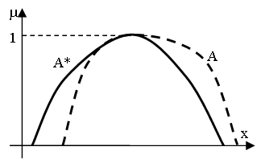
Single Rule reasoning
The observation (A*) overlaps only partly the antecedent set of the conclusion
Generalized Modus Ponens
Observation: x is A*
Rule: IF x is A THEN y is B
Conclusion: y is B*
Notes:
In the second step of the inference the conclusion is generated by firing the new rule. The reference point of the interpolated conclusion in the current dimension will be the same as the reference point of the consequent set of the new rule in the current dimension. Usually the antecedent part of the rule does not fit perfectly the observation. Therefore a special single rule reasoning technique is needed. There are several methods for this task in the literature, but their common drawback is that their applicability is restricted to some regular cases.
A fuzzy logikán alapuló rendszerek működése során gyakran előfordul, hogy a következtetési folyamat bemeneteként jelentkező megfigyelés (A*) csak részben fedi le egy vagy több szabály antecedens részét (A). Egydimenziós antecedens alaphalmaz esetén az 1. ábra segítségével szemléltethetjük a helyzetet. Ilyenkor a következmény előállítása az általánosított modus ponens (1) alkalmazásával történik.
Megfigyelés: x értéke A*
Szabály: ha x értéke A akkor y értéke B (1)
Következmény: y értéke B*
ahol x és y a bemeneti és kimeneti nyelvi változók, A és B az antecedens és a konzekvens alaphalmazbeli nyelvi értékek, A* a megfigyelés és B* az előállított következmény. A Zadeh féle kompozíciós következtetéstől a különböző revíziós elvekig számos megoldás született az általánosított modus ponens gyakorlati megvalósítására. A továbbiakban áttekintünk és összehasonlítunk néhányat ezek közül. A szemléletesség érdekében az eljárások ismertetése során egydimenziós antecedens és konzekvens alaphalmazokat feltételezünk, de megemlítjük a többdimenziós alkalmazhatóságot ott, ahol ez lehetséges.

Slide 95
Single rule reasoning based on polar cuts – SURE-p
μ
θ
x
Notes:
The technique SURE-p (Single rUle REasoning based on polar cuts) being presented alleviates this problem. In addition its advantage is its applicability in multi-dimensional cases. SURE-p is based on the concept of polar cut. Although it determines the conclusion sets in each consequent dimension independently, there are some common calculations that have to be done only once at the beginning. Thus for each polar cut firstly the difference between the polar distance of the antecedent set and the polar distance of the observation in each dimension is calculated, and the result is divided by the range of the linguistic variable.
where r_{j theta} is the relative difference at the \theta level in the j^{th} antecedent dimension, rho( A^{i}_{j theta}) the polar distance of the antecedent set, rho( A^{*}_{j}) is the polar distance of the observation and $range_{aj}$ is the range of the antecedent linguistic variable in the j^{th} dimension. Next an average relative difference is calculated taking into consideration therelative differences in all antecedent dimensions.
where \overline{r}_{theta} is the average relative difference at the theta level, n_{a} is the number of the antecedent dimensions.

Slide 96
The shape of the consequent set
Conservation of the average relative differences
Maximizing the height of the set to 1:
Notes:
In each consequent dimension the corresponding polar cut is calculated supposing that the relative difference at theta level between the polar distances of the rule consequent and the conclusion is equal to overline{r}_{theta}.
where rho( B^{i}_{l theta}) the polar distance of the interpolated consequent set, rho( B^{*}_{l theta}) is the polar distance of the conclusion, range_{cl} is the range of the consequent linguistic variable in the l^{th} output dimension and theta is the polar angle. Due to the nature of the fuzzy sets the resulting height of the conclusion has to be maximized to 1. Thus arises the second formula.

Slide 97
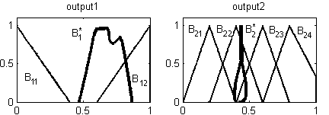
Abnormal conclusions obtained by the formula
Conditions on avoiding abnormal conclusions
the horizontal distance to the centre of the polar co-ordinate system of each point is not smaller than the same distance calculated for the previous point
the vertical distance to the centre of the polar co-ordinate system of each point is not greater than the same distance calculated for the previous point
Notes:
Due to the revision of the interpolated consequent sets based on the average relative antecedent difference the formula presented on the previous slide can easily lead to a non-convex fuzzy set. As an example the figure on this slide presents the consequent partitions of a system with two output dimensions (output1 and output2). The interpolated conclusion sets (B^{*}_{1} and B^{*}_{2}) are drawn with bold lines.
In order to alleviate the problem the calculations should start at polar level pi/2 in top-down direction, they should be done separately for the right and left flanks of the linguistic terms as well a control and correction algorithm should be included. Further on the basic ideas and the steps that have to be done are presented only for the case of the right flank of the set. The calculation of the left flank is similar.
The convexity requirement is satisfied if and only if the horizontal distance to the centre of the polar co-ordinate system of each point is not smaller than the same distance calculated for the previous point and if the vertical distance to the centre of the polar co-ordinate system of each point is not greater than the same distance calculated for the previous point. This condition can be expressed by the formula presented on this slide.

Slide 98


Conditions on avoiding abnormal conclusion
μ
ρ(B^{*C}_{lθ(k-1)})
ρ(B*_{lθ(k)})
θ(k-1)
θ(k)
x
ρ(B^{*C}_{lθ(k)}).cos(θ(k-1))
ρ(B*_{lθ(k)}).cos(θ(k))

Slide 99
The corrected polar distance
Notes:
The formula presented on this slide corrects the shape if the convexity conditions are not fulfilled.
Where theta is an array containing the polar angles necessary for the calculation of the right flank from pi/2 to 0 in descending order, rho( B^{*}_{l theta(k)}) is the polar distance calculated by the previous formula and rho( B^{*c}_{l theta(k)}) is the corrected polar distance.

Slide 100
FRIPOC applied with p=0.001 to a system with 2 input and 1 output dimension and 2 rules
Notes:
In_2D_Out_1D_S_03
Obs_2D_Trap_03
In the followings the sensitivity of the method FRIPOC to the value of its parameter p will be studied through some numerical examples.
The figure presents a fuzzy system having two antecedent (input1 and input2) dimensions and one consequent dimension (output1). There are triangular, trapezoidal and rectangular (crisp) set shapes and four of the sets are subnormal. For the sake of simplicity each original antecedent partition contains only two sets that are surrounding the observation drawn by bold line. Based on the same consideration the original consequent partition also contains two fuzzy sets. The rule base consist of two rules.
The observation is trapezoid shaped in both antecedent dimensions (A^{*}_{1} and $A^{*}_{2}). The third axes (frame) contains the final interpolated conclusion marked by bold line and obtained for the value p=0.001.

Slide 101
Conclusions obtained for p=1, p=2 and p=3
Notes:
The figure contains three further results obtained for the values 1, 2 and 3 of the parameter p. One can clearly observe that increasing the value of p the second rule (R_{2}), which is visibly the nearest one to the observation keeps getting more dominant and the corrected interpolated conclusion (B^{*c}_{1}) becomes more and more similar to the set B_{12}.

Slide 102
SURE-p characteristics
Advantages
  Applicable in case of each valid membership function
  Subnormal sets also can be handled
Disadvantage
  Does not conserve the characteristic shape type of the partition

Slide 103
SURE-LS₁
Observation+New Rule->Conclusion
Modification of the shape of the rule consequents
Set of α-levels
Left and right flanks separately
Notes:
The revision method SURE-LS (Single rUle REasoning based on the method of Least Squares) was developed for the case when all linguistic terms of a consequent partition belong to the same shape type (e.g. singleton, triangle, trapezoid, etc.) and all characteristic (break) points are situated at the same alpha-levels. It also means that the height of all sets is the same. Thus the method seeks a special shape form with predetermined ordinate values of the characteristic points. Therefore only the abscissas of the characteristic points have to be calculated.
SURE-LS applies an alpha-cut based approach for this task. It uses a set of alpha-levels compiled together by taking into consideration the break-point levels of all antecedent dimensions and the current consequent partition. The calculations are done separately for the left and right flanks. On each side for each level it calculates the weighted average of the distances between the endpoints of the a-cuts of the rule antecedent and the observation set. The weighting makes possible to take into consideration the different antecedent dimensions (input state variables) with different influence.

Slide 104
SURE-LS
Set of α-levels
Differences measured on the antecedent side
Notes:
Az antecedens oldalon α-vágatonként mért eltérések súlyozott átlaga határozza meg a konzekvens módosítását

Slide 105
SURE-LS₂
Conservation of the weighted average difference
Conditions on the result:
  Valid set shape
  The shape should adhere
  to the characteristic set
  shape of the partition
μ
h
α_{i}
x
Notes:
The basic idea of the method is the conservation of the weighted average differences measured on the antecedent side. Applying these modifications on the consequent side usually results in a set of characteristic points that do not fit the default set shape type of the partition. Therefore the method of Least Squares is used in order to find the break-points of an acceptable conclusion.

Slide 106
SURE-LS characteristics
Advantage
  Preserves the characteristic shape type of the consequent partition
Disadvatage
  The height of all sets must be the same

Slide 107
FRI Software
FRI Matlab Toolbox

Slide 108
FRI Matlab Toolbox
Extension of the standard Fuzzy Logic Toolbox
Supported FRI methods:
  KH, the stabilized version of the KH, MACI, IMUL, CRF, FIVE, VKK, GM with SCM, FERI, and FPL, and GM with FEAT-p, FERI, and FPL or FEFRI, LESFRI, FRIPOC, VEIN, FRISUV
Matlab 7
http://fri.gamf.hu
Notes:
We have developed a Matlab toolbox that implements several FRI methods. It is freely available under the GPL license. Our aim was to facilitate the practical application as well as the comparison of the implemented methods. We choose Matlab because it ensured an easy-to-learn and program framework.

Slide 109
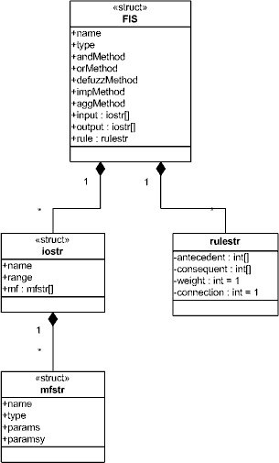
FIS data structure
Subnormal sets are enabled
Comparision possibility
Description of the membership functions
  MF1=’mf1’:’trimf’,[0.4 0.6 0.8]![0 0.8 0]
Notes:
Owing to the dynamically extendable structure based fuzzy system data storage concept which originates from the Matlab’s commercial fuzzy logic toolbox the development of the system was fast and it proved to be an excellent framework to evaluate and try new concepts. The figure in this slide represents the structure that describes the fuzzy system.

Slide 110
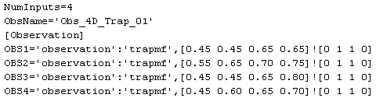

Observation
Naming convention
Obs_4D_Trap_01.obs
The structure describing the observation
Notes:
Data file describing the observation. The figure in this slide represents the structure that describes the observation. The toolbox can accept multidimensional fuzzy as well as crisp input values. In the later case they are undegoing a fuzzyfication process for example in case of the FRIT program.

Slide 111

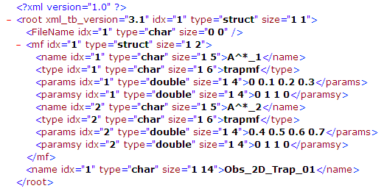
Data Structures for the Fuzzy System and the Observation
Notes:
Besides the traditional plain text file based fuzzy system and observation representation/storage we also developed an XML based one which makes easier the data exchange and processing.
The XML example presented on this slide presents a two dimensional observation.

Slide 112
Properties
Not required
Number of the α-levels can be set by the user
Type of the reference point can be set by the user
Multidimensional distances in the Minkowski sense
Notes:
In case of some (earlier) FRI methods there was a constraint that the inference was possible only if there were at least two neighbouring rules that surround the observation. Most of the implemented methods are extrapolation capable too, therefore the fulfilment of this demand is not needed any more.

Slide 113
Usage of the software
Programmatically – API from Matlab
TestIT
FRIT
Notes:
The toolbox can be used either by calling its functions (API) or by using the two GUI programs

Slide 114
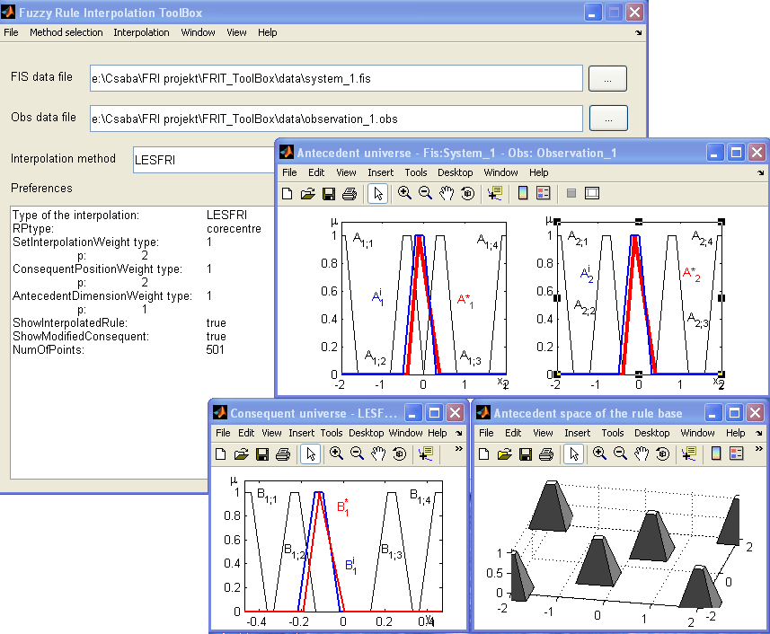
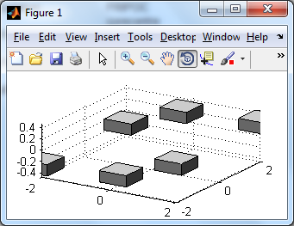
FRIT

Slide 115
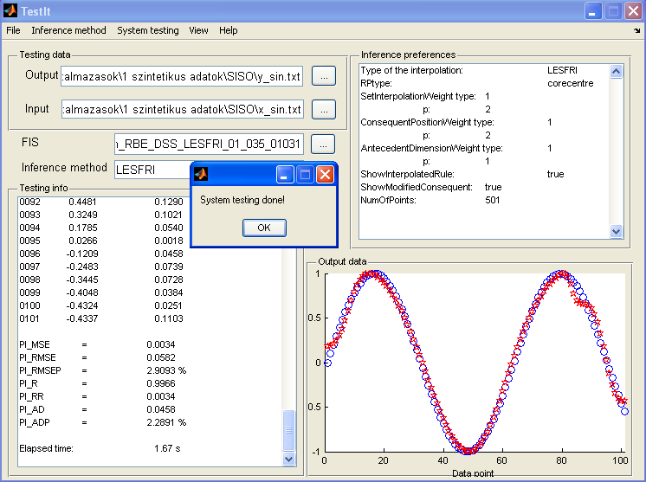
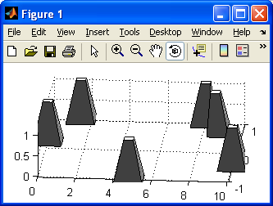
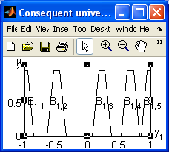
TestIt

Slide 116
Rule base generation

Slide 117
Fuzzy Rule Base Generation
Initial rule base
  Employing human experts,
  Fuzzy clustering, Grid partitioning,
  Finding the extreme values of the modeled functional relation
  Random rules
  etc
Parameter tuning
  Global search
  Local search
  Hybrid
Notes:
The performance of a fuzzy inference based system is determined in a significant measure by its rule base. The rule base can be compiled manually based entirely on human knowledge and expertise (based on Zadeh’s initial linguistic variable concept) and/or using methods and software that allow the automatic rule extraction and parameter tuning using machine learning approaches. The second part of the lecture presents some rule base generation and optimization methods that are implemented in the SFMI Matlab ToolBox (developed by the lecturer) and mostly aim the creation of a sparse rule base.
Fuzzy model identification aims the determination of the quasi-optimal rules. Usually the rule base generation breaks down into two steps. First, an initial rule base is generated and next, the quasi-optimal values of the parameters are determined through a process called parameter tuning.
There are several different approaches supporting the first step, e.g. employing human experts, fuzzy clustering, grid partitioning, or finding the extreme values of the modeled functional relation. The second step applies a global, a local or a hybrid search technique.
Evolúciós (GA, AIS, MA, PSO, stb.)
Egyéb lépegetős.

Slide 118
Automatic Sparse Fuzzy Model Identification
Training data set
Tuning → minimizing the difference between the training output and the system output
Approaches
  Eliminating the non-relevant rules
  (dense r.b. → sparse r.b.)
  Create a sparse rule base directly
Notes:
Further on I will concentrate on the automatic creation of sparse rule bases from sample data.
In case of automatic fuzzy model identification one possesses a training data set that describes the expected behavior of the system in several points, i.e. contains a list of mating input-output values. The model identification algorithm seeks for those values of the system parameters for which the difference between the output values of the training data set and the output provided by the current fuzzy system in case of the same input is small. In most of the cases especially when the training data set contains a large amount of data an exact match cannot be reached. Therefore the fuzzy system gives only a more or less good approximation of the modeled input-output relation described by the sample data.
Usually the approximation can be improved by increasing the number of linguistic terms and rules. The situation is similar to the neural networks based modeling. Sparse fuzzy systems with low complexity can be obtained following two different approaches. The first one starts with a dense rule base ( in (1)) [21], i.e. as step 0 a covering rule base should be generated and then the rules considered as non relevant ones are eliminated. The methods proposed by Botzheim, Cabrita, Kóczy and Ruano [3], Botzheim, Hámori and Kóczy [4], as well as by Kóczy, Botzheim and Gedeon [19] follow this way.
The second approach tries to create a sparse rule base directly from the available data.

Slide 119
Create the Initial Sparse Rule Base Directly
Identify the so called optimal fuzzy rules (Kosko and Dickerson, Kosko)
Methods based on fuzzy clustering(e.g. Chong; Klawonn and Kruse; Sugeno and Yakusawa; Tikk, Gedeon, Kóczy and Bíró; Wong, Kóczy, Gedeon, Chong and Tikk; Johanyák)
Methods following the concept of rule base extension (e.g. Johanyák and Kovács)
Methods based on evolutionary algorithms
Notes:
The current version of the SFMI Matlab ToolBox contains the implementation of the clustering based ACP method [13] and the implementation of the techniques RBE-DSS and RBE-SI [15] that follow the concept of rule base extension + clonal selection. All methods consist of two steps. First a raw (starting) fuzzy system is generated followed by an iterative parameter identification process (second step).

Slide 120
Initial Rule Base

Slide 121
Creation of the initial rule base
Generation
Initial rule base
Fuzzy clustering
2 rules
2^{n}+2 rules
Grid partition
Notes:
Further on I will present four initial rule base generation methods that are implemented in the SFMI toolbox

Slide 122
Fuzzy Clustering Based Initial Rule Base
Automatic fuzzy system generation based on fuzzy clustering and projection (ACP)
Notes:
It starts with a one dimensional clustering of the sample output data. The membership functions created from the clusters are trapezoidal and their parameters are determined by a horizontal cut of the clusters at a predefined α-level. The α-cut endpoints define the core of the fuzzy sets; while the support is determined by the Ruspini character of the partition (see Figure 2).
Next, for each fuzzy set one selects the corresponding data rows from the sample data which is followed by a one dimensional fuzzy c-mean clustering of the selected data in each antecedent dimension. This step is also called projection into the antecedent space.
In each antecedent dimension the obtained cluster centers are collected into a single group and are examined against some cluster mergeability conditions. The final fuzzy sets are generated from the remaining clusters using the same horizontal cut based technique as in the case of the consequent partition.
Having the antecedent and consequent partitions generated the rules are created based on the sample data rows that correspond to the individual output fuzzy sets.

Slide 123
Output partition
Optimal cluster number determination
Hybrid cluster validity index (Chong, Gedeon and Kóczy)
Upper limit for the cluster number
One-dimensional FCM clustering on the output data
Ruspini partition with trapezoidal shaped fuzzy sets by cutting
Notes:
The rule base generation starts with the determination of the optimal cluster number for a fuzzy c‑mean (FCM) clustering of the output sample data. It is calculated by the help of a cluster validity index (CVI). One can find several CVIs in the literature. A survey and comparison of the available techniques was made by Wang and Zhang in [35]. ACP adapted the hybrid approach proposed by Chong, Gedeon and Kóczy [17] enhanced by the application of an upper limit for the cluster number.
After the determination of the optimal output cluster number one does a one-dimensional FCM clustering on the output data. The applied technique is based on the FCM proposed by Bezdek [14]. One estimates the output partition’s fuzzy sets from the previously identified clusters. The Ruspini type partition with trapezoidal shaped fuzzy sets is produced by cutting the clusters at an α-level (usually α=0.85) and creating the set’s cores from the width values of the cuts. One determines the supports of the sets automatically from the corresponding endpoints of the adjacent linguistic terms.

Slide 124
Projection into the antecedent space
For each output fuzzy set (B_{j})
  Select the data rows whose output falls into the support of the set
  1D FCM clustering
  Keep the cluster centers (A_{i,j,k})
  Define rules
In each input dimension
  Interleave and renumber cluster centers
  Merge identical cluster centers
  Correct rules
  Ruspini partition with trapezoidal shaped fuzzy sets by cutting
Notes:
Next, the consequent linguistic terms are projected into the antecedent space. For each output fuzzy set one selects the data rows whose output fall into the support of the set. Then one does a one dimensional fuzzy clustering in each antecedent dimension on the current subset of the sample data. The cluster centers will be used later as reference points of the estimated antecedent fuzzy sets.
An identifier with three indices (A_{i,j,k}) is assigned to each cluster, where i is the ordinal number of the antecedent dimension, j is the ordinal number of the consequent fuzzy set in its partition, and k is the ordinal number of the cluster in the current clustering.
One can generate two or more rules for each output fuzzy set in the form
where m is the ordinal number of the rule, N is the number of antecedent dimensions. Thus one obtains several groups of cluster centers in each input dimension. Next, they are interleaved and renumbered in order to get a cluster partition in each dimension. Some of the cluster centers will be identical or nearly identical. They are united applying a prescribed distance threshold whose value is a parameter of the method. After a cluster union the related rules are also corrected or united.
One estimates the antecedent partitions and linguistic terms using the same methods as in the case of the consequent partition.

Slide 125
Sample data and the generated rules’ antecedent sets

Slide 126
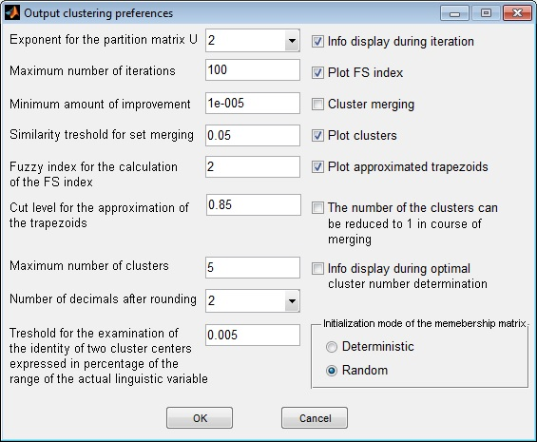
Parameterization of the output clustering and fuzzy membership function extraction

Slide 127
System with two initial rules
Select two data rows from the sample data set
  Lowest output value
  Highest output value
Meta rules
  If the reference point of a new set would be close to the RP of an existent set the new set is not inserted into the system
  If the new set is similar enough to an old one the new set is not inserted into the system
Notes:
The “two initial rules” based method [15] first selects two data rows from the sample data set: one that represents the lowest output value, and one that contains the highest output value. If more than one data row contains the same extreme output value that one is selected which is closer to the lower or upper bound of the antecedent space. Next, two rules are created that describe the two specified output values. The fuzzy sets contained in the antecedent and consequent parts of the rules are created with trapezoidal membership functions where the width of the core (w_{c}) and support (w_{s}) are defined in function of the range of the actual partition and the reference point is identical with the respective element of the selected data row. Optionally one can select the application of the following two meta rules as well.
If the distance between the reference point of the new fuzzy set and the reference point of an old fuzzy set is smaller or equal than a specified threshold value (d_{min}), the old set is used as antecedent/consequent of the new rule in the current input/output dimension (the algorithm does not create a new fuzzy set).
2. If the average distance between the corresponding parameters of the new set and an old set is smaller or equal than a specified threshold (dp_{min}) the two sets are merged into one.

Slide 128
Sample data and the generated rules’ antecedent sets

Slide 129

Parameterization of the method that creates two initial rules

Slide 130
System with 2^{n}+2 rules
Two rules approach
  Sometimes slow tuning
  Requires extrapolation capability from the FRI method
Solution: rules at the corner points of the antecedent space (max. 2^{n}+2 rules)
Notes:
The rule base generation method that applies the above presented “two rules” approach usually ensures after the parameter optimization a final fuzzy system with a low number of rules; however, the process can be very time consuming. Besides, another problem could arise from the deficiency that not all the FRI methods have extrapolation capability. In order to alleviate the above mentioned problems the SFMI toolbox offers as a new feature an initial rule base generation mode that beside the above specified two rules also creates a rule for each corner point of the hypercube of the antecedent space.
This approach results in (at most) four rules in case of a one dimensional antecedent space, and ten rules in case of a two dimensional antecedent space. In the general case the number of rules will be 2^{n}+2where n is the number of input dimensions. Sometimes the actual number of rules can be less than the value specified in (2) because one or both of the extreme outputs could correspond to corner-points of the antecedent hypercube. For example in case of our synthetic data set one gets a rule base with only five rules because the rule describing the corner point x=0, y=50 is identical with the rule corresponding to the lowest output. The main steps of the algorithm are presented on the next slide.

Slide 131
Algorithm
Create an initial rule base with the “two initial rules” method.
Create a 2 by n matrix with the lower (row 1) and upper (row 2) bounds of the input dimensions.
Create a 2^{n} by n+1 matrix with the coordinates of the antecedent space’s corner points (first n columns) and the respective output values (n+1th) column.
For each corner point
  In each antecedent dimension
    IF there is no fuzzy set with the same reference point as the corner point THEN create a new fuzzy set.
  In the consequent dimension
    IF there is no fuzzy set with the same reference point as the output value THEN create a new fuzzy set.
  Create a rule that describes the current corner point and the corresponding output.
  IF the current rule is a duplicate THEN remove the current rule.
  IF meta rule 2 is allowed THEN apply it.
Notes:
The first two rules and the fuzzy sets of the other rules as well are generated using the technique presented in Section II.B. The parameters of the method are also identical with the previously presented ones. The “2^{n}+2” approach can be used only when all the corner points of the antecedent space are covered by sample data.

Slide 132

System Based on Grid Partitioning
Notes:
All the three previously presented methods create a sparse rule base, i.e. for some possible observations (allowed input values) there are no applicable rules. As an extension of its functionality the 1.1.6 version of the SFMI toolbox also supports the creation of a rule base that ensures a full coverage of the input space.
allowing the system architect the specification of the coverage level, the number of the fuzzy sets in the current partition, and the width of the fuzzy sets’ core as well (see Figure 8).
The algorithm defines the characteristics of the grid partitioning conform Figure 9, where µ_{c} is the coverage level,

Slide 133


Slide 134
Algorithm
In each antecedent dimension
  Calculate d₁, w_{c}, and w_{s}.
  Create partition.
In the consequent dimension
  Calculate d₁, w_{c}, and w_{s}.
  Create partition.
For each possible antecedent set combination (N_{R})
  Select the data rows from the sample that fall inside the hypercube defined by the supports of the related fuzzy sets.
  In case of each selected data row find the consequent set(s) where the output of the data row falls inside the support.
  Select the consequent set with the most data rows.
  Create a rule with the selected consequent set.

Slide 135
Graphical representation
Notes:
The SFMI toolbox supports three types of graphical representation. The first one is the classical two-dimensional representation of a partition’s membership functions. For example Figure 11 shows the output partition of the fuzzy system generated using the grid partitioning based approach with five fuzzy sets in a partition.
The second type of graphical representation is a three-dimensional one and is applicable either in case of 1D in – 1D out or in case of 2D in – 1D out fuzzy systems. In the former case it shows the rules in form of bodies defined by the related antecedent and consequent sets (for example truncated pyramids in case of trapezoidal membership functions on both the antecedent and consequent side). In the latter case (see e.g. Figure 4) the body represents the antecedent part of a rule.

Slide 136
3D representation of a rule base
Notes:
The third type of graphical representation gives a three-dimensional picture of a 2D in – 1D out fuzzy system’s rule base. Here each rule is represented by a brick whose edges are defined by the supports of the fuzzy sets involved in the rule. For example Figure 12 represents the rule base of the fuzzy system obtained by the clustering based method.

Slide 137
INTERNAL REPRESENTATION OF THE GENERATED FUZZY SYSTEM
fis--name
|-type
|-...
|-refType
|
|-input(i)--name
| |-range(i)
| |-mf(i)--name
| |-type
| |-params(i)
| |-paramsy(i)
|
|-output(i)--name
| |-range(i)
| |-mf(i)--name
| |-type
| |-params(i)
| |-paramsy(i)
|
|-rule(i)—antecedent(i)
|-consequent(i)
|-weight
|-connection
Notes:
The internal representation of the generated fuzzy system is identical with the one used by the FRI toolbox. It is an extended version of the Matlab Fuzzy Logic ToolBox’s (FL TB) internal FIS representation. It is easy understandable, well-arranged, and based on series of embedded structures. Figure 13 presents the most relevant elements of this data structure. The “(i)” index indicates that the respective field is a vector. The structure contains some fields storing general information (e.g. the name of the system (name), the type of the used reference point (refType), etc.).
The input vector-field describes the antecedent part of the system. Each of its elements is a structure that stores a partition. This structure contains three fields, one for the name of the current linguistic variable (name), a vector with two elements for the lower and upper bounds of the partition (range), and one with the membership functions of the partition (mf). The last one is also a vector that contains a separate structure for each fuzzy set. This structure has four fields, which are the name of the current fuzzy set (name), its type (type), and two other fields for the parameters. In case of the most used piece-wise linear membership functions (e.g. trapezoidal, triangle shaped, etc.) the abscissa (params) and ordinate (paramsy) values of the break-points are stored as parameters.
The output field of the fis structure describes the consequent part of the FIS in an identical way with the input field. The rule base is stored by the help of the rule field. Each element of this vector describes a rule with a structure, which contains four fields. The first one (antecedent) is a vector having the same size as the number of antecedent dimensions. It stores in case of each input dimension the ordinal number of the fuzzy sets belonging to the premise of the rule. The second field (consequent) holds the ordinal numbers of the rule consequents’ sets in a similar way. The last two fields (weight and connection) stand for the weights associated with the rules, respectively the type of connections between the sets of a rule (AND, OR). For now they are not used by FRI TB, they are kept for compatibility purposes.

Slide 138
Parameter Tuning

Slide 139
Tuning of the Rule Base Parameters
Hill climbing (ACP)
Hill climbing + new rules (RBE-DSS + RBE-SI)
Clonal selection
Direct local search
Notes:
The current version of the SFMI toolbox supports four main approaches for the tuning of the rules base parameters.
The first one applies a local search approach. The second one extends it with the incremental extension of the rule base.
The third one applies an artificial immune system algorithm.
The last one is a variation of the classical Nelder-Mead.
Further on I will present briefly the key ideas of the most used approaches.

Slide 140
Parameterization
Notes:
One can choose one from the following four different parameterization strategies.
Abscissas of the four break-points as parameters
Relative distances as parameters (In this case the first parameter serves the identification of the position of the fuzzy set and it is equal to the horizontal co-ordinate of the left endpoint of the support. The horizontal position of the remaining three vertices is described by positive or zero values indicating their distance from the predecessor break-points.)
Core endpoints as parameters (Here only the endpoints of the cores are used as parameters, the abscissas of the other two vertices are identical with the horizontal co-ordinates of the respective core-endpoints of the neighboring linguistic terms.)
Reference points

Slide 141

Rule Base Extension
Tune the initial rule base
Create new rule when the step becomes too small
Position: where the difference between the sample output and
the calculated output is maximal
RBE-DSS & RBE-SI
Notes:
The concept of rule base extension In case of RBE when the coefficient (C) of the step () reaches its minimum one generates a new rule fitting the output value where the difference between the sample output and the calculated output is maximal.
Rule Base Extension using Default Set Shapes (RBE-DSS) creates the fuzzy sets of the new rule with the same core and support width values (supposing trapezoidal shaped membership functions) as the ones applied for the first two rules. However, the insertion of the new rule sometimes results in a temporary deterioration of the performance index.
In order to avoid this problem Rule Base Extension using Set Interpolation (RBE-SI) calculates the shape of the antecedent and consequent linguistic terms based on set interpolation. It is not mandatory but it could be expedient to choose the set interpolation method conform to the applied fuzzy rule interpolation based reasoning technique.

Slide 142
Tuning with RBE (DSS & SI)
Hill climbing approach
Performance indices (error measures)
Algorithm:
While PI>PI_{tr} and N_{iter}<N_{max} and st>st_{min}
  For each dimension
    For each parameter
      One step right evaluate the system
      One step left evaluate the system
      Keep the best
  If PI does not improve halve the step
  If the step is too small generate a new rule
Notes:
The algorithm uses an iterative hill climbing approach. After each step (each parameter modification) the resulting fuzzy system is evaluated by the means of a performance index, which gives information about the difference between the prescribed output given by the sample data set and the calculated data set using the fuzzy system. The toolbox contains seven options for the selection of the performance index. Probably the most used and straightforward one is the relative value of the mean square error expressed in percentage of the output range (RMSEP). The algorithm investigates the parameters one-by-one in course of each iteration cycle. First the system is evaluated with the current parameter set. Next one calculates two new values for the actual parameter one by decreasing the original value and one by increasing the original value. The step is calculated in function of the range in the actual dimensionwhere C is a constant that applies to each dimension. After the evaluation of the system with he two new parameter values one keeps that value from the available three ones (original and two new values), which results the best system performance. An iteration cycle contains the investigation of all parameters once.
At the end of the cycle one compares the actual performance with the performance of the system measured at the end of the previous cycle (). If the amelioration of PI is greater than a threshold the value of C is doubled otherwise C is decreased to its half. When it becomes smaller than a threshold () for the first time the process receives a second chance by increasing C to its original value. The algorithm stops when either C reaches its minimum for the second time or the prescribed number of iteration cycles is reached or the performance index of the system becomes better than a threshold value.

Slide 143
Performance Index
Notes:
In course of the parameter identification process after each parameter adjustment the resulting parameter set is evaluated by calculating the system output for a collection of predefined input data, for which the expected output values are known (training data set). In order to compare the results obtained with different parameter sets a performance index is calculated after each system evaluation. We use the root mean square [8] (quadratic mean) of the error for this task. It was chosen owing to its good comprehensibility and comparability to the range of the output linguistic variable.
The relative value of RMSE (RMSEP) expressed in percentage of the range is also monitored during the calculations. The application of RMSEP as performance index makes possible the parameter identification by our algorithm even in case of Multiple Input Multiple Output (MIMO) systems.

Slide 144
Tuning Algorithm₁
Evaluate the raw system with the training data
Store RMSE as RMSE minimum
Do iteration until the maximal number of iterations is reached
For each input and for the output dimension
Calculate modification step
For each parameter being adjusted
For both modification directions
Calculate the modified value of the parameter
Apply constraints
Evaluate the system with the training data
If RMSE actual < RMSE minimum
Store adjusted parameter value
Store RMSE actual as RMSE minimum
EndIf
EndFor
EndFor
EndFor
Notes:
The parameter identification method used in course of the calculations is a heuristic algorithm a variant of the gradient descent method. It modifies the parameters of the input and output linguistic terms. The parameters of the final system considered as optimal (corresponding to a local or global minimum of RMSE) are iteratively approximated by the algorithm.
In course of iteration each parameter is modified one by one in both of the possible upper and lower (increasing and decreasing) directions. After determining a new value for the current parameter the system is evaluated calculating the actual value of the performance index. If this is better than the previous minimum the new parameter value is stored.
The amount of modification of the parameters is dependent on the range of the current input/output dimension, i.e. the step is calculated by multiplying the range by a coefficient.
We propose an adaptive approach, which determines the actual value of the coefficient depending on the change of RMSE during an iteration stage, the history of previous iteration stages, and a prescribed minimum value for the coefficient (Cmin). The iteration starts with a prescribed value of the coefficient (default: 0.2).

Slide 145
Tuning Algorithm₂
If RMSE did not change in course of one iteration
If Coefficient is equal to the minimum allowed value
Generate new rule
Else
Halve Coefficient
EndIf
EndIf
If RMSE decreased more than a threshold
Double Coefficient
EndIf
End
Notes:
If the improvement of the system slows down or even stops, i.e. the value of RMSE does not reduce more than a prescribed threshold (default: 0.001) during one iteration, the coefficient is divided by two unless its vale is already equal to Cmin. In that case we generate a new rule.
On the other hand the coefficient is increased multiplying it by two when the improvement of the system speeds up, i.e. the value of RMSE increases more than a specified threshold (default: 10) during one iteration. The algorithm also stops when the prescribed number of iteration is done.

Slide 146

Experiments
Notes:
In course of the experiments we used two data sets, one having one input and one output dimension and one having two input dimensions and one output dimension. It is the same function as used in [1], [9] and [10]. Fig. 5 shows the surface described by the second function. The systems were trained to the fuzzy rule interpolation based inference techniques FRIPOC [2] and LESFRI [3] separately.

Slide 147
RMSE in course of the tuning of the first system for LESFRI with both methods
Notes:
The time demand of one iteration could be different in case of the studied methods. It is because they do not apply the same constraints for the newly calculated value of the parameter being adjusted. Thus it easily can happen that after applying the specified conditions one gets back the original value of the parameter. Under such circumstances no system evaluation is made and therefore the time need is negligible.
In order to ensure the comparability of the methods the horizontal axis indicates the number of system evaluations (SE) on figures showing the variation of the performance in course of the process (see e.g. fig. 6). During a system evaluation one calculates the output for all values belonging to the training data set, and calculates the performance index.
In case of the SISO system, which approximates function (11), RBE-DSS ensured the best results by both reasoning

Slide 148
RMSE in course of the tuning of the first system for FRIPOC with both methods
Notes:
techniques (see fig. 6 and fig. 7). The performance curve of RBE-DSS shows some repetitive salient portions, which correspond to the introduction of new rules. In case of RBE-SI some protuberances also can be recognized, but these are much milder. Hence it can be stated that our expectations regarding the positive effects of the application of set interpolation were only partly fulfilled. The introduction of a new rule was not followed by a temporarily increase of the value of RMSE as it has been seen by RBE-DSS, but the error measure also did not decrease sufficiently in course of the examined number of system evaluations.

Slide 149
Rule antecedents
Best performing system tuned for the first function with the RBE-DSS method and the LESFRI inference technique
Notes:
This case the better performance index values were obtained by the inference technique LESFRI. The rule base of the tuned system is represented on fig. 8. If one compares it with fig. 4 it can observe easily that the rules are grouped at the turning points of the function, like by the so-called optimal fuzzy rules discussed by Kosko in [6]. Probably the same results could be obtained by a smaller number of rules as well by an improved tuning algorithm. This topic is subject to further research work.

Slide 150
RMSE in course of the tuning of the second system for LESFRI with both methods
Notes:
In case of the MISO system, which approximates function (12), there are also observable peek points corresponding to the creation of new rules (see fig. 9 and 10). Surprisingly they appear significantly in case of the set interpolation based rule base extension as well. In case of both figures some portions of the performance curves are overlapped and therefore the one corresponding to RBE-SI is indicated by a bold line.
This case the final RMSE values obtained by the two methods are more similar. However the best performance is attained by RBE-SI in course of the tuning of the system for inference technique LESFRI.

Slide 151
RMSE in course of the tuning of the second system for FRIPOC with both methods

Slide 152
Rule antecedents
Antecedent space of the system tuned for the second function with the RBE-SI method and LESFRI inference technique
Notes:
The input space (rule antecedents) of the best tuned system is represented on fig. 11. Table II. presents the RMSE values of the final systems.

Slide 153
Fuzzy Model Identification
Initial rule base
  Employing human experts,
  Fuzzy clustering, Grid partitioning,
  Finding the extreme values of the modeled functional relation
  etc
Parameter tuning
  Global search
  Local search
  Hybrid

Slide 154
Clonal Selection Algorithm
Clonal Selection Principle
  Clonal selection
  Clonal expansion
  Somatic hypermutation
Variants: CLONALG by (de Castro and Von Zuben), CLONALG1 and CLONALG2 (Cutello et al.), MOCSA (Campelo et al.), AIRS (Watkins), BCA (Kelsey and Timmis), SIA (Cutelo and Nicosia), MISA (Coello et al.)
Notes:
The Clonal Selection Algorithm mimics the biological Clonal Selection Principle [3] by implementing mechanisms like clonal selection, clonal expansion, and somatic hypermutation. The algorithm was originally suggested by de Castro and Von Zuben [5]. Similarly to the case of other heuristics several variants have been proposed since the first publication. Some examples are CLONALG by de Castro and Von Zuben [5], CLONALG1 and CLONALG2 by Cutello et al. [8], MOCSA by Campelo et al. [4], AIRS by Watkins [24], BCA by Kelsey and Timmis [16], SIA by Cutelo and Nicosia [9], and MISA by Coello et al. [6].
Clonal selection based algorithms have been applied successfully for several diverse problems. An algorithm taxonomy, a standardized nomenclature, and a classification of the methods as well as a review of practical applications can be found in [3]. Further on we will present a variant of CLONALG that was used for the optimization of the rule base’s parameters. It follows an iterative approach and applies global as well as local search steps in the parameter space.

Slide 155
The Applied Algorithm
Create starting repertoire of antibodies
  Generate (random) antibodies: N x (BitArray of length L)
  Measure antibody affinity
Create clones
  Sort antibodies based on affinity in descending order
  Select first n instances
  Clone selected instances (Nc copies of each instance)
Do hypermutation (antibody maturation)
  Mutation controlled by p
  Measure antibody affinity (mutated antibodies)
Extend repertoire of antibodies
  Attache clones to the original pool of antibodies
Create next generation repertoire of antibodies
  Sort antibodies based on affinity in descending order
  Select first N-d instances (drop the rest)
  Generate new (random) antibodies: d x (BitArray of length L)
Notes:
L=number of the bits used to encode the k system parameters
The algorithm starts with the generation of N bit-arrays of length L, where each instance represents a candidate solution containing one value for each parameter of the fuzzy system. These arrays (instances) are called antibodies in the AIS terminology. Next, one measures the affinity of each antibody, i.e. it calculates the performance of that fuzzy system which applies as parameters the values stored in the antibody. After ranking the antibodies based on their affinity the best ones (the first n instances) are selected for cloning. The cloning means that Nc
copies are made from each selected antibody [3], where β∈(0,1] is a user parameter. In order to increase the diversity of the solutions the clones are subjected to an intensive mutation (hypermutation) which process is also called maturation of the antibodies. The mutation is done by changing (inverting) the values of some bits. It is controlled by the probability distribution [3]p.
where PI (PI∈[0,1]) is the performance indicator of the fuzzy system and ρ (ρ∈(0,1]) is a user parameter. In case of PI the lowest possible value corresponds to the worst performance while the highest value indicates the best performance.
In practice in case of each bit of an antibody a random r (r∈(0,1]) value is generated. If r<p the bit is inverted (flipped). Next, one calculates the affinity of each new antibody (performance of the fuzzy system represented by the antibody). This process is called antibody maturation. It performs a local search in the neighborhood of each instance belonging to the elite group. The neighborhood is closer in case of antibodies with better performance than in case of antibodies showing worse affinity.
The resulting pool of antibodies is attached to the original group and the whole repertoire is sorted in descending order based on the affinity (performance) values. The first N-d antibodies are selected for the next generation and the rest of them are dropped. Then d new instances are created with random bit patterns in order to ensure the diversity of the repertoire. This randomness ensures a global search character to the method.

Slide 156
Stopping conditions
n_{af} the number of affinity evaluations
n_{g} the number of generations
PI_{tr} an upper threshold value for the affinity
n_{ni} the number of consecutive generations without
any significant improvement regarding the best
affinity value
Notes:
The algorithm stops when at least one of the predefined stopping conditions is fulfilled. Stopping conditions can be for example
n_{af} the number of affinity evaluations – owing to the fact that the calculation of the performance indicator is one of the computationally most expensive steps,
n_{g} the number of generations,
PI_{tr} an upper threshold value for the affinity,
n_{ni} the number of consecutive generations without any improvement regarding the best affinity value (best antibody).

Slide 157


Encoding Scheme

Slide 158

Experiments

Slide 159
Experiments and evaluation
Reference point based parameterization
N=30, β=0.1, n=15, d=5, ρ=0.3
A. Initial repertoire with randomly generated antibodies
B. Initial repertoire with one initial antibody (fuzzy system generated based on fuzzy clustering) + hypermutation
Performance indicator (affinity of the antibody)

Slide 160
Experiments
Data sample size
  Training n_{str}=120
  Test n_{ste}=60
Stopping criteria
  Number of generations n_{g}=20
Results
 | Training data |  | Test data
 | A | B | A | B
SISO | 0.90 | 0.95 | 0.82 | 0.85
MISO | 0.87 | 0.93 | 0.81 | 0.87

Slide 161
SFMI toolbox GUI

Slide 162

GUI program

Slide 163


GUI program
Raw fuzzy system generation from the sample data
  Separate raw system for each output dimension
  Graphical repr.
Notes:
The graphical user interface of the toolbox can be started by typing in the Matlab Command Window the command RuleMaker. Conform to the implemented fuzzy model identification methods one can distinguish two main areas in the functionality of the GUI program. The first one deals with the generation of the raw fuzzy system from the sample data. The training data should be loaded in two separate text files, one containing the output values and one containing the input values. In both cases each row corresponds to one data point. If the input or output is multi-dimensional the co-ordinates in the different dimensions are separated by tabulators. Figure 4. Parameters of the raw fuzzy system generation
One can generate the raw fuzzy system either by clustering or by the extreme values based approach. The system can be saved in a text file using the same format as the Fuzzy Rule Interpolation Matlab toolbox [17]. The program generates a separate raw system for each output dimension in case of sample data with multi-dimensional output.
The current version (1.0.0) of the toolbox supports only the trapezoidal shaped membership functions, which includes with corresponding parameterization the triangle and the singleton shaped fuzzy sets as well. The default core and support width values and some other parameters can be set by the user through dialog boxes. They are also displayed in a textbox in the main window (see fig. 4).
The program makes possible the graphical representation of the input and output partitions (see e.g. fig. 5) separately, as well as a three dimensional representation of the rule base or antecedent space if the number of antecedent dimensions does not exceed three. If the fuzzy model has only one input dimension the program offers a three dimensional representation of the rule base each rule being indicated by a pyramid defined by the antecedent and consequent membership functions (see e.g. fig. 6). If the number of input dimensions is two one can use the pyramid-type representation for the visualization of the antecedent space. Here the pyramids are defined by the antecedent fuzzy sets. However, the user can choose the cuboid-type representation (e.g. fig. 1) where the rule consequents still can be drawn into the visualization. In this case the edges of a cuboid represent the supports of the antecedent and consequent linguistic terms of a rule. The drawback of this type is that other parts of the sets’ shape cannot be visualized. In case of fuzzy systems having three input dimensions only the cuboid-type representation is available. It can be used for the visualization of the rule antecedents.

Slide 164
Applications

Slide 165
Practical applications
Fuzzy control
  Automated guided vehicle
  Automated mobile robot room surveillance navigation control
Fuzzy modeling
  Petrophysical properties prediction
  Fuzzy modeling of an anaerob tapered fluidized bed reactor
  Tool life prediction
  Mechanical properties of composite materials
  Prediction of the student enrollment number
Fuzzy expert system
  Student evaluation

Slide 166

Fuzzy Control₁
Automated guided vehicle
main goals: path tracking and collision avoidance
FIVE
12 rules for steering
5 rules for speed

Slide 167

Fuzzy Control₂
Automated mobile robot room surveillance navigation control
Task: go through the "waypoints" 1..4, avoid the collisions (obstacles, walls)
FIVE
Full rule base: 1040 rules
Applied sparse rule: 51 rules

Slide 168

Prediction of some Composites’ Mechanical Properties
Thermoplastic composites’ yield strength and Charpy impact strength prediction as a function of the percent amount of the components
  Multiwall Carbon Nanotube (MB-6015-00)
  ABS (POLYMAN HH 3)
  Polycarbonate
http://www.umi.surrey.ac.uk/people/profiles/postgrads?s_id=315

Slide 169
Introduction
Polymers
  In some cases there is no pure material to fulfill all the requirements
  Mixing pure polymeric materials with fullerenes
Carbon nanotube-polymer composites
  Increase of the polymer’s conductivity
  Decrease of its resistance
  Enhanced mechanical properties
  Improved thermal stability and fire resistance
Notes:
In the 19. century polymers were used as synthetic substitute materials instead of raw materials. Nowadays polymers are very important materials; they are used for different purposes. The variety of plastics is enormous; however, in some cases there is no pure material to fulfill all the requirements. In these cases it is important to prepare the desired material by mixing pure polymeric materials with fullerenes in order to reach the desired mechanical properties.
One type of fullerenes, the carbon nanotube is in the focus of the researchers of polymer blends in the last ten years [1][2]. Carbon nanotube-polymer composites are often used owing to the increase of the polymer’s conductivity [3][4][5] and decrease of its resistance. Thus electrostatic discharge can be avoided. It was also discovered that the mechanical properties (modulus, strength, etc.) can be enhanced by adding carbon nanotube to virgin polymer [6][7]. In addition, among other properties the thermal stability and fire resistance can be influenced favorably as well by using carbon nanotube [8][9][10].

Slide 170
Experiments
Incomplete full factorial experimental design
The sum of the component’s percent amount had to be 100% (NT+ABS+PC=100)
Nanotube levels: 0%, 1%, 1.5%
ABS levels: 0%, 10%, 20%, 30%, 40%, 50%, 60%, 70%, 80%, 90%, 100%
Polycarbonate: dependent variable
Experimental settings: 30
Replications: 10
Notes:
In order to investigate variation of the Charpy impact strength (CIS) and yield strength (YS) of the composites in function of the component’s percent amount we created an incomplete full factorial experimental design. The incompleteness derived from the constraint that the sum of the component’s percent amount had to be 100%.
The components were the ABS (POLYMAN HH 3), the Multiwall Carbon nanotube master batch (MB-6015-00, Hyperion Catalyst, USA) and the polycarbonate (PC). The ABS and polycarbonate polymers were used as matrix materials.
Composites are made up of individual materials referred to as constituent materials. There are two categories of constituent materials: matrix and reinforcement. At least one portion of each type is required. The matrix material surrounds and supports the reinforcement materials by maintaining their relative positions. The reinforcements impart their special mechanical and physical properties to enhance the matrix properties.
We defined three levels for the nanotube (0%, 1% and 1.5%) and eleven levels for the ABS. The full factorial experiment plan contained 33 settings from which 30 were executable due to the incompatible levels (see the above mentioned constraints). Each setting was tried ten times. The experiments were carried out in random order. In course of the modeling the average value for each setting was taken into consideration as setting results.

Slide 171
Technical details
Mixing of polymers in melt - Infinitely Variable Dynamic Shear Mixer
Extruder is a Collin Teach-Line E20T
Test pieces were injection molded by ARBURG Allrounder 270 U 350-70
Melt temperature 260º C
Mould temperature 40º C
Yield strength determined by INSTRON 4482
Charpy impact strength determined by Charpy pendulum
Notes:
The mixing of polymers was carried out in melt to achieve homogeneous properties. We used a special mixing unit called Infinitely Variable Dynamic Shear Mixer (IDMX) [11] to produce blends. The mixing instrument consists of the dynamic unit and a satellite extruder. The extruder is a Collin Teach-Line E20T. The single screw extruder pumps the melt into the dynamic mixer. The mixer has its own drive and a screw feed section which takes the melt streams and conveys them into the mixer elements consisting of rotors and stators. The setup of the mixing elements generates high shear to give dispersive and distributive mixing of the components. The test pieces were injection molded by ARBURG Allrounder 270 U 350-70. The melt temperature was 260º C. The mould temperature was 40º C.
In order to study the mechanical properties of the test pieces we broke them under liquid nitrogen. The yield strength was determined by an INSTRON 4482 equipment. The Charpy impact strength was determined as well using a swinging pendulum (Charpy pendulum).
We also prepared scanning electron microscopic (SEM) pictures to investigate the fractured surface of the composites. A field-emission SEM (FESEM, Hitachi-S4700) was applied for this task. SEM micrographs of the fractured sample composites containing carbon nanotube are shown in Fig. 1 and Fig. 2. The sample preparation was carried out in the same way as in [12]. The carbon nanotube can be seen on the fractured surfaces. It is important to emphasize that the distribution of the nanotube in the matrix material is more or less uniform. We did not find any sign of agglomerates in the materials.

Slide 172

Charpy impact strength
Training: RMSEP 2.1594 %
Test: RMSEP 2.9305 %
Size reduction of the rule base 27.27 %

Slide 173

Yield strength
Training: RMSEP 0.4795 %
Test: RMSEP 0.7732 %
Size reduction of the rule base 31.82 %

Slide 174

Furniture selection

Slide 175

Fuzzy modeling of an anaerob tapered fluidized bed reactor
4 inputs 5 outputs
Kimenet | PI_{RMSE}
COD_{out} | 30,1954
Biogas | 0,8012
VFA | 18,2828
Alkalinity | 76,0786
BOD_{out} | 88,4201

Slide 176
Petrophysical properties prediction - analysis of petroleum well log data
3 inputs 1 output
PHI=f(GR,ILD,DT)
GR - gamma rediation
ILD - deep induction resistivity
DT – acustic travel time
PHI - porosity
Applied method | Correlation c.
 | Training data | Test data | Rule no.
MACI | 0,917 | 0,865 | 63
LESFRI | 0,934 | 0,890 | 9
FRIPOC | 0,966 | 0,880 | 37

Slide 177

Tool life prediction in case of machining operations
Input: Cutting speed + Feed rate
Output: Tool life
Traditional models: exponential, Taylor, corrected Taylor, Gilbert, Kronenberg, etc.
 | Exp. | Taylor | T. corr | RBE-SI+ FRIPOC
DA20 | 1.1223% | 2.8816% | 4.7610% | 0.0146 %
DA25 | 0.7045% | 3.9486% | 7.2525% | 0.0005 %

Slide 178
Ground Level Ozone Concentration
Most important factors: NO, NO2, NOx, T, RH, and O3
259 measurements for system training purposes
84 measurements for testing purposes
The test data were selected randomly from the original sample
Notes:
Ground-level ozone (O₃) is a very dangerous air pollutant. It is an irritating and reactive component in atmosphere that has negative impacts on human health, climate, vegetation and materials. Therefore it is important to develop models that are able to predict its concentration.
The experimental data were collected in an urban site of Northern Portugal [31]. In course of the experiments 10 characteristics were measured: the hourly average concentrations (in µg/m³) of carbon monoxide (CO), nitrogen oxides (NO, NO2 and NOx) and O3; hourly averages of air temperature (T), solar radiation (RAD), relative humidity (RH) and wind speed (WS); the day of week (DW; the O₃ behavior is different on weekdays and on weekend).
Based on the results published in [30] we took into consideration in course of the modeling only the most important factors those are NO, NO2, NOx, T, RH, and O3. We formed two groups of the experimental data: one containing 259 measurements for system training purposes and one with 84 measurements for testing purposes. The test data were selected randomly from the original sample.

Slide 179
Student evaluation
Evaluation of narrative student responses
Aspects of the scoring of each response
  the accuracy of the response → fuzzy number → average fuzzy evaluation
  the time necessary for answering the questions → crisp number → fuzzy average time
  the correct use of the technical terms → fuzzy number → average fuzzy evaluation
General fuzzy evaluation of the student using fuzzy inference – 74 rules

Slide 180
Input and output partitions

Slide 181
Prediction of the student enrollment number

Slide 182
Modeling Results
Aim: predict the number of students who will enroll into the Network Administration course
  Probability of passing the NA exam for each student
  Average probability for the whole group
  Estimated number of the students who will pass the exam

Slide 183
Input - Output
Input
What was the result of the student’s last (successful) CNI exam? Variable: N1R, possible values: 2..5.
Is this the 1st, 2nd, or 3rd enrolment of the student into the Network Administration course? Variable: NEN, possible values: 1..3.
How many credits has the student collected until now? Variable: NCr, possible values: SM, AV, BG
Output
Probability of passing the exam. Variable: PS, possible values: SM, AL, AH, BG

Slide 184
Input partition

Slide 185
Results
Original rule base
  Training: PI=0.73 Test: PI=0.74
Final rule base
  Training: PI=0.81 Test: PI=0.76

Slide 186
Matlab and C

Slide 187
Thank you for your attention!
csaba@johanyak.hu

Slide 188

http://fri.gamf.hu

Slide 189


Slide 190


Slide 191


Slide 192


Slide 193


