Slide 1
Software Engineering Selected Topics
Dr. Zsolt Csaba Johanyák
John Von Neumann University, Kecskemét, Hungary
Johanyak.Csaba@gamf.Uni-neumann.Hu

Slide 2
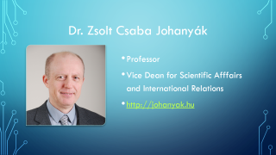
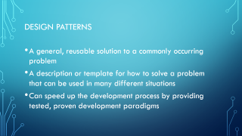
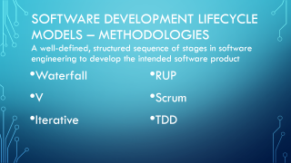
Contents

Slide 3



Dr. Zsolt Csaba Johanyák
Professor
Vice Dean for Scientific Afffairs and International Relations
http://johanyak.hu

Slide 4
City - University - Faculty

Slide 5
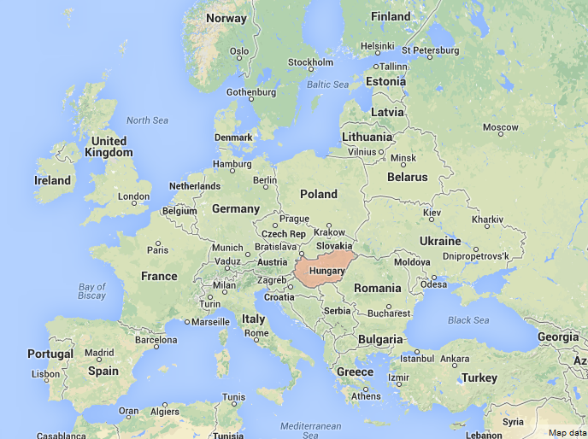

Slide 6


Slide 7



Historic places
Notes:
Kecskemét was mentioned as a market-town of the first time in a charter from 1368.
The Main Square was the former market-place and is known as one of the most beautiful city centres of Hungary.

Slide 8



Historic places

Slide 9




Traditions

Slide 10


Wellness Tourism
The region of the Southern Great Plain is the sunniest part of Hungary.
It is the favourite place of the visitors looking for recovery, and recreation.

Slide 11


John von Neumann University GAMF Faculty of Engineering and Computer Science
Department of Information Technology

Slide 12

John von Neumann University
Significant center of higher education and research in the middle of Hungary
Diplomas in Engineering, Information Technology, Economy and Business Administration, Agricultural and Teacher Training
Creator of the dual training model in Hungary
Four faculties:
GAMF Faculty of Engineering and Computer Science
Faculty of Economics and Business
Faculty of Horticulture and Rural Development
Teacher Training Faculty
Number of students: ~4.000
Academic staff: ~200

Slide 13
GAMF Faculty of Engineering & Computer Science)
Founded 1964
Number of teaching staff 100
Total number of students ~2000
Full-time students ~70%
Part-time students ~30%
Departments 5

Slide 14
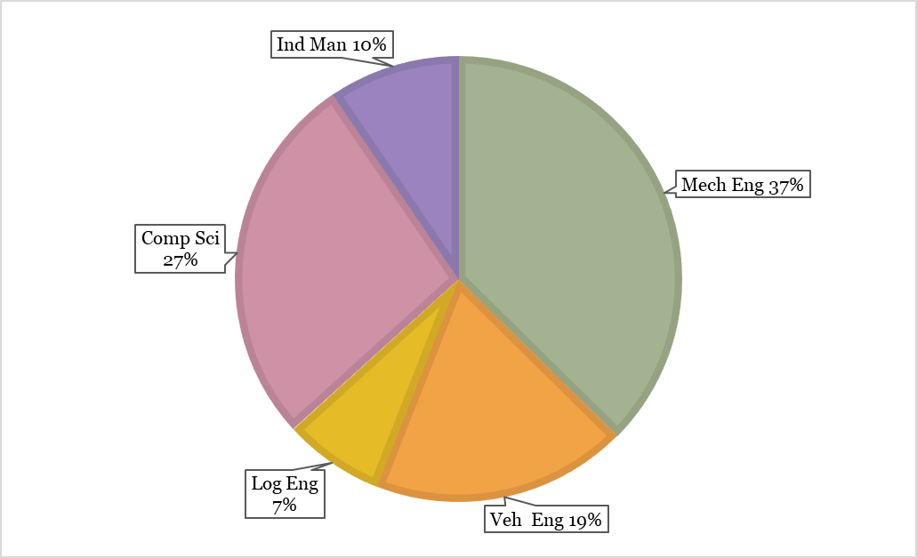
Study Programmes
Higher Vocational Training (4 semesters) (~2 %)
Information Engineering (Computer System Administration)
Software Engineering
Bachelor Level (7 semesters) (~84%)
Mechanical Engineering (BSc)
Computer Science Engineering (BSc) (HU+EN)
Computer Science Operational Engineer (BProf)
Vehicle Engineering (BSc)
Industrial Management (BSc)
Logistical Engineering (BSc)
Master Level (MSc)
Mechanical Engineering
Postgraduate specialist training courses (~14 %)
Software Engineering, Logistics, Quality management

Slide 15
Software Development Lifecycle Models – Methodologies A well-defined, structured sequence of stages in software engineering to develop the intended software product
Waterfall
V
Iterative
RUP
Scrum
TDD
Notes:
Sofware systems are complex systems whose design, planning and development requires methodological approach. SE focuses on these methodological efforts in order to ensure the best outcome (product) . Since the mid seventies several methodologies have been developed for this task.
Software Development Lifecycle Models describe how and through which steps a sw product should be produced.
In this slide some famous and typical models are enlisted that are going to be presented in details in today’s lecture.
The first four of them represent traditional approaches while the last two belong to the family of agile methodologies.

Slide 16
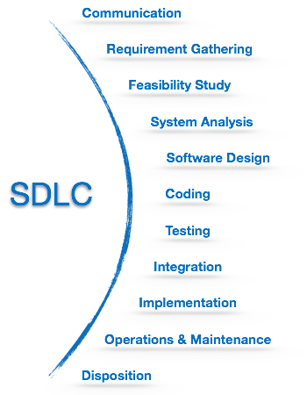
SDLC Activities

Slide 17
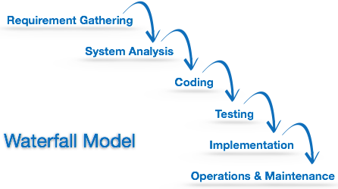
Waterfall Model
Notes:
The Waterfall model is the simplest model of software development paradigm. All the phases of SDLC will function one after another in linear manner. That is, when the
first phase is finished then only the second phase will start and so on. This model assumes that everything is carried out and taken place perfectly as
planned in the previous stage and there is no need to think about the past issues that may arise in the next phase. This model does not work smoothly if there are
some issues left at the previous step. The sequential nature of model does not allow us to go back and undo or redo our actions.
This model is best suited when developers already have designed and developed similar software in the past and are aware of all its domains.

Slide 18
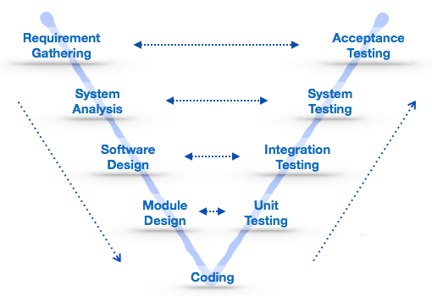
V-model
Notes:
The major drawback of waterfall model is we move to the next stage only when the previous one is finished and there was no chance to go back if something is
found wrong in later stages. V-Model provides means of testing of software at each stage in reverse manner.
At every stage, test plans and test cases are created to verify and validate the product according to the requirement of that stage. For example, in requirement
gathering stage the test team prepares all the test cases in correspondence to the requirements. Later, when the product is developed and is ready for testing, test
cases of this stage verify the software against its validity towards requirements at this stage. This makes both verification and validation go in parallel. This model is also known as verification and validation model.

Slide 19
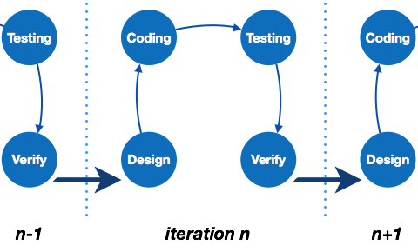
Iterative model
Notes:
This model leads the software development process in iterations. It projects the process of development in cyclic manner repeating every step after every cycle of
SDLC process. The software is first developed on very small scale and all the steps are followed which are taken into consideration. Then, on every next iteration, more features and modules are designed, coded, tested, and added to the software. Every cycle produces a software, which is complete in itself and has more features and
capabilities than that of the previous one.
After each iteration, the management team can do work on risk management and prepare for the next iteration. Because a cycle includes small portion of whole software process, it is easier to manage the development process but it consumes more resources.

Slide 20
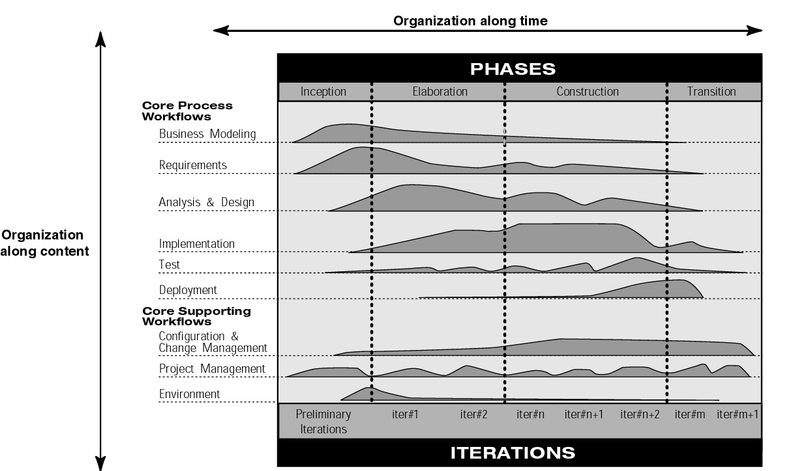
Notes:
The process can be described in two dimensions, or along two axis:
• the horizontal axis represents time and shows the dynamic aspect of the process as it is enacted, and it is
expressed in terms of cycles, phases, iterations, and milestones.
• the vertical axis represents the static aspect of the process: how it is described in terms of activities,
artifacts, workers and workflows.
Each phase is concluded with a well-defined milestone—a point in time at which certain critical decisions must be
made, and therefore key goals must have been achieved [2]

Slide 21
Agile software development principles
Customer satisfaction by early and continuous delivery of valuable software.
Welcome changing requirements, even in late development.
Deliver working software frequently (weeks rather than months)
Close, daily cooperation between business people and developers
Projects are built around motivated individuals, who should be trusted
Face-to-face conversation is the best form of communication (co-location)

Slide 22
Working software is the primary measure of progress
Sustainable development, able to maintain a constant pace
Continuous attention to technical excellence and good design
Simplicity—the art of maximizing the amount of work not done—is essential
Best architectures, requirements, and designs emerge from self-organizing teams
Regularly, the team reflects on how to become more effective, and adjusts accordingly

Slide 23
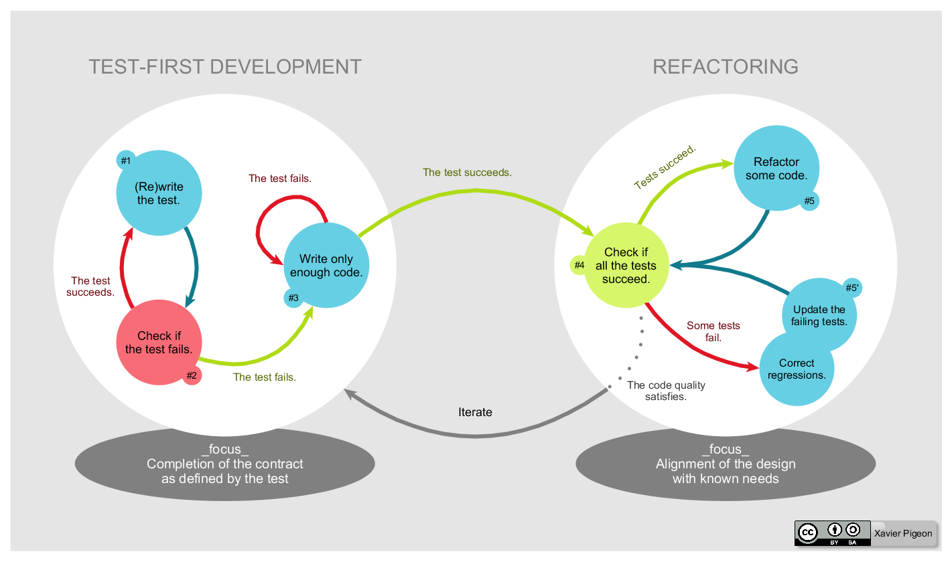
Test Driven Development
By Xarawn - Own work, CC BY-SA 4.0, https://commons.wikimedia.org/w/index.php?curid=44782343
Notes:
Az extrém programozáshoz kapcsolódóan jelent meg először.
Alapgondolat: először tesztet írni, és csak utána programkódot, mikroiterációk sorozatának eredményeképpen keletkezik a szoftver
Lépések:
0. Az alkalmazás elvárt funkcionalitásának egészen kis, elemi részekre bontása – lista összeállítása
Teszt(függvény) megírása és
Teszt futtatása→ piros (sikertelen teszt), ha sikeres a teszt (gond) → 1
Az alkalmazásfüggvény megfelelő kódrészletének megírása – csak a minimálisan szükséges kódot, ami ahhoz elég, hogy a tesztet kielégítsük. Teszt újra, és fejlesztés stb. amíg a tesztet ki nem elégítjük.
Az összes teszt futtatása (regresszió)
Kód optimalizálás, regressziós tesztek hibáinak javítása
Következő elemi funkcionalitás kiválasztása a listáról és → 1

Slide 24
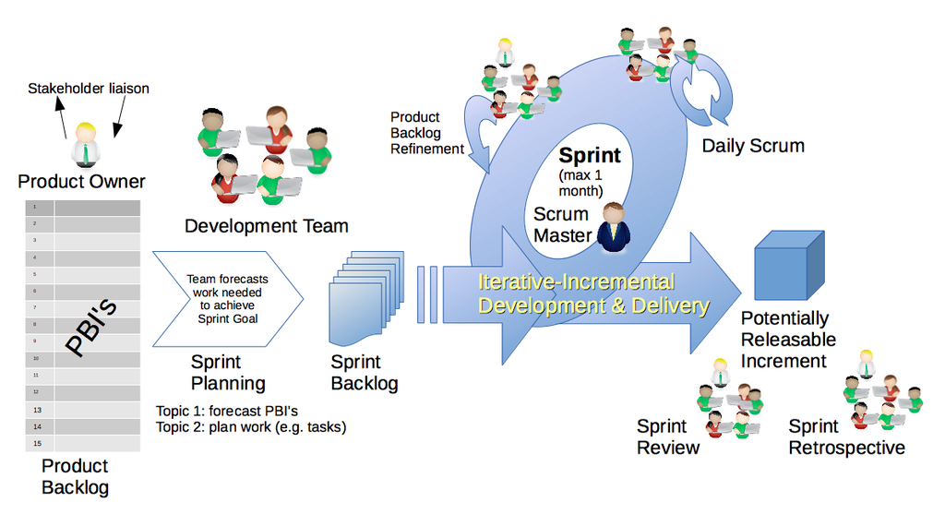
Scrum
By Dr ian mitchell - Own work, CC BY-SA 4.0, https://commons.wikimedia.org/w/index.php?curid=44894952
Notes:
https://en.wikipedia.org/wiki/Scrum_(software_development)

Slide 25
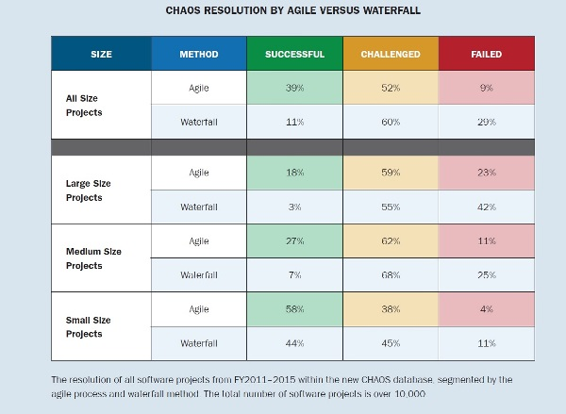
CHAOS report
https://www.infoq.com/articles/standish-chaos-2015/

Slide 26
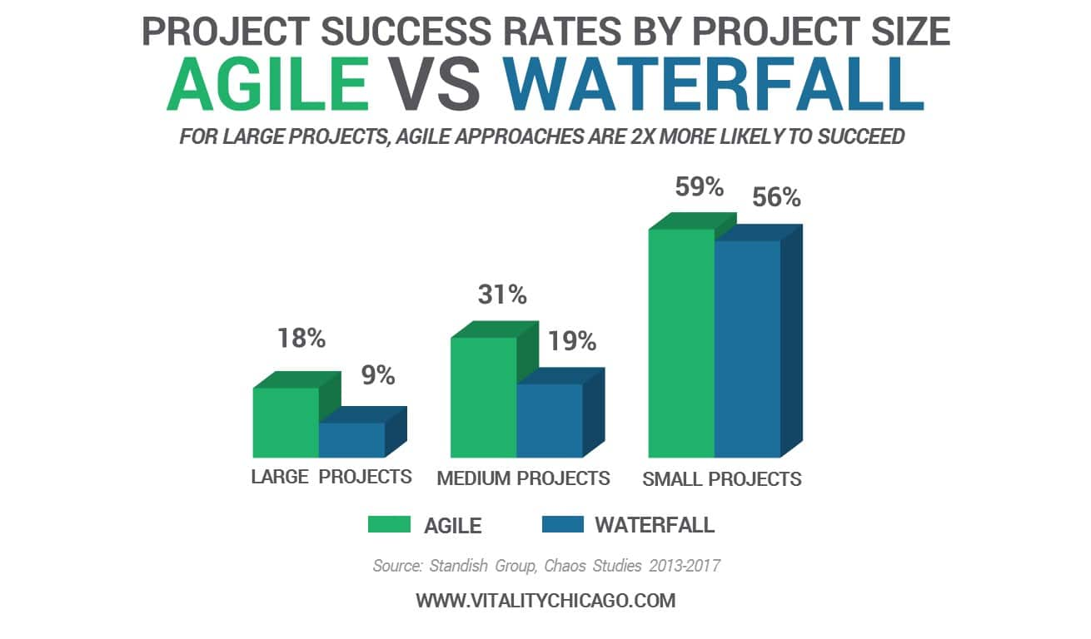

Slide 27
What approach should We use?
Agile Prerequisites
The requirements are vague
Close collaboration with customers
The team is setup for change – knowledge necessary to make changes quickly and confidently
Experienced developers
Traditional models usually work better
Predictive, repeatable work
Mission Critical Systems?

Slide 28
Design Patterns
A general, reusable solution to a commonly occurring problem
A description or template for how to solve a problem that can be used in many different situations
Can speed up the development process by providing tested, proven development paradigms

Slide 29
Classification
Creational patterns: Abstract factory, Builder, Dependency Injection, Factory method, Lazy initialization, Multiton, Object pool, Prototype, Resource acquisition is initialization (RAII), Singleton
Structural patterns: Adapter, Bridge, Composite, Decorator, Extension object, Facade, Flyweight, Front controller, Marker, Module, Proxy, Twin
Behavioral patterns: Blackboard, Chain of responsibility, Command, Interpreter, Iterator, Mediator, Memento, Null object, Observer or Publish/subscribe, Servant, Specification, State, Strategy, Template method, Visitor

Slide 30
Classification
Concurrency patterns: Active Object, Balking, Binding properties, Compute kernel, Double-checked locking, Event-based asynchronous, Guarded suspension, Join, Lock, Messaging design pattern (MDP), Monitor object, Reactor, Read-write lock, Scheduler, Thread pool, Thread-specific storage

Slide 31
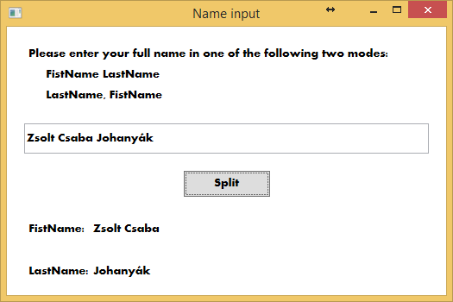

Simple Factory

Slide 32
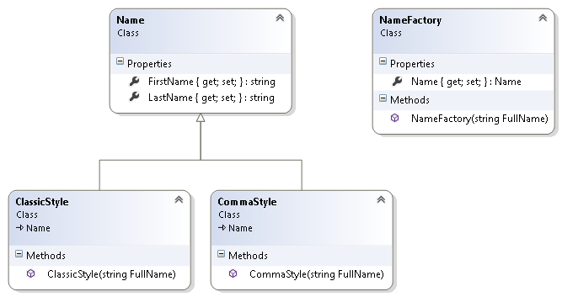
Simple Factory

Slide 33
ClassicStyle
public class ClassicStyle:Name
{
public ClassicStyle(string FullName)
{ string[] sa = FullName.Split(' ');
LastName = sa[sa.Count() - 1];
FirstName = "";
for (int i = 0; i < sa.Count()-1; i++)
{ FirstName += sa[i]+" ";
}
}
}

Slide 34
CommaStyle
public class CommaStyle:Name
{
public CommaStyle(string FullName)
{
string[] sa = FullName.Split(',');
FirstName = sa[1].Trim();
LastName = sa[0].Trim();
}
}

Slide 35
NameFactory
public class NameFactory
{ public NameFactory(string FullName)
{ if (FullName.IndexOf(",") > -1)
Name = new CommaStyle(FullName);
else
Name = new ClassicStyle(FullName);
}
public Name Name{get; set;}
}

Slide 36
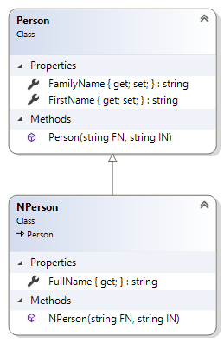
Adapter

Slide 37
Bridge
Smart TV
Cable
Satellite
IPTV
Functionality: get the program, start video
Different implementation in case of each program source
Source: http://www.codeproject.com/Articles/434352/Understanding-and-Implementing-Bridge-Pattern-in-C

Slide 38
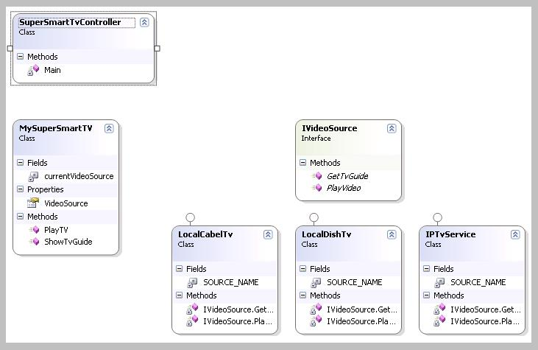
Bridge – Class Diagram
https://www.codeproject.com/Articles/434352/Understanding-and-Implementing-Bridge-Pattern-in-C
Notes:
Az absztakció lehet absztrakt osztály és interfész is.

Slide 39
Interface
interface IVideoSource
{
string GetTvGuide();
string PlayVideo();
}

Slide 40
Implementation
class LocalCabelTv : IVideoSource
{
const string SOURCE_NAME = "Local Cabel TV";
string GetTvGuide()
{
return string.Format("Getting TV guide from - {0}",
SOURCE_NAME);
}
string PlayVideo()
{
return string.Format("Playing - {0}", SOURCE_NAME);
}
}

Slide 41
LocalDishTv
class LocalDishTv : IVideoSource
{
const string SOURCE_NAME = "Local DISH TV";
string GetTvGuide()
{
return string.Format("Getting TV guide from - {0}",
SOURCE_NAME);
}
string PlayVideo()
{
return string.Format("Playing - {0}", SOURCE_NAME);
}
}

Slide 42
IPTvService
class IPTvService: IVideoSource
{
const string SOURCE_NAME = "IP TV";
string GetTvGuide()
{
return string.Format("Getting TV guide from - {0}",
SOURCE_NAME);
}
string PlayVideo()
{
return string.Format("Playing - {0}", SOURCE_NAME);
}
}

Slide 43
RefinedAbstraction
class MySuperSmartTV
{ IVideoSource _VideoSource = null;
public IVideoSource VideoSource
{ get { return currentVideoSource; }
set { _VideoSource = value;}
}
public void ShowTvGuide()
{ if (currentVideoSource != null)
{ Console.WriteLine(_VideoSource.GetTvGuide());
}
else
{ Console.WriteLine("Please select a Video Source to get TV"+" guide from");
}
}

Slide 44
public void PlayTV()
{ if (_VideoSource != null)
{ Console.WriteLine(_VideoSource.PlayVideo());
}
else
{ Console.WriteLine(
"Please select a Video Source to play");
}
}
}

Slide 45
class SuperSmartTvController
{ static void Main(string[] args)
{ MySuperSmartTV myTv = new MySuperSmartTV(); Console.WriteLine("Select A source to get TV Guide and Play"); Console.WriteLine("1. Local Cable TV\n2. Local Dish TV\n3. IP TV");
ConsoleKeyInfo input = Console.ReadKey();
switch (input.KeyChar)
{ case '1': myTv.VideoSource = new LocalCabelTv(); break;
case '2': myTv.VideoSource = new LocalDishTv(); break;
case '3': myTv.VideoSource = new IPTvService(); break;
}
myTv.ShowTvGuide();
myTv.PlayTV();
}
}

Slide 46
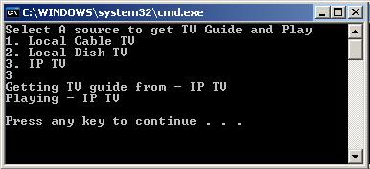

Slide 47
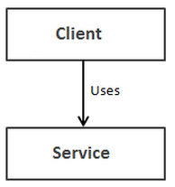
Dependency Injection
Interface
Client has to know only the IService interface
Solutuions
Constructor Injection
Property (Setter) Injection
Method Injection
Notes:
Forrás: http://www.dotnet-tricks.com/Tutorial/dependencyinjection/67LX120413-Implementation-of-Dependency-Injection-Pattern-in-C
Osztályok és komponensek közötti laza csatolást tesz lehetővé. Az erős kapcsolatok elkerülése könnyebbé teszi a későbbi változtatásokat és a kód karbantartást. „Építő” (builder) objektumokat használ az objektumok inicializálásához és lehetővé teszi, hogy az objektumok közötti függőségeket „befecskendezzük” (inject) az osztályon kívülről.
Reduces class coupling
Increases code reusing
Improves code maintainability
Improves application testing

Slide 48
Constructor Injection
public interface IService
{
void Serve();
}
public class Service : IService
{
public void Serve()
{
Console.WriteLine("Service Called");
//To Do: Some Stuff
}
}
Notes:
This is the most common DI.
Dependency Injection is done by supplying the DEPENDENCY through the class’s constructor when instantiating that class.
Injected component can be used anywhere within the class.
Should be used when the injected dependency is required for the class to function.
It addresses the most common scenario where a class requires one or more dependencies.

Slide 49
Client
public class Client
{ private IService _service;
public Client(IService service)
{
this._service = service;
}
public void Start()
{
Console.WriteLine("Service Started");
this._service.Serve();
//To Do: Some Stuff
}
}
Notes:
A konstruktor paraméterként megkapja a szolgáltatást végző objektum referenciáját. A szolgáltatás a Start metódus meghívásával indítható.

Slide 50
Usage
class Program
{ static void Main(string[] args)
{
client = new Client(new Service());
client.Start();
Console.ReadKey();
}
}
Notes:
Itt a Program osztály látja el az építő szerepet.

Slide 51
Property (Setter) Injection
public interface IService
{
void Serve();
}
public class Service : IService
{
public void Serve()
{
Console.WriteLine("Service Called");
//To Do: Some Stuff
}
}
Notes:
Also called Setter injection.
Used when a class has optional dependencies, or where the implementations may need to be swapped. Different logger implementations could be used this way.
May require checking for a provided implementation throughout the class(need to check for null before using it).
Does not require adding or modifying constructors.

Slide 52
Client
public class Client
{ private IService _service;
public IService Service
{ set
{ this._service = value;
}
}
public void Start()
{ Console.WriteLine("Service Started");
this._service.Serve();
//To Do: Some Stuff
}
}

Slide 53
Usage
class Program
{
static void Main(string[] args)
{
Client client = new Client{
Service = new Service()};
client.Start();
Console.ReadKey();
}
}

Slide 54
Method Injection Service class
public interface IService
{
void Serve();
}
public class Service : IService
{
public void Serve()
{
Console.WriteLine("Service Called");
//To Do: Some Stuff
}
}
Notes:
Inject the dependency into a single method, for use by that method.
Could be useful where the whole class does not need the dependency, just the one method.
Generally uncommon, usually used for edge cases.

Slide 55
Client Class
public class Client
{ private IService _service;
public void Start(IService Service)
{ this._service=Service
Console.WriteLine("Service Started");
this._service.Serve();
//To Do: Some Stuff
}
}

Slide 56
Usage
class Program
{
static void Main(string[] args)
{
Client client = new Client();
client.Start(new Service());
Console.ReadKey();
}
}
Notes:
További olvasmány: http://en.wikipedia.org/wiki/Dependency_injection

