Slide 1
Mobile App Development with AppInventor
Dr. Zsolt Csaba Johanyák
Johanyak.csaba@gamf.uni-neumann.hu

Slide 2
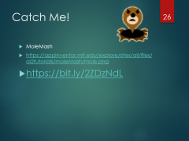
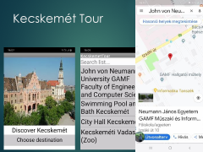


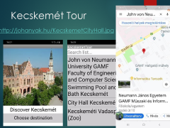

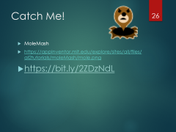

Contents

Slide 3

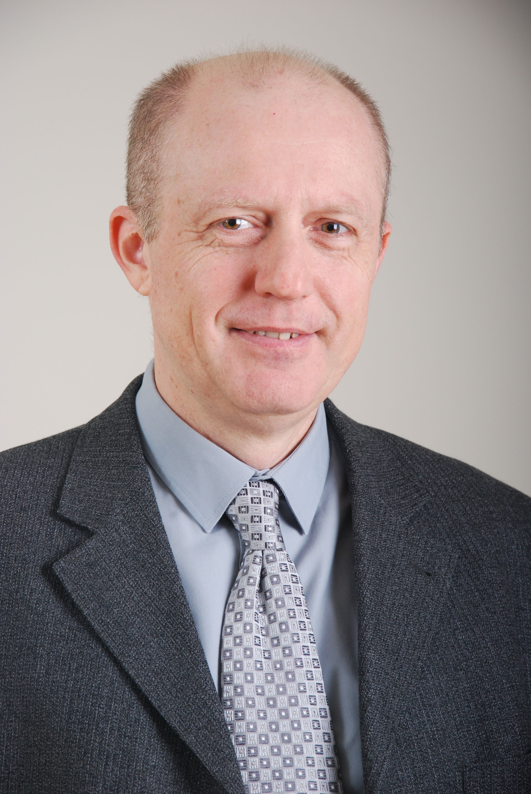




Dr. Zsolt Csaba Johanyák
Professor
Vice Dean for Scientific Affairs and International Relations
http://johanyak.hu
.Net (C#), C/C++, Matlab, Software Engineering, Visual programming
Linux and Windows network administration

Slide 4
City - University - Faculty

Slide 5
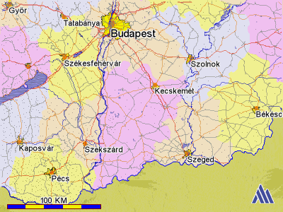

Slide 6
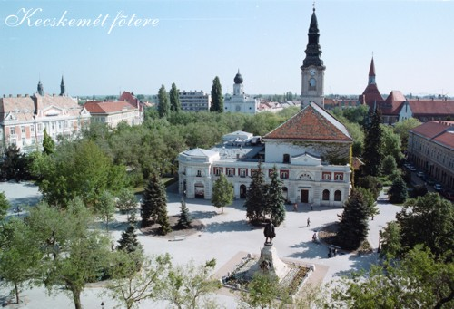


Historic places
Notes:
Kecskemét was mentioned as a market-town of the first time in a charter from 1368.
The Main Square was the former market-place and is known as one of the most beautiful city centres of Hungary.

Slide 7
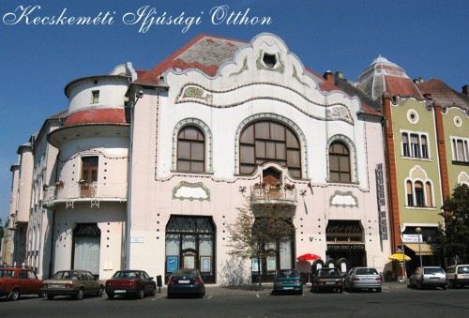

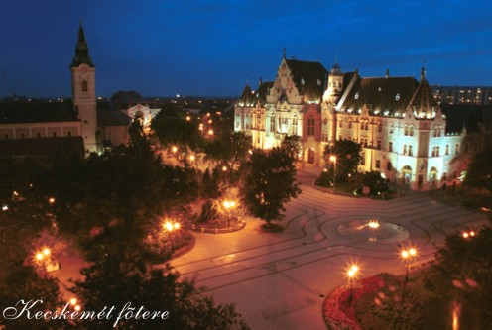
Historic places

Slide 8
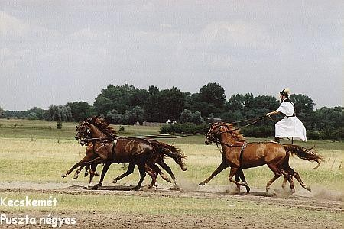
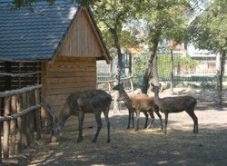
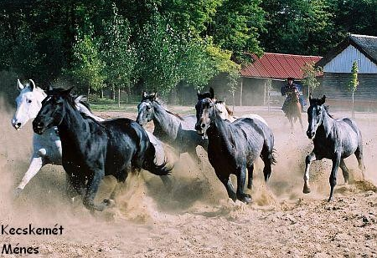
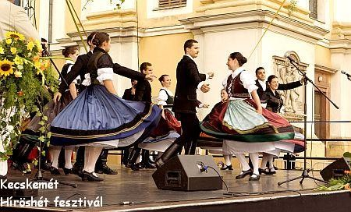
Traditions

Slide 9
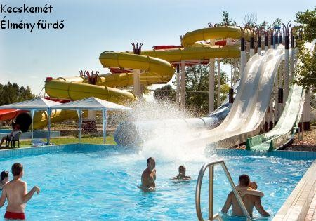
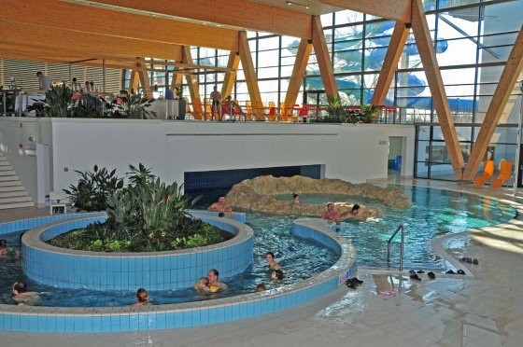
Wellness Tourism
The region of the Southern Great Plain is the sunniest part of Hungary.
It is the favourite place of the visitors looking for recovery, and recreation.

Slide 10
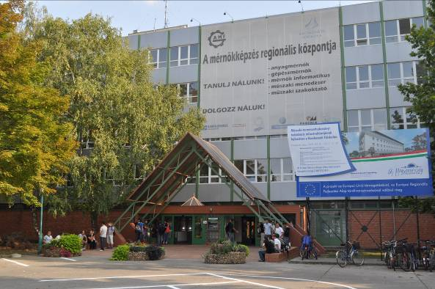
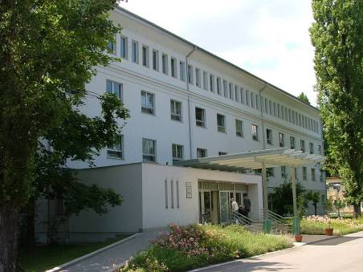
John von Neumann University
GAMF Faculty of Engineering and Computer Science
Department of Information Technology

Slide 11
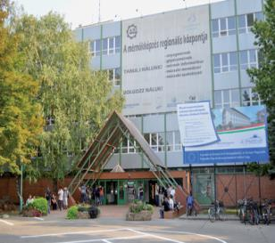
John von Neumann University
Significant center of higher education and research in the middle of Hungary
Diplomas in Engineering, Information Technology, Economy and Business Administration, Agricultural and Teacher Training
Creator of the dual training model in Hungary
Four faculties:
  GAMF Faculty of Engineering and Computer Science
  Faculty of Economics and Business
  Faculty of Horticulture and Rural
  Development
  Teacher Training Faculty
Number of students: ~4.000
Academic staff: ~200

Slide 12
GAMF Faculty of Engineering & Computer Science)
Founded 1964
Number of teaching staff 100
Total number of students ~2000
Full-time students ~70%
Part-time students ~30%
Departments 5

Slide 13
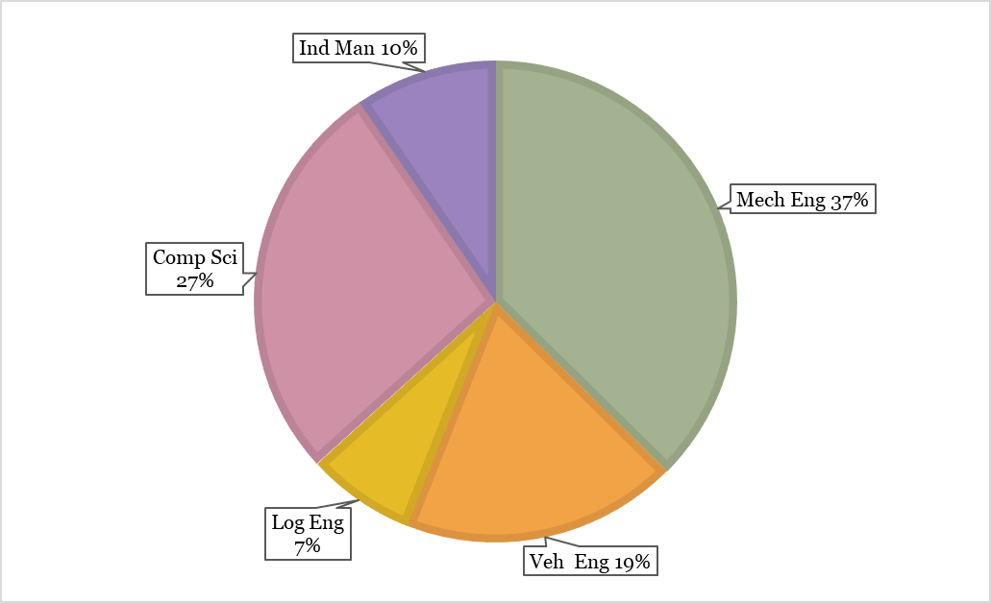
Study Programmes
Higher Vocational Training (4 semesters) (~2 %)
Information Engineering (Computer System Administration)
Software Engineering
Bachelor Level (7 semesters) (~84%)
Mechanical Engineering (BSc)
Computer Science Engineering (BSc) (HU+EN)
Computer Science Operational Engineer (BProf)
Vehicle Engineering (BSc)
Industrial Management (BSc)
Logistical Engineering (BSc)
Master Level (MSc)
Mechanical Engineering
Postgraduate specialist training courses (~14 %)
Software Engineering, Logistics, Quality management

Slide 14
AppInventor

Slide 15


Scope and Reading
Rapid creation of not too complex Android applications using visual tools
Web based development environment
http://appinventor.mit.edu/
David Wolber, Hal Abelson, Liz Looney, Ellen Spertus: App Inventor 2, Create Your Own Android Apps, 2nd Edition, O'Reilly Media, 2014, ISBN-13: 978-1491906842
http://www.appinventor.org/book2

Slide 16
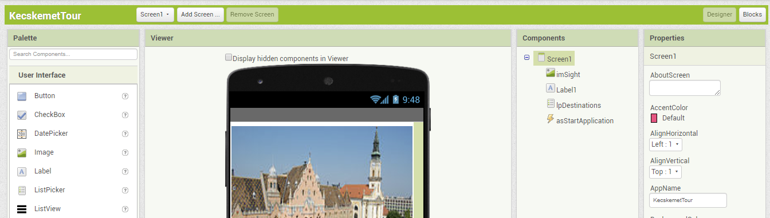
Development Environment https://appinventor.mit.edu/
Sign in with your Google account
Start a new project: KecskemetTour

Slide 17
http://johanyak.hu/KecskemetCityHall.jpg

Slide 18
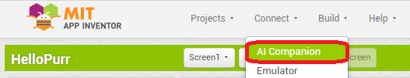
Live testing the application on your Android device
If your Android device is connected to the same WiFi as your computer
Install the MIT App Inventor 2 companion application on your Android device if it is not already installed. https://play.google.com/store/apps/details?id=edu.mit.appinventor.aicompanion3&hl=en
Select Connect/AI Companion in the browser on your computer.

Slide 19
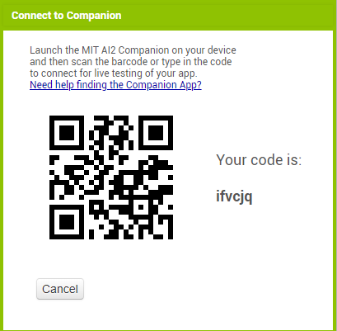
Live Testing
Start the MIT App Inventor 2 companion application app on your Android device and tap on “scan QR code”. Scan the QR code and wait until the user interface of your application appears in the screen of the mobile device.

Slide 20
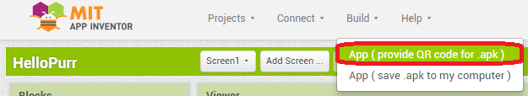
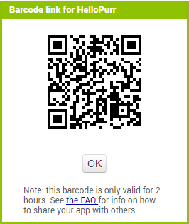
Installing the application on your Android device
Enable on your Android device the application installation from unknown sources: https://www.androidcentral.com/unknown-sources
Start the app and tap on “scan QR code”.
A notification will appear, enable the installation of the app.

Slide 21
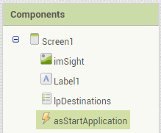
ActivtyStarter Properties
Action:
android.intent.action.VIEW
ActivityClass:
com.google.android.maps.MapsActivity
ActivityPackage:
com.google.android.apps.maps

Slide 22
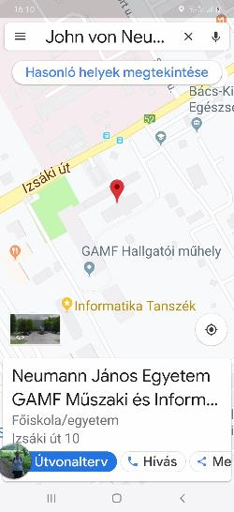
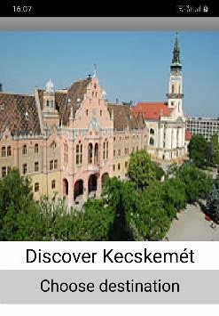
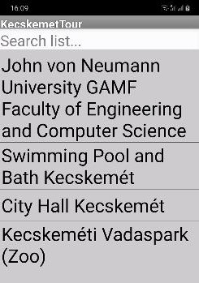
Kecskemét Tour
http://johanyak.hu/KecskemetCityHall.jpg

Slide 23
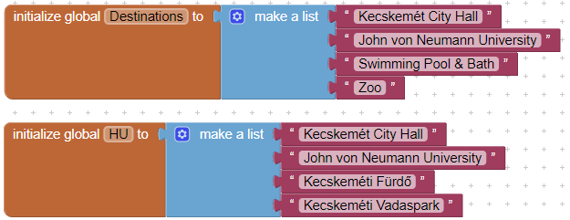
List of Sights

Slide 24

Feed the List into the List Picker

Slide 25
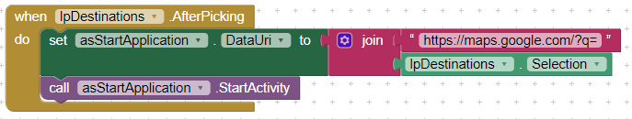
Start Google Maps with the Chosen Destination

Slide 26

Catch Me!
MoleMash
https://appinventor.mit.edu/explore/sites/all/files/ai2tutorials/moleMash/mole.png
https://bit.ly/2ZDzNdL

Slide 27
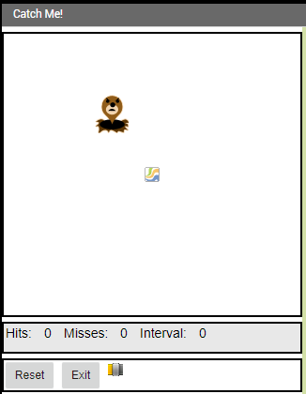
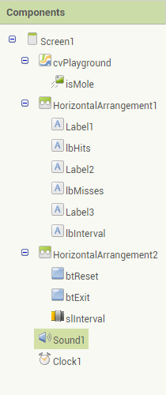
GUI Designer
Naming Convention

Slide 28
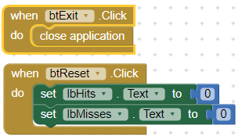
Event Handlers for the Exit and Reset Buttons

Slide 29
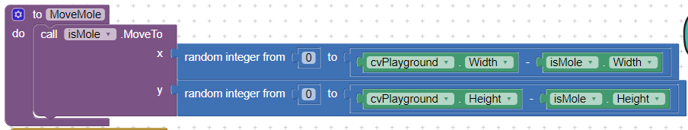
Move the Mole into a new random position
y
x

Slide 30


At the Beginning and After the Preset Time Ellapsed

Slide 31
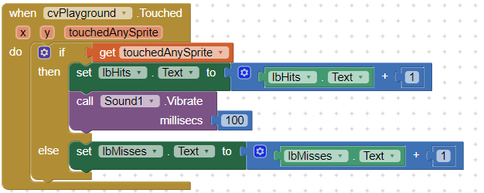
Touched Event

Slide 32
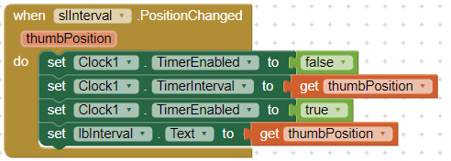
Modify the Interval of the Timer

